Slide 1
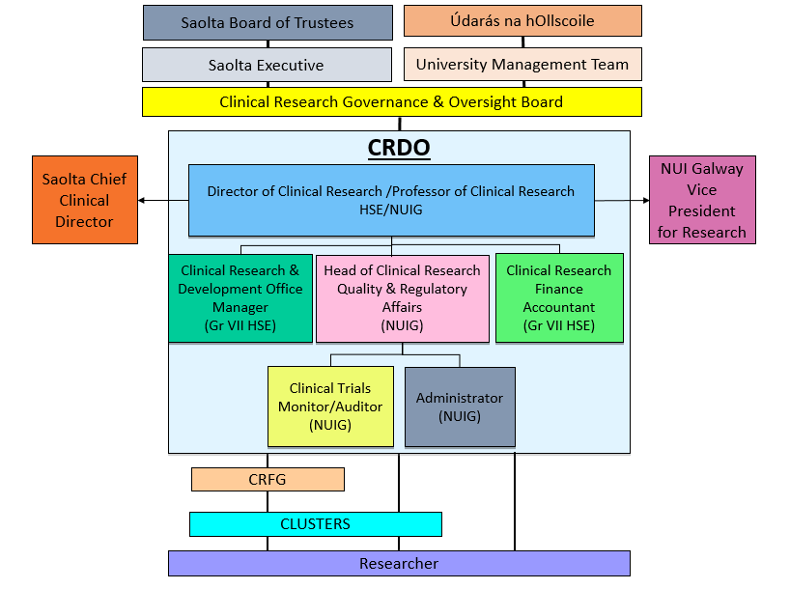
Saolta-NUI Galway Clinical Research & Development Office

