Slide 1
Stress Management & Study Skills
Dr. Chris Dwyer
School of Psychology
Rm. 061
Arts Millennium Building Extension
NUI Galway

Slide 2
Stress as a Process
What is stress???
According to psychological theory, stress is a subjective process
An event is seen as stressful if it is appraised as such
Appraisal is the interpretation of situations, events and the person’s behaviour.
Notes:
2

Slide 3
Factors that Affect Appraisal
A lot of work has been conducted to determine what factors affect appraisal of events as stressful
Events that are likely to be appraised as stressful are those that are:
imminent
unexpected
unpredictable
ambiguous
undesirable
perceived to be uncontrollable
likely to require lifestyle changes
Notes:
3

Slide 4
The Transactional Model of Stress
Lazarus & Folkman (1984)
Stress is the result of an interaction between an individual’s (1) characteristics and appraisals, (2) environment (stressors) and (3) the internal and external resources the individual has available to them
When a person is confronted with a new or changing environment they engage in appraisal
Notes:
4

Slide 5
POTENTIAL
STRESSOR
PRIMARY
APPRAISAL
Harmless
Harmful
SECONDARY
APPRAISAL
NO STRESS
Unable to cope
Able to cope
STRESS
Lazarus & Folkman (1984)
Two stage appraisal of stress
Notes:
5

Slide 6
What is coping and how do we do it?
Coping refers to the use of strategies to deal with problems (real or anticipated) and any possible negative emotions that may arise.
This approach helps us to control our reactions to the demands placed upon us. We use actions, thoughts and feelings to cope.

Slide 7
Problem-Focused Coping is aimed at changing a situation or its accompanying demands.
It is most appropriate when you have some control over a situation or when you can manage the problem in the environment. It uses specific activities to accomplish a task.
For example, maybe a student is having difficulties with a roommate who creates a lot of distractions; thus, preventing the student from studying.
How would you solve this problem?

Slide 8
Emotion-Focused Coping is aimed at dealing with the emotions caused by a situation and its demands.
It is more appropriate when you have little or no control over a situation. This type of coping involves reducing anxiety associated with the stressful situation without addressing the problem.
For example, due to a scheduling conflict, your exam may be changed to a date much sooner than originally anticipated.
How would you solve this problem?

Slide 9
Cognitive Coping Strategies
Reframing – focus on the good not the bad; think in terms of wants instead of shoulds. It’s best if our thinking is related to our goals. For example, “I want to read and understand this chapter in Biology so I do well in my lab practical” instead of “I have to read this difficult chapter in Biology”.
Challenging negative thinking – stopping the negative thoughts we may have about a situation or ourselves. Examples of negative thoughts include expecting failure, putting yourself down, feelings of inadequacy - a thought such as “Everyone else seems to understand this except me.”
Positive self-talk – using positive language and statements to ourselves. These are sometimes referred to as positive affirmations; they are useful for building confidence and challenging negative thoughts. For example, “I can do this or understand this” or “I’ll try my best”. These work best when they are realistic and tailored to your needs and goals.
Count to ten (or better yet, 1,000) – this allows you time to gain control and perhaps rethink the situation or come up with a better coping strategy.
Cost-benefit analysis – asking yourself questions about the worth of thinking, feeling or acting a particular way. “Is it helping me to get things done when I think this way?” “Is it worth getting upset over?” “Am I making the best use of my time?”

Slide 10
Cognitive Coping Strategies
Smell the roses – Experiencing life as fully as possible requires conscious effort, since we become habituated to things which are repeated. Varying our experiences (such as taking different routes to school or work) can help in this process.
Keeping perspective – when under stress it is easy to lose perspective; things can seem insurmountable. Some questions to ask yourself: Is this really a problem? Is this a problem anyone else has had? Can I prioritise the problems? Does it really matter?
Reducing uncertainty – seek any information or clarification you may require to reduce the uncertainty. It helps to ask in a positive way. Situations that are difficult to classify, are obscure or have multiple meanings can create stress.
Using imagery/visualisation –imagining yourself in a pleasant or a successful situation to help reduce stress. One way to use imagery is as a relaxation tool; try to remember the pleasure of an experience you’ve had or a place you’ve been. The more senses you involve in the image the more realistic, therefore the more powerful. This strategy is often combined with deep breathing or relaxation exercises.
Visualisation can also be used as a rehearsal strategy for an anticipated stressful event. For example, if you have a presentation to give, practice it in the mind a few times, picturing the audience’s reaction and even visualising yourself overcoming any potential pitfalls.

Slide 11
Behavioural Coping Strategies
Physical exercise – aerobic exercise is the most beneficial strategy for reducing stress. It releases neurochemicals in the brain that aid concentration. For some people, even a short walk is sufficient to relieve stress.
Relaxation – from simple relaxation such as dropping the head forward and rolling it gently from side to side or simply stretching, to more complex progressive relaxation exercises.
Breathing – from simple deep breaths to more complex breathing exercises related to relaxation and meditation.

Slide 12
Behavioural Coping Strategies
Smile and Laugh - gives us energy and helps to lighten the load; relaxes muscles in the face.
Social Support/Friends – encourage the development and nurturing of relationships. There is an association between good social support and a reduced risk of drop out (Tinto, 1998).
Seek Help – to help us cope with unmanageable stress. This is a sign of taking control, not of weakness. There are many supports available in College for students including Student Health Service, Student Counselling Service, College Tutors and the Chaplaincy.
Chill Out and Go for a Pint! – Sometimes, you just need to escape studying; otherwise, you will burnout. Go to the cinema, bowling, pitch-and-putt or simply socialise with friends.
Time management – specific strategies such as clarifying priorities, setting goals, evaluating how time is spent, developing an action plan, overcoming procrastination and organising time. These help us to cope with the numerous demands placed upon us, often a source of stress.

Slide 13
Student Stress
Amount of Work
The time in which to do the work
Be
Organised!!!

Slide 14
Optimising your Study-Time
Only a small percentage of learning happens in the classroom.
Lectures serve as an introduction to a subject:
It’s up to you to put the flesh on the bones through further
reading, assignments, note-making and revision.
It is crucial to set aside enough time for study to consolidate and deepen your learning.
You might want to treat university pretty much as a 9-5 job…with some weekend work too!
One hour of lectures = One hour of study time!

Slide 15
Exam Preparation
You should be studying throughout the semester!
A couple of weeks prior to your exam, collate your:
Lecture Notes
Lecture Slides
Notes taken from your
reading of the text-book
Notes taken from the
additional reading

Slide 16
What’s on the Exam?
Look at past Exams
Is this the first time your lecturer has provided this module?
What’s the format of the exam?
Multiple-Choice Questions
Fill-in-the-blanks
Essay
Be sure to go to your (review) lectures for hints!
If you don’t get hints, consider what questions YOU would set if you had taught the course.

Slide 17
Revision
Develop a clear overview of what needs to be covered in each subject.
Draw up a revision plan. You might need to allocate more time to some subjects.
Revise actively
Just reading through your notes is not enough.
Test yourself by working through problems, summarising
key points, memorising and trying to replicate exam
conditions.

Slide 18
Exam Stress
While some people breeze through exams without too much trouble, many others experience a great deal of anxiety and stress around exam time.
Take a break!
The best way to reduce exam anxiety is to be confident that you have done as much as you reasonably could to prepare for the exam.
Remember that exams are not about ‘catching you out’ – your lecturers want you to do well!

Slide 19
Your Disposition is Important Too!
Try to stay positive.
Acknowledge the work that you have done and tell yourself that the exam is an opportunity for you to demonstrate your knowledge and understanding of an area of study.
It’s also a chance for you to show how you can ‘think on your feet’ and cope under pressure – valuable skills for life.

Slide 20
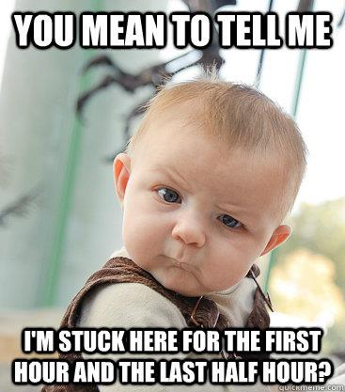
Time Management
You will know in advance:
How much time you have
(e.g. 2 or 3 hours).
The format of the exam
(e.g. MCQs and Essays).
Based on this knowledge, decide how to allocate your time in the exam hall and stick rigidly to your time-management plan.

Slide 21
Reading the Directions
When the exam starts, write everything you fear you might forget onto the question sheet!
Read the directions carefully:
what to answer,
where to answer,
marking schemes, etc.
Allocate a few minutes to scan the entire exam and select your preferred questions.

Slide 22
Review your work!
If you have time at the end of any exam, resist the urge to leave the exam hall. Use the time to review what you have done thoroughly.
Check for errors, make sure that you have answered all questions, and add any missing information.
If you run out of time, jot down the key points that you would have made and the key terms that are relevant to the topic – much like our outline from earlier.

Slide 23
During the exam…
If you experience severe anxiety during an exam, try some or all of the following:
Deep, slow breaths.
Try not to focus on the anxiety, instead focus on the task at hand.
Tell yourself that you have done, and are doing, your best.
Take a short break to clear your mind. Drink some water.
If you go ‘blank’, don’t panic – it happens all the time. Take a few moments, or move on to a different question. Be confident that what you need to recall will come back to you.

Slide 24
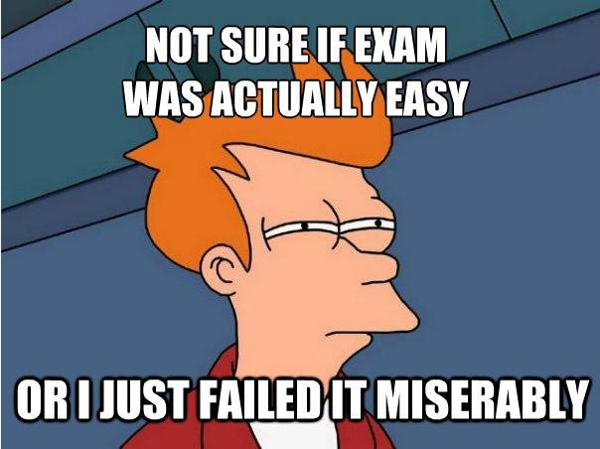
After the exam…
Consider what worked best and resolve to use those techniques again.
Avoid post-mortems – you have another exam to prepare for!
Seek feedback if you’re disappointed with an exam result: learning where you went wrong before is the best way to ensure it doesn’t happen again.

Slide 25
In Summary,
Organize Yourself and Plan Ahead!
Control Your Environment by controlling who and what is surrounding you. In this way, you can either get rid of stress or get support for yourself.
Love Yourself by giving yourself positive feedback. Remember, you are a unique individual who is doing the best you can.
Reward Yourself by planning leisure activities into your life.
Exercise & Eat Healthy
Relax Yourself by taking your mind off your stress and concentrating on breathing and positive thoughts.
Rest Yourself
Be Aware of Yourself

Slide 26
More Tips!
Get up fifteen minutes earlier in the morning. The inevitable morning mishaps will be less stressful.
Prepare for the morning the evening before.
Don't rely on your memory. Write down appointment times, due dates, etc.
Be prepared to wait. A paperback can make a wait in a queue almost pleasant.
Procrastination is stressful. Whatever you want to do tomorrow, do today; whatever you want to do today, do it now.
Forget Murphy’s Law! Think: Pollyanna-Power!
For every one thing that goes wrong, there are probably 10 or 50 or 100 blessings. Count 'em!
Ask questions
Make friends with non-worriers

