Slide 1



How to Improve the Visibility and
Impact of Your Research
School Institute Name to go here
Notes:
1

Slide 2
The Big Picture: Research Metrics Uses
KPIs metrics
Researcher Profile metrics
Internal Promotions and PMDS
Hiring decisions
Funding Applications
University KPIs
Institutional Review of Research performance (IRRP)
Research Strategy – Opportunities, strengths
Benchmarking
Rankings
IRRP metrics

Slide 3




The Big Picture: Sources of Research Metrics
IRIS – Institutional Research Information System
  web-based system that enables researchers and academic staff to create, update and maintain their own web profiles/CV’s and showcase their research expertise and research achievements to a global audience
  Links to WOS automatically
Scopus - bibliographic database containing abstracts and citations for over 60m academic journal articles since 1996. Encompasses over 21.5k peer reviewed journals and 130k books. Scopus offers author profiles which cover affiliations, number of publications and their bibliographic data, references, and details on the number of citations each published document has received. Ensure you use a consistent Author name/ID
SciVal links to profiles in Scopus. Can combine profiles into Schools, Research Groups and present visual research performance, benchmark relative to peers, develop collaborative partnerships and analyze research trends at an institutional or department or subject level.
Incites based on Web of Science (WOS) – similar to Scopus but more scientific and uses a different database of journals. Web of Science encompasses over 50,000 scholarly books, 12,000 journals and 160,000 conference proceedings
Altmetrics: measure of online engagement and impact/reach of a paper/person. non-traditional metrics proposed as an alternative to more traditional citation impact metrics - Based off a very broad group of metrics (eg. Viewed, Discussed, Saved, Cited, Recommended) capturing alternative measures of impact a paper or work can have. Altmetric tracks a range of sources to capture and collate this activity.
By Claire O’Connor

Slide 4
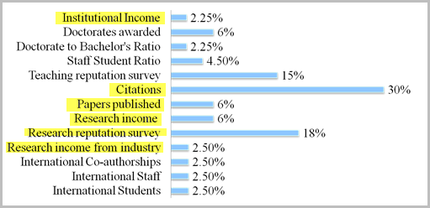
The Really Big Picture: University Rankings Metrics
Importance of Research - THE
Research related metrics account for 64.75%
Teaching
Research
International
By Claire O’Connor

Slide 5
The Really Big Picture: University Rankings Metrics
Importance of Research - QS
Based on Journals ASJC Code not the Academic
Takes both survey results from previous year; 2012-2016 for 2017 Ranking results
Citation per paper and H-Index from Scopus from 2011-2015
Metric weighting depends on Subject
By Claire O’Connor
Notes:
5

Slide 6
ROUTINES FOR SUCCESS
Joseph Reilly
Research Impact Librarian
School Institute Name to go here
Notes:
6

Slide 7


Slide 8
ROUTINES FOR SUCCESS
Before Submitting
Preparing Your Research
Announcing Your Research
Monitor and Measure
School Institute Name to go here
Notes:
8

Slide 9
ROUTINES FOR SUCCESS:
BEFORE SUBMITTING
Creating and managing your digital identity
  ORCID ID: https://orcid.org/signin
Where to submit?
  Consider:
    Journal Rankings (CiteScore, SJR SNIP), Open Access, Funding, Embargos
  About Open Access:
    Which Repository?
    What to upload: Data, Software, Graphics and Photos, Presentation Materials
School Institute Name to go here
Notes:
9

Slide 10
ROUTINES FOR SUCCESS:
PREPARING YOUR RESEARCH
Keywords in Title, Captions, Abstracts
Why? 54% of views to your work originate in search engines, 26% from indexes like SCOPUS
The TITLE is vital!
    2-3 keywords used at start of title
      Test variance in Google and subject index
      No acronyms
      Under 15 words: Google truncates titles to 55-60 characters
    Not only keywords but format
      WRONG: “Helping Others to Find your Work Online: Search Engine Optimization (SEO) in 4 Easy Steps”
      RIGHT: “Search Engine Optimization (SEO) in 4 Easy Steps: Helping Others to Find your Work Online”
School Institute Name to go here
Notes:
10

Slide 11
ROUTINES FOR SUCCESS:
ANNOUNCING YOUR RESEARCH
Social Media
Blogs
ListServs
Academic Networks: ResearchGate, Mendeley etc
Conferences and Talks
YouTube
The Importance of LINKS:
  Links to your work on NUI Website, your personal website, all social media, blogs, in your EMAIL SIGNATURE
  Link to Link: Your webpage to your publication. Your publication to your webpage.
School Institute Name to go here
Notes:
11

Slide 12
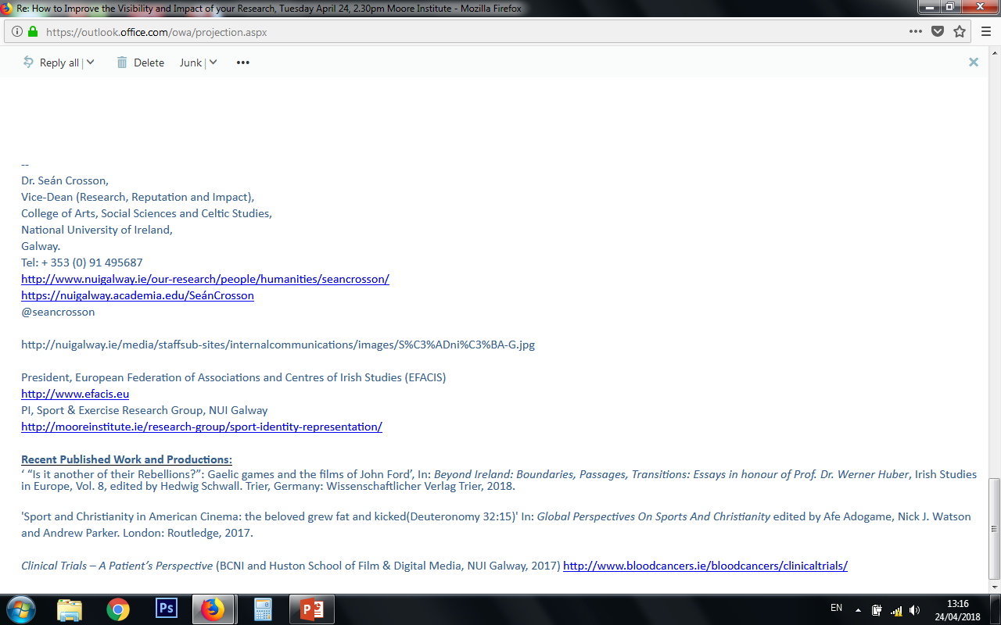

Slide 13
ROUTINES FOR SUCCESS:
MONITOR AND MEASURE
Academic Indicators: h-index and citation counts
Social Indicators: Views, Downloads, Mentions
EXAMPLE: PROF. DEVANE
School Institute Name to go here
Notes:
13

Slide 14
ROUTINES FOR SUCCESS:
LAST THOUGHTS
These are ROUTINES, not chores
Ultimately, YOU are responsible for your success.
You’ve worked unbelievably hard on your research, now show the world!
School Institute Name to go here
Notes:
14

Slide 15
Questions?
School Institute Name to go here
Notes:
15

