Slide 1
The Chain Fountain
An analysis of the angular motion of a discrete system

Slide 2
What is the chain fountain?

Slide 3
What is the chain fountain?
Intuitively, a chain resting in a container would simply trickle to the floor when one end is exposed to some external force. The reality (as spoiled by the title) is not so straightforward.
The chain rises and forms an arch, before toppling back to the floor. The reasons behind this are still being disputed.

Slide 4
Biggins and Warner conjecture
The previously accepted conjecture believed this to be a direct ramification of a reactionary normal force from the base of the container, as the link tries to rotate with respect to the centre of mass, as well as the tension in the string.
While their idea of greater height meaning higher fountain ($\frac{1}{2}v^{2}=gh$, ignoring loss of energy to environment), their idea of the normal force being the driving catalyst is demonstrably incorrect.

Slide 5
Objectives and approach
Consider an idealised chain of ‘n’ incompressible links. The Lagrangian of the angles subtending the link and the $x$-axis was used to determine their equations of motion, but our first task was to find the co-ordinates, ($x_{i}$,$y_{i}$) of each links’ centre of mass.
The objective of the project was to locate these equations, represent some examples numerically and challenge the proposed theorem of the primary operations of the effect.

Slide 6
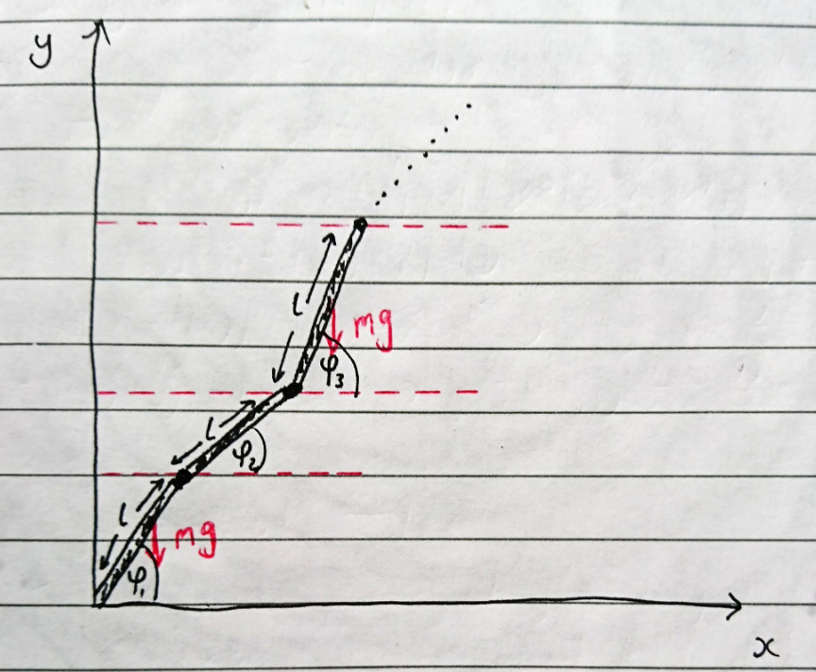
Centre of mass formulation
The first step involved computing $x$ and $y$ for the 2-dimensional analogy. This involved some simple geometry, as well as summing all terms prior to the $i$-th iteration.
$x_{i}= \frac{1}{2}lcos\left(φ_{i}\right)+l\sum_{j=1}^{i−1}{cos⁡(φ_{i}})$
$y_{i}= \frac{1}{2}lsin(φ_{i})$ $+ l\sum_{j=1}^{i−1}{sin⁡(φ_{i}})$

Slide 7
The case for 2 links
In order to find the equations for ‘n’ links, it was important to build up gradually and find commonalities. Using the $x$ and $y$ co-ordinates on the last slide and differentiating with respect to $t$ with chain rule ($\frac{dx}{dφ_{i}}\frac{dφ_{i}}{dt}= \frac{dx}{dt}$), the kinetic energy $T_{i}= \frac{1}{2}m\left({{\dot{x}}_{i}}^{2}+{{\dot{y}}_{i}}^{2}\right)+\frac{1}{2}I{{\dot{φ}}_{i}}^{2}$ was found, as was potential energy $U_{i}=mgy_{i}$. Using the Lagrangian,$L$ and the Euler Langrange equation: $\frac{d}{dt}\left(\frac{dL}{d{\dot{φ}}_{i}}\right)−\frac{dL}{dφ_{i}}=0$, the two equations of motion were found to be as follows:

Slide 8
Result of the 2 link chain
This is represented in matrix form for convenience. This was similarly done for the three linked chain. Note that the mass is not part of the final equations, as it is common to each term. The previous conjecture ignored the angle perspective, opting instead for an explanation involving the tension in the chain.

Slide 9
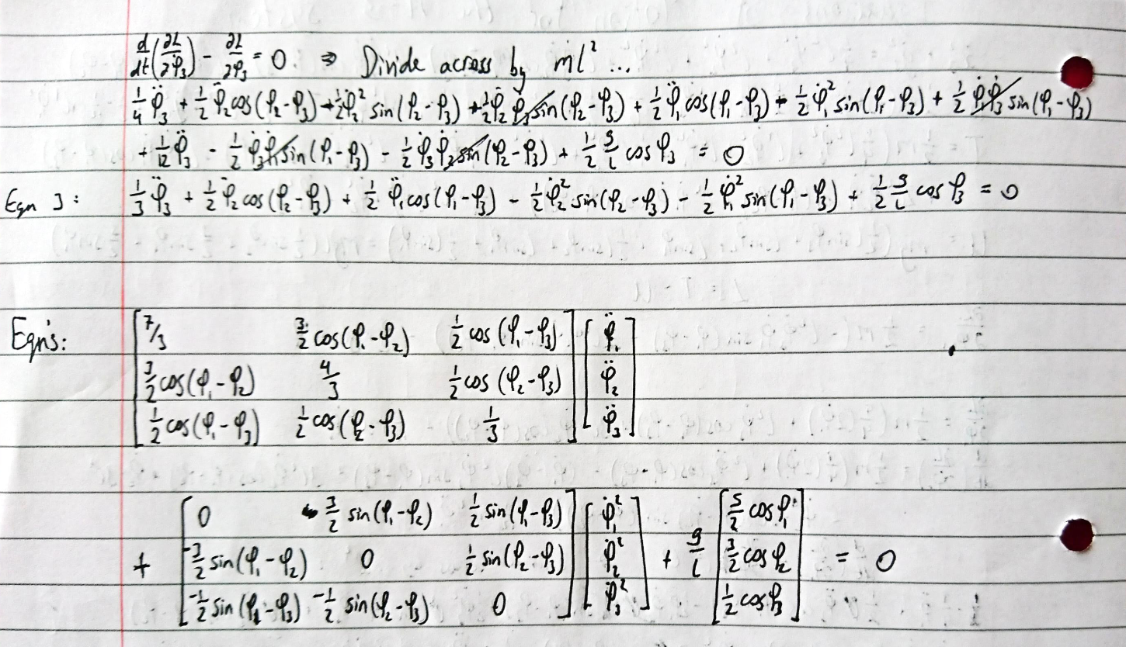
Results of the 3 linked system

Slide 10
Equations of motion for an n-linked chain
$T=ml^{2}\sum_{i=1}^{n}{\left[\frac{3\left(n−i\right)+1}{6}\right]{{\dot{φ}}_{i}}^{2}+ml^{2}\sum_{i=1}^{n}{\sum_{j=i+1}^{n}{[\frac{2\left(n−j\right)+1}{2}]{\dot{φ}}_{i}{\dot{φ}}_{j}cos⁡(φ_{i}−φ_{j})}} }$
$U=mgl\sum_{i=1}^{n}{\left[\frac{2\left(n−i\right)+1}{2}\right]sin⁡(φ_{i})}$
$2\sum_{i=1}^{n}{\left[\frac{3\left(n−i\right)+1}{6}\right]{\ddot{φ_{i}}}^{2}+\sum_{i=1}^{n}{\sum_{j=i+1}^{n}{[\frac{2\left(n−j\right)+1}{2}]\ddot{φ_{j}} cos⁡(φ_{i}−φ_{j})}}+\left[\frac{2\left(n−j\right)+1}{2}\right]{{\dot{φ}}_{j}}^{2}\sin\left(φ_{i}−φ_{j}\right)+\sum_{i=1}^{n}{[\frac{2\left(n−i\right)+1}{2}]\frac{g}{l}cos⁡(φ_{i})}}=0$
Using the Euler-Lagrange formula, the equations of motion for a discrete chain with respect to the link angles was derived.

Slide 11
Recursion relation of ${{\dot{φ}}_{i}}^{2}$ terms
$T=$ $\sum_{i=1}^{n}{\frac{1}{2}m\left({{\dot{x}}_{i}}^{2}+{{\dot{y}}_{i}}^{2}\right)+\frac{1}{2}I{{\dot{φ}}_{i}}^{2}}$, where $I=\frac{1}{12}ml^{2}$ for a rigid rod
$ml^{2}$ $\sum_{i=1}^{n}{\frac{1}{2}\left(\frac{1}{4}{{\dot{φ}}_{i}}^{2}+\frac{1}{24}{{\dot{φ}}_{i}}^{2}+\sum_{j=1}^{i−1}{{{\dot{φ}}_{j}}^{2}}\right)}$
$ml^{2}$ $\sum_{i=1}^{n}{\left(\frac{1}{6}{{\dot{φ}}_{i}}^{2}+\frac{1}{2}\sum_{j=1}^{i−1}{{{\dot{φ}}_{j}}^{2}}\right)}$, noting that the coefficient of the i-th term will be $\frac{1}{6}$ and the coefficient of all the preceding j terms will be $\frac{1}{2}$.
Thus, introduce a $q\left(n−i\right)$ term (for some q), for the case when $i=n$. Dividing everything by 6 for convenience and recognising that the $i = (n−1)$term will have a coefficient of $\frac{1}{2}$, we’re left with $\frac{q(n−(n−1))}{6}=\frac{1}{2}$. It’s easy to deduce from this example that $q=3$, such that we can rewrite the ${{\dot{φ}}_{i}}^{2}$ terms using the following recursion relation: $ml^{2}$ $\sum_{i=1}^{n}{{{[\frac{3\left(n−i\right)+1)}{6}]\dot{φ}}_{i}}^{2}}$

Slide 12
Numerical implementation
Due to the complexity of the system of these non-linear differential equations, a numerical approach was considered. The two and three link cases were represented by the double and triple pendulum, respectively, until constraints could be appropriately implemented.

Slide 13
Graph +animation of the double pendulum

Slide 14
Graph +animation of the triple pendulum

Slide 15
Graph +animation of the 4 linked chain

Slide 16
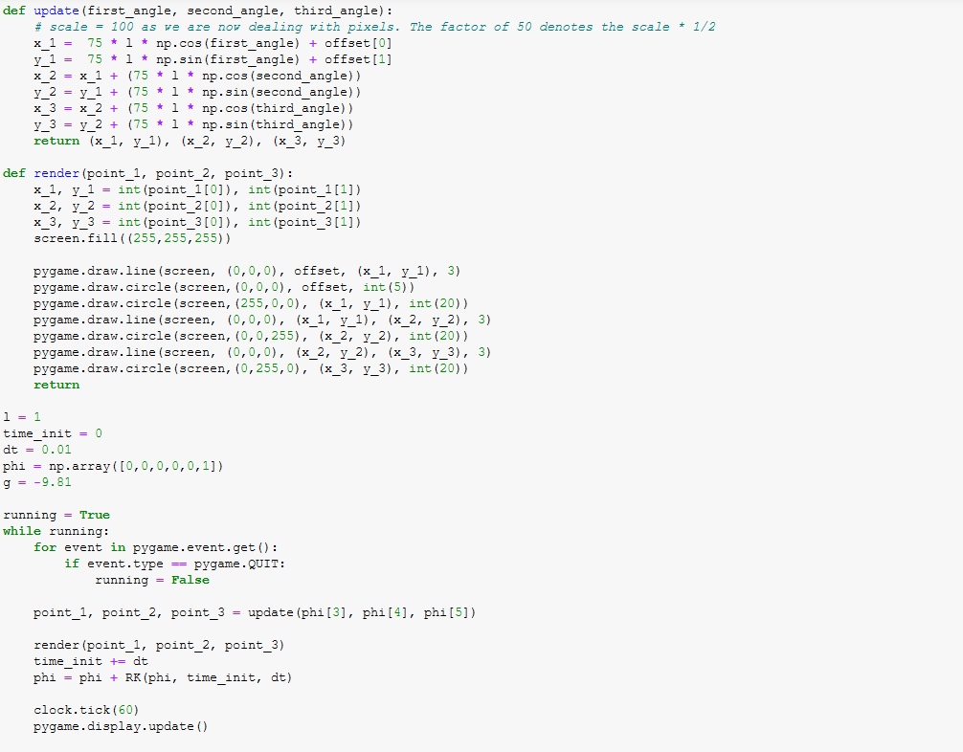
Bitta code

Slide 17
Issues with the current chain fountain
The chain fountain was first brought to the mainstream by Steve Mould and inspired a conjecture that the fountain was caused by a force exerted from the base of the chain’s container. However, it seems the internal interactions between links, as well as sudden alterations in linear momentum play a far more significant role. The next big step to arguing this theory is through finding internal constraints and initial conditions of the system. The chain should want to accelerate under gravity as it falls, but it instead falls with a constant velocity. There must be a counter force acting against this, which we think is derived much more so from interactions in the air, not the container.

Slide 18
“2-D” case, arguing the necessity of the jar

Slide 19
In summary/what was learned
A good bit of preliminary research from YouTube and Scholar had to be done, to investigate other theories
Understood that there was a large amount of debate over the current theory and recognised a potential reform
Model the chain as a series of discrete, cylindrical rods (analogous to the sphere chain) and derive the equations of angular motion
Tested numerics for some sample chains, using python and pygame
Matter is yet to be fully resolved. Further research is required to establish maximum angles and initial conditions

