Slide 1


GY101:
Performance and Screen Studies:
PSS Modules Orientation
Dr. Charlotte McIvor and
Dr. Seán Crosson,
programme co-directors

Slide 2
In this presentation, we will cover:
What is Performance Studies and what is Screen Studies? Why study both together?
What modules will I take and how will I learn in this subject?
Module Material, Submitting Work and Guidelines/Policies
Questions

Slide 3
College of Arts, Social Sciences and Celtic Studies
School of English, Media and Creative Arts
English
Drama and Theatre Studies
Huston School of Film and Digital Media
Media
Music
You are HERE!
Performance and Screen Studies

Slide 4
Main Contacts:
Performance and Screen Studies
Name | Role | Email
Dr Seán Crosson | Co-Head of Performance and Screen Studies, Head of First Year | sean.crosson@universityofgalway.ie
Dr Charlotte McIvor | Co-Head of Performance and Screen Studies, Head of Second and Final Year | charlotte.mcivor@universityofgalway.ie
Teresa O’Donovan | Administrator, Drama and Theatre Studies and Performance and Screen Studies | odonovant@universityofgalway.ie
Designing Futures (Year 2) |  | For any inquiries on modules taken as part of the Designing Futures, please email designingfutures@universityofgalway.ie or the module convenor directly.

Slide 5
Refer to your year One PSS handbook for all module descriptions and direct module convenor contact information.

Slide 6
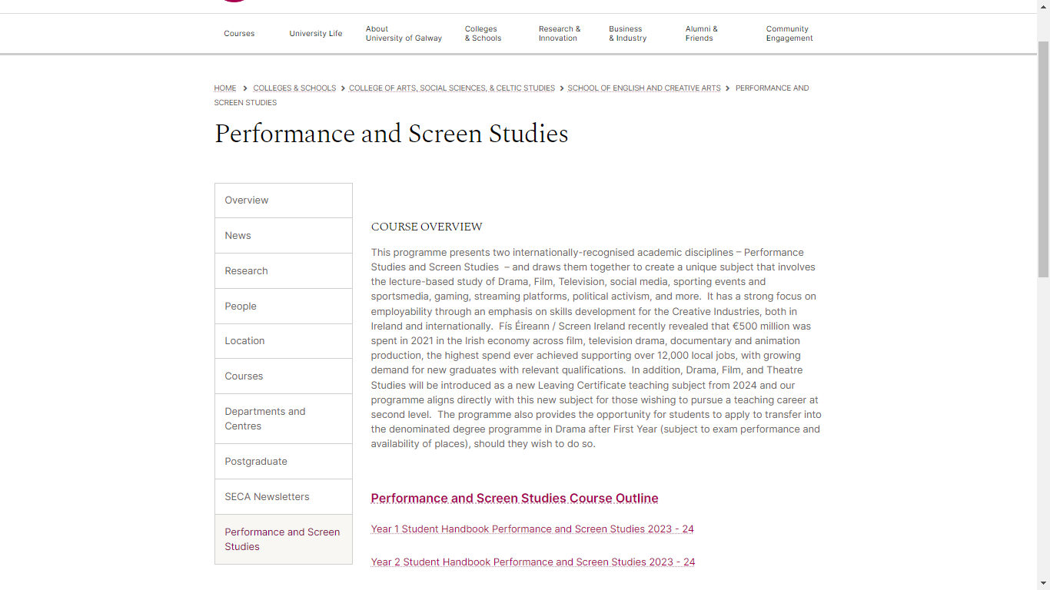
Further module, programme, and contact information for module lecturers available in your handbook
https://www.universityofgalway.ie/colleges-and-schools/arts-social-sciences-and-celtic-studies/english-creative-arts/performanceandscreenstudies/

Slide 7
What is Performance Studies?

Slide 8


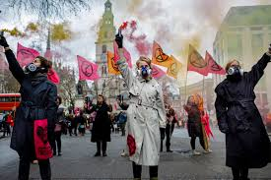

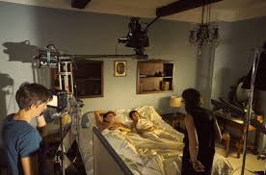

Performance Studies…
…involves the multidisciplinary exploration of established performing arts (Drama, Film, Television, etc) while branching into other forms of public performance (such as social media, sporting events and sports media, political activism, and more).

Slide 9

Performance Studies…
…is taught in universities internationally but has never before been offered as a subject in Ireland.

Slide 10
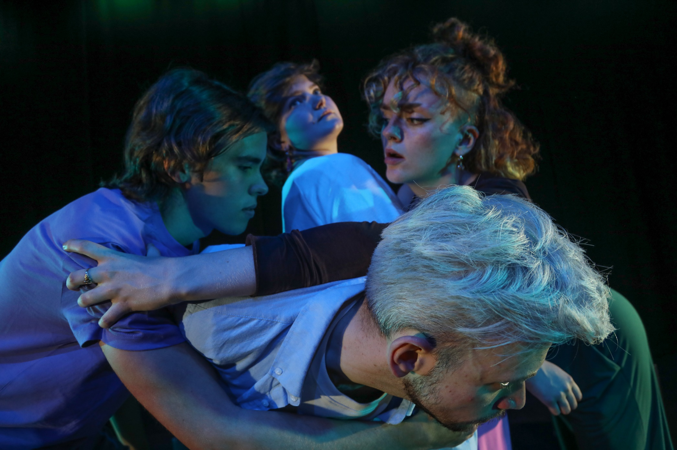
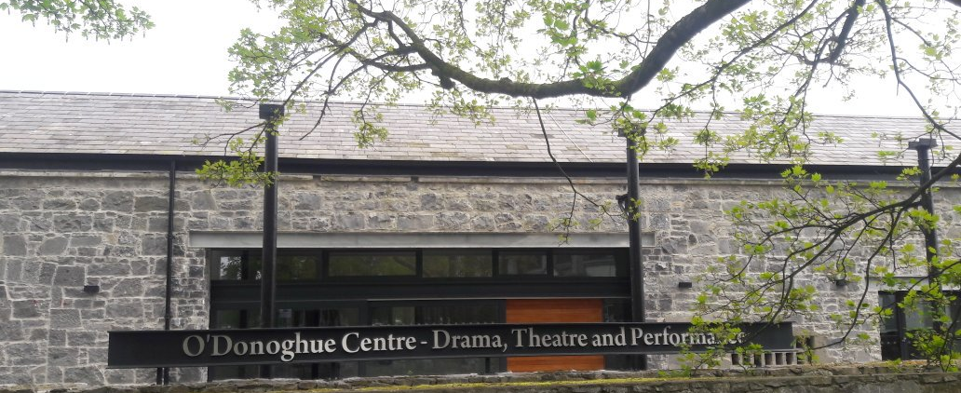
Performance Studies…
Builds upon University of Galway’s excellence in the area of Drama and Theatre Studies and staff research in Performance Studies

Slide 11
What is Screen Studies?

Slide 12

Screen Studies
The study of film and other screen media including television and platform / streaming
It involves discussion of texts and the contexts in which screen media are produced – social, political and cultural.

Slide 13



Screen Studies…
Builds upon University of Galway’s excellence in the area of Film Studies at the Huston School of Film & Digital Media

Slide 14

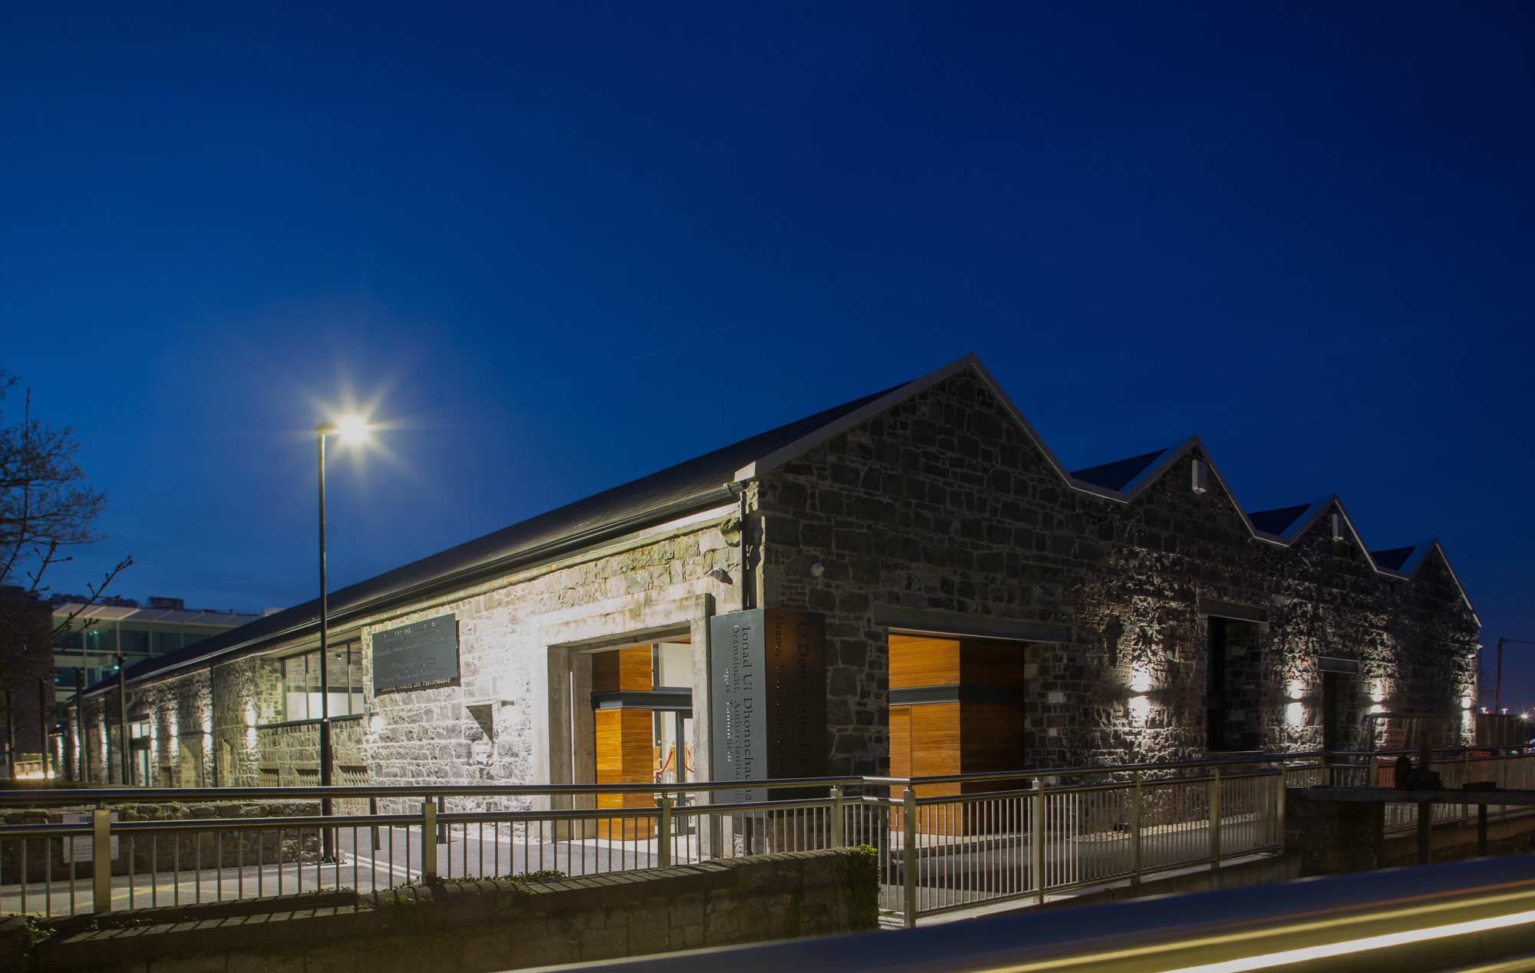
Why University of Galway?
- Partnerships with arts organisations – Druid, Galway International Arts Festival, and many more.
- As a UNESCO City of Film and the home of the Screen Ireland, Galway is situated at the heart of Ireland’s creative and cultural sector
- Creative arts on-campus: Arts in Action, student societies, professional artists and producers on staff
- Galway as Ireland’s unofficial cultural capital!
Performance and Screen Studies

Slide 15
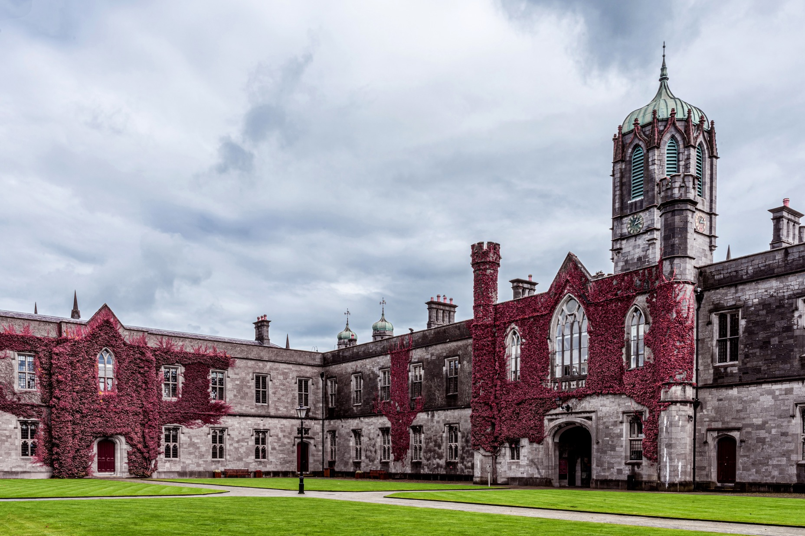
Why study both together?
- Reflects the way in which creative arts professions now operate.
- The pandemic has shown that old boundaries are breaking down.
- Opportunities in the west of Ireland, nationally and internationally.
- Allows you to develop the skills needed for the creation of sustainable creative enterprises in local, national and international contexts
Performance and Screen Studies

Slide 16
How does it work?
- A three-year programme, taken as part of the Arts Degree
- In First Year, you study it as one of your three subjects.
- In second and final year, you study it with ONE other subject
- Can be taken with denominated degrees in Drama, Music, Creative Writing
- Located in Arts Subjects Group 2, allowing you to study it with English, languages, Sociology and Politics, and more.
Performance and Screen Studies

Slide 17
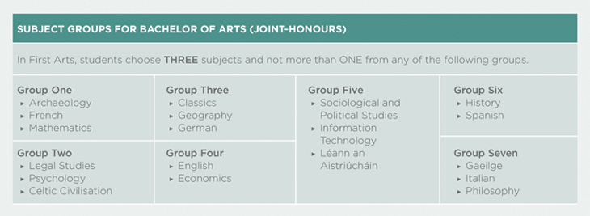
Subject combinations

Slide 18

What modules will I take and how will I learn in this subject?

Slide 19

Year One modules:
Building a common vocabulary
In semester one, all students take PSS1100: Introduction to Performance Studies and FS101 Introduction to Film Studies 1: Form.
In semester two, all students take FM1100: Introduction to Visual Culture and PSS1101: Performing and Screening Ireland.

Slide 20
Class | Semester | Day, Time and Venue
PSS1100 Introduction to Performance Studies | 1 | Monday 4-5pm O’Donoghue Theatre, BOI Theatre wk 6 Wednesday 3-4pm O’Donoghue Theatre , BOI Theatre wk 6
FS101 Introduction to Film Studies 1: Form | 1 | Wednesday 9-10am Martin Ryan Annex 201 Thursday 4-5pm Martin Ryan Annex 201 Weekly Screening: Tuesday 6-7:30 pm - AMB-1023 Mairtin O' Tnuthail Theatre [Arts Millennium]
FM1100 Introduction to Visual Culture | 2 | Wednesday 9-10 am, venue TBC Thursday 4-5pm CSB -G005
PSS1101 Performing and Screening Ireland | 2 | Monday 4-5pm Bank of Ireland Theatre Wednesday 3-4PM, O’Donoghue Theatre wk 1-5, Studio 1 wk 6-12

Slide 21
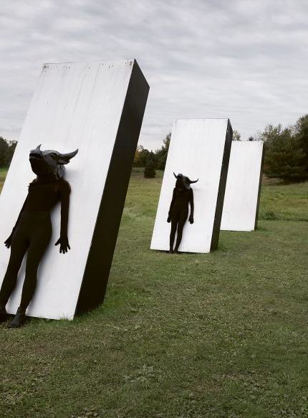
How will I learn in year two and final year?
Modules in years two and three of the programme focus on special topics in performance and screen studies including some focus on the creative industries as a business as well as practical application of the concepts we focus on in first year.
Some modules will have smaller class sizes and some of your modes of assessment will become more diverse (moving more towards portfolio and project work).
You can link into business and enterprise focused modules in “Designing Futures” to build skills.
You can combine PSS with other subjects to enhance your practical experiences in the area and avail of opportunities in those subjects like studying abroad and/or work placement.
Performance duo Artemis Beast

Slide 22
For more in-depth module information on year two and final year, visit our website and review the second and final year handbooks.

Slide 23

After I graduate?
Creative Industries
Creative producing
Arts management
A career in academia
All the benefits of an arts degree:
  Teaching
    Drama, Film and Theatre Studies is now a Leaving Cert subject from 2024-2025. Plans to sync up with this in our programme currently underway!
  Public Service
  Tourism and Heritage
  Business
  Information Technology

Slide 24
Module Material,
Submitting Work and Guidelines/Policies

Slide 25

Access Canvas and FAQs for students and staff here:
https://www.universityofgalway.ie/information-solutions-services/services-for-students/canvas/

Slide 26
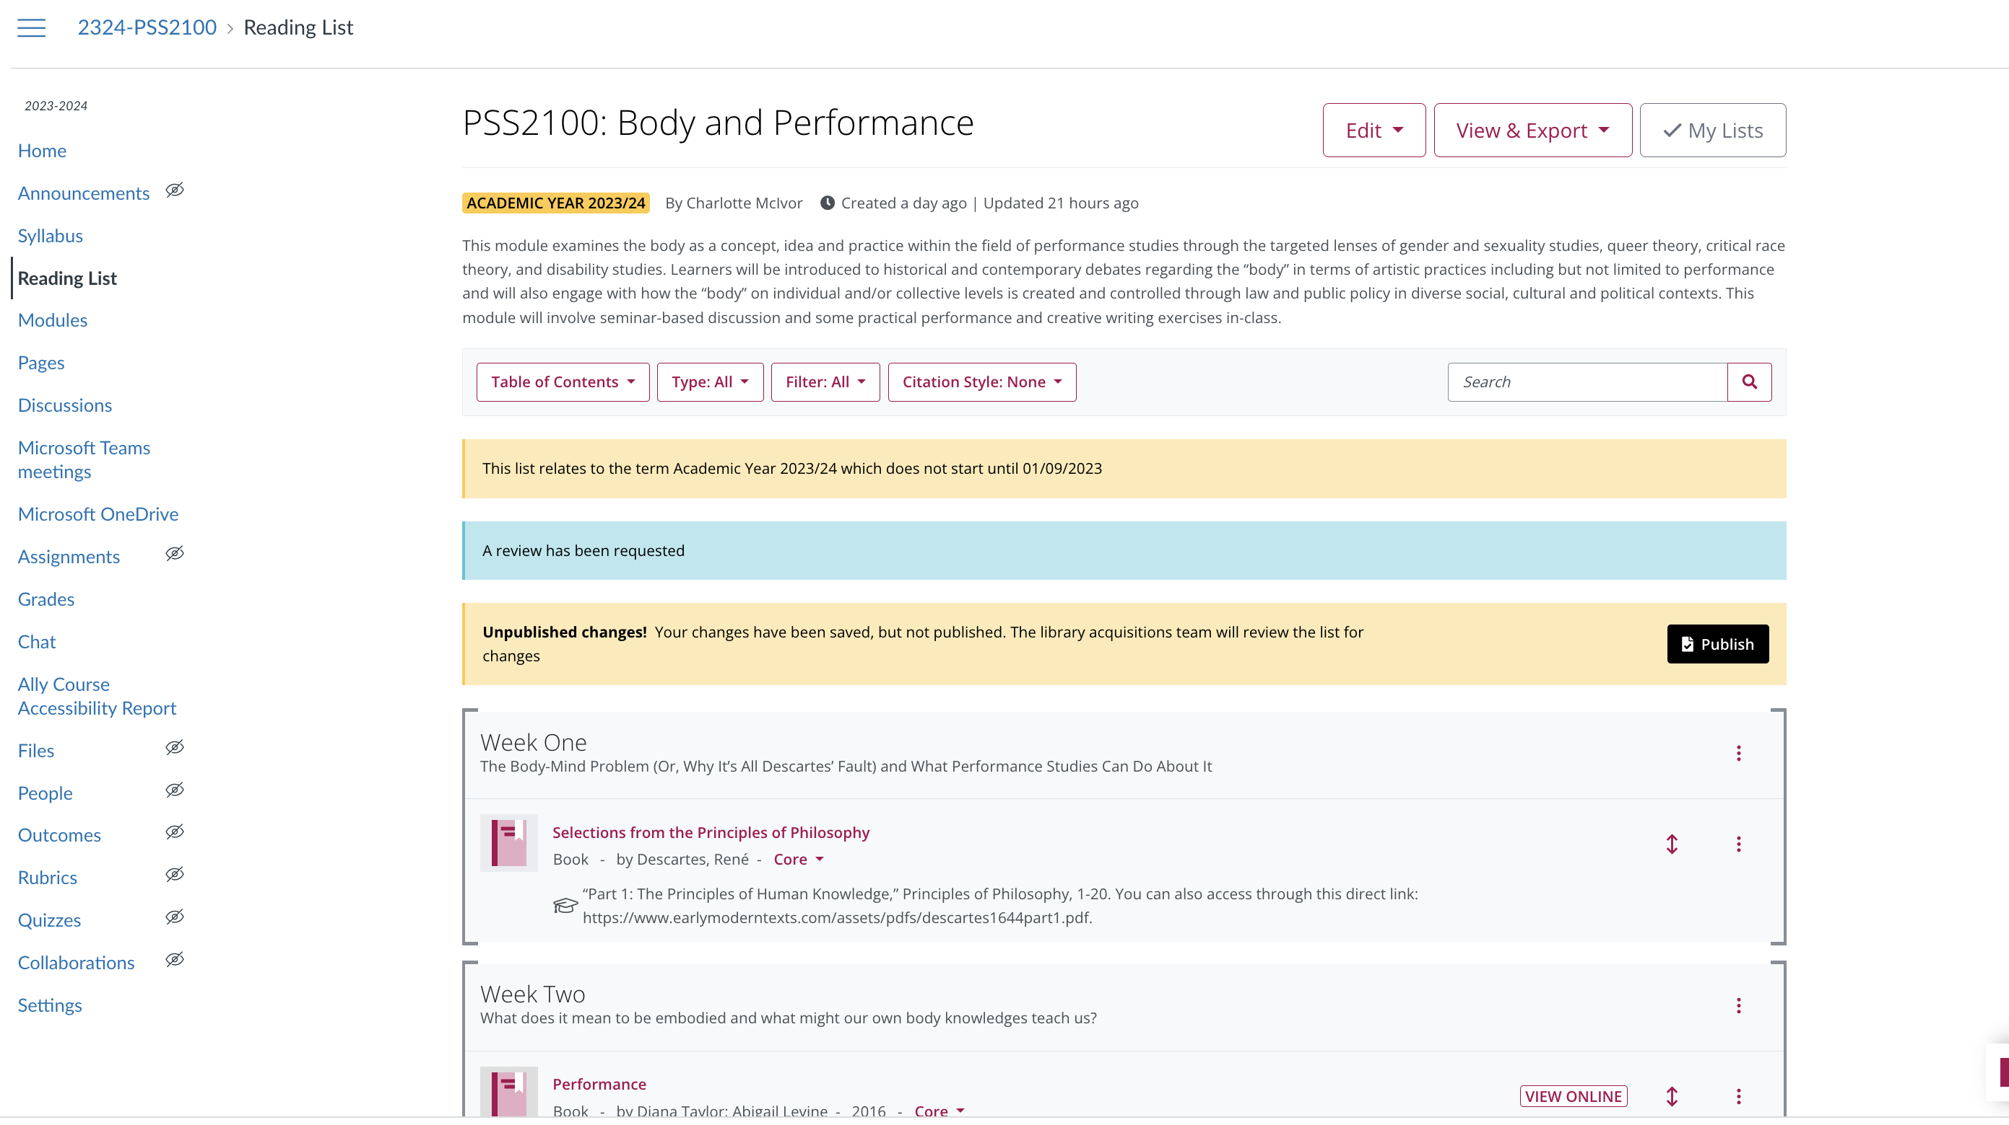
Using the Reading List on Canvas for modules

Slide 27
Academic Integrity
You can refer to the University’s policy on Academic Integrity (QA220) here: https://www.universityofgalway.ie/media/registrar/docs/QA220-Academic-Integrity-Policy-Final.pdf

Slide 28

AI and Assessment
We will critically study the rise and use of AI across this subject.
However, unauthorised use of artificial intelligence is not permitted in your assessments.
Your module outlines or assessment tasks will indicate ONE of the below:
1. Acceptable and unacceptable uses of GenAI
2. Use of GenAI prohibited
3. Use of GenAI accepted or encouraged

Slide 29

When can students submit work late?
Students should ONLY seek to submit work late in the event of serious extenuating circumstances which is defined by university policy QA209 as “serious unavoidable, unpredictable and exceptional circumstances outside the control of the student, which may negatively impact the student’s performance in assessment.”
A full list of what DOES and DOES not count as extenuating circumstances is available here: https://www.universityofgalway.ie/media/registry/exams/policiesprocedures/QA209-Extenuating-Circumstances.pdf.

Slide 30
Students with approved extenuating circumstances can ask for and receive extensions ONLY from Head of Year/Programme (less than seven days, with documentation) OR CASSCS.

Slide 31
If students have met the grounds for extenuating circumstances, they will seek either:
1. An extension: This is when the College of Arts Office and/or Head of Year/Programme allows you to submit work late without penalty following a process of application with documentation (I.e. medical or other certificates).
A deferral: This is when you get College of Arts Office permission to submit outstanding work following the end of a module without penalty in the autumn exam

Slide 32
What happens if a student fails a module?
You will have to undertake a repeat.
When you fail a module, students have to complete a repeat assignment or exam in the autumn exam period which constitutes 100% of your total assessment. If they are in years 2, 3, or 4 of your programme, their repeat results are capped at 40%. They must pay fees for each module they repeat.

Slide 33
FYI: Any student who needs to submit work more than seven days late can ONLY have this decision cleared by the College of Arts unless they have an accommodation from Disability Support Services.

Slide 34
College Forms for requesting deferrals due to extenuating circumstances
You can access the form here: https://www.universityofgalway.ie/colleges-and-schools/arts-social-sciences-and-celtic-studies/student-information/studentformsandlinks/

Slide 35
What is an “accommodation” and how do I know if I should have one?
“Students with a disability are entitled, under law, to reasonable accommodations to enable them to participate on more equal terms with their peers. Supports and reasonable accommodations are determined through an individual needs assessment, taking into account the nature and impact of the disability, evidence of disability, and course requirements.”
  Learn more about the range of services available through the Disability Support Services at University of Galway here: https://www.universityofgalway.ie/disability/
Accommodations might look like:
          Additional time for examinations or continuous assessments
          Permission to record sessions
    Access to Assistive technologies
    A note taker or SNA (special needs assistant)

Slide 36
Pre-disclosure of accommodation and/or access needs for Performance and Screen Studies Students:
This optional confidential form allows students to individually disclose accommodation, access, and/or additional needs that teaching staff need to be aware of IN ADDITION to engaging with university and/or other services such as disability support services (https://www.universityofgalway.ie/disability/).
We created this form so that we as staff:
Could have information immediately in the academic year
Could store and disseminate information centrally to relevant staff minimising students' need to disclose to multiple people multiple times
Could identify areas where we need to bring these needs into consideration in relationship to our own class planning of activities, etc. as early as possible

Slide 37
Access needs vs. accommodation vs. additional needs or circumstances
An access need is something that needs to be taken into account for a learner to fully participate in class activities or that may present a challenge to them doing so (i.e. hearing or vision impairment, limited mobility, sensitivity to loud noises, bright lights, etc., chronic medical condition etc.)
An accommodation is a learning support/supports that Disability Support Services will ultimately green light and advise us on integrating into your assessment planning with us. Learn more here about what supports may be available to you: https://www.universityofgalway.ie/disability/support/. Please note you can disclose here what accommodations that you may have been granted here or at other institutions, but we WILL need a report from Disability Support Services to ACTION specific accommodations like additional time for assessments, etc.
Additional needs or circumstances for you is anything relevant to our supporting your classroom attendance and participation like a change in name or pronouns, a currently challenging commute or caring responsibilities, etc.

Slide 38
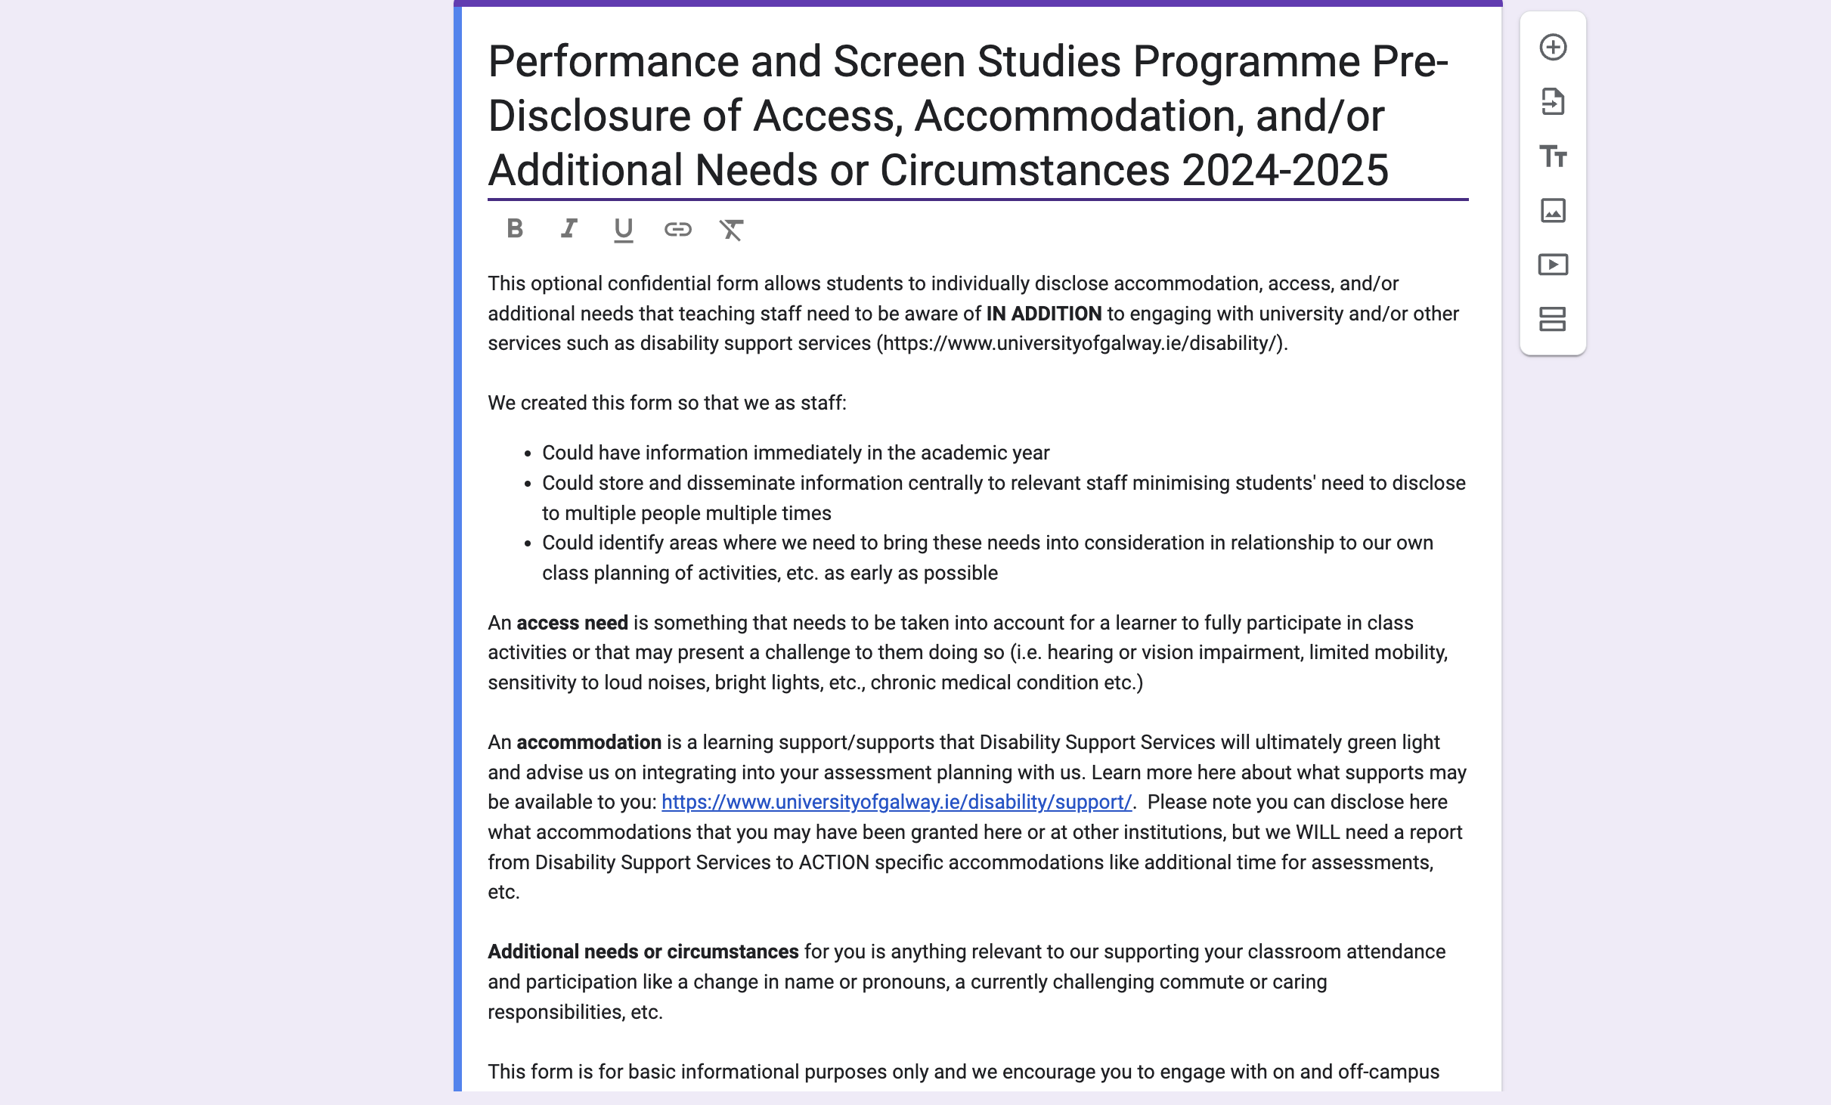
Pre-Disclosure of Accommodation and Access Needs Form: https://forms.gle/shPfqQYQfQ9NH8ea6

Slide 39
Students should register with our Disability Support Services if they have a diagnosis of…
• Attention Deficit Disorder (ADD) / Attention Deficit Hyperactivity Disorder (ADHD)
• Autism Spectrum Disorder including Asperger’s Syndrome
• Blind/Visual Impairment
• Deaf/Hard of Hearing
• Dyspraxia/Developmental Co-ordination Disorder (DCD)
• Mental Health Condition
• Neurological Condition
• Physical Disability
• Significant On-going Illness
• Specific Learning Difficulty (including dyslexia or dyscalculia)
From https://www.universityofgalway.ie/disability/faqs/

Slide 40
For students struggling with mental health challenges
The University of Galway counselling service provides support information to staff here on basic language and engagement strategies here including the Students in Distress Information Booklet: https://www.universityofgalway.ie/counsellors/staff-information/.
Students can find information on booking counselling at the service here: https://www.universityofgalway.ie/counsellors/self-help/appointments/
Other helpful resources to refer students to which may offer immediate relief include:
  Crisis Text Line - Text GALWAY 50808 (free-text 24/7)
  The Student Health Unit healthunit@universityofgalway.ie
  UCHG Emergency Department 091 544556
  Samaritans 116 123 (freephone 24/7)
  Pieta House help line 1800 247 247 (freephone 24/7)
  Togetherall – Anonymous Mental Health Support App togetherall.com/en-ie
  Speak Out – Online Anonymous Report & Support Tool unigalway.speakout.ie

Slide 41
College of Arts
Student Advisor Service
Students also have access to a College of Arts Student Advisor, Mary T. Cairns, for students in distress and/or seeking immediate academic support.
This service “provide[s] confidential, non-judgmental support and an empathetic space for students to share their concerns. In addition, a student advisor can offer personal support and advice on topics such as study planning, time management and any personal challenges that may compromise their ability to study.”
You can learn more here about how they book appointments and are supported through this avenue here: https://www.universityofgalway.ie/artsstudentadvisor/

Slide 42
Supports for Students at the
University of Galway
A full map of Student Support Services is given here and more in-depth information listed in most handbooks for the discipline/programme you are teaching into:
https://www.universityofgalway.ie/media/collegeofartssocialsciencescelticstudies/CASSCS_StudentSupportMapReadOnly.pdf

Slide 43
If work IS late and has not been granted extension, deferral and/or accommodation:
Late work that does not meet the grounds for an extension , deferral or accommodation or is simply late will be penalised at two points per day including weekends and bank holidays.
Late work penalties can still apply even if they are granted an extension if their documentation does not cover an additional period of lateness. For example, if they provide a cert saying that they were sick for two days, then they can hand in their work two days late without penalty. But if their cert says they were sick for two days and they hand in a week late, they will lose marks for five days.
Work that is any more than two weeks’ late (14 days) cannot be accepted even if students have medical certificates etc. without a deferral from College Office. Students whose work has not been submitted by this time will automatically be listed as having failed or must seek permission from the College Office to defer the assessment.
Check with your Head of Year/Programme as to whether you should APPLY the late penalty or state the number of days late in notes when submitting marks to them.

Slide 44
Questions, Course Feedback and the Student Voice

Slide 45
You can ask questions or give feedback about this programme or your modules by:
Participating actively in class
Approaching a teacher after class
Emailing a lecturer (with expectation of 48-72 hours response time)
Visiting the lecturer during office hours (see module outlines, Canvas and/or email for appointment)
Speaking to a class rep (more information on the next slide)
Filling out your module feedback forms when offered during and at the end of term
Responding to any other in-class polls or surveys offered by the teacher during term

Slide 46
Class Rep System
Class rep elections happen through the Student Union: https://su.universityofgalway.ie/class-reps-council/
Notify Seán once you have elected your class reps and there will be TWO meetings each term, mid-way and end of term.

Slide 47
Additional student services and supports at the University of Galway are listed in your handbook.

Slide 48
Any questions?

Slide 49
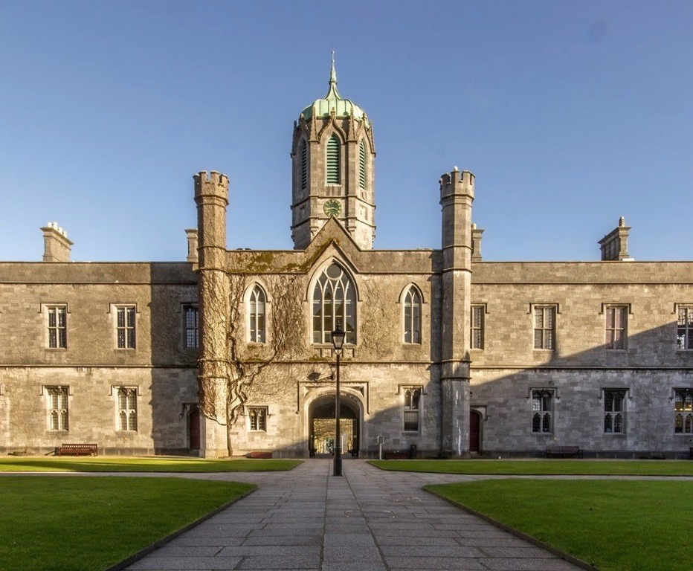
Online:
https://www.universityofgalway.ie/colleges-and-schools/arts-social-sciences-and-celtic-studies/english-creative-arts/performanceandscreenstudies/
Head of First Year: Dr Seán Crosson
Email: sean.crosson@universityofgalway.ie
If you have any queries, please do not hesitate to make contact.
Thank you for listening.

Slide 50



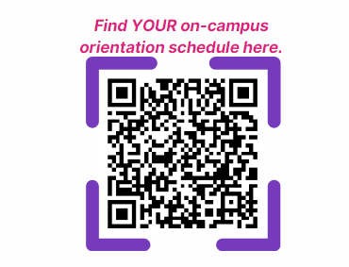

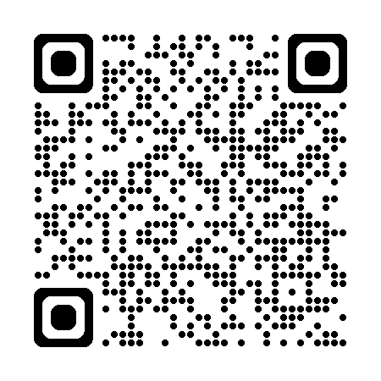
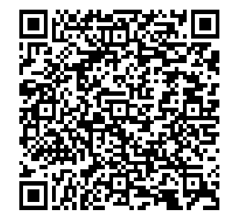

Scan the QR code to complete Starter Pack and get university ready!
Notes:
Slide for inclusion at online events to help student prepare for on campus orientation. Can also be used at on campus events particularly those on Thursday morning.
Prearrival module, Starter Pack (https://rise.articulate.com/share/pJQGIZOxZczciRwEetmwbTlHWTc53yDl#/) has valuable information on the university, systems ID cards, intro to Student Support Officers etc. Recommended to complete this before coming on campus. QR code to CASSCS orientation schedules to help plan the days, location for talks, events etc.

Slide 51
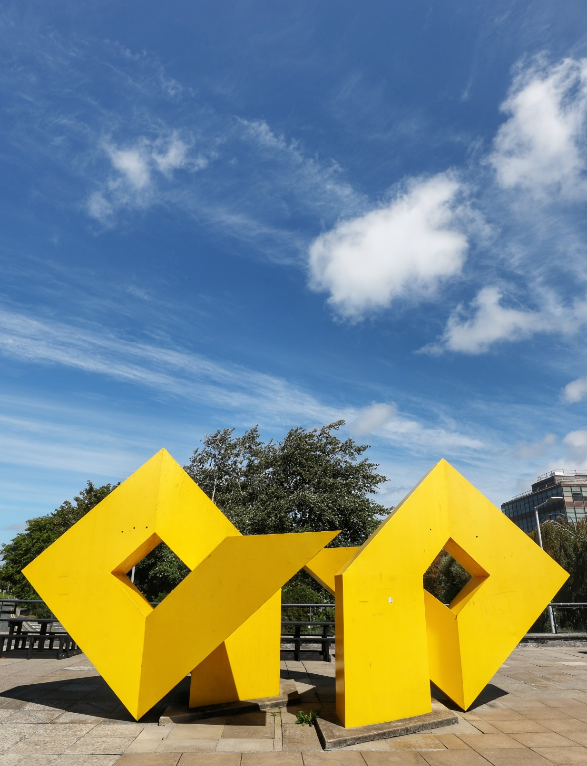

Campus Challenge
Complete the Circuit
#CampusWelcome
Grab your friends - or make new ones - and start exploring. Your mission? Complete the Circuit by visiting 10 Challenge Stations all over campus. Great prizes to be won!
Notes:
Campus challenge is a chance to meet new people and learn to navigate the campus. See webpage for more info: https://www.universityofgalway.ie/startinguniversity/campus-challenge/

Slide 52
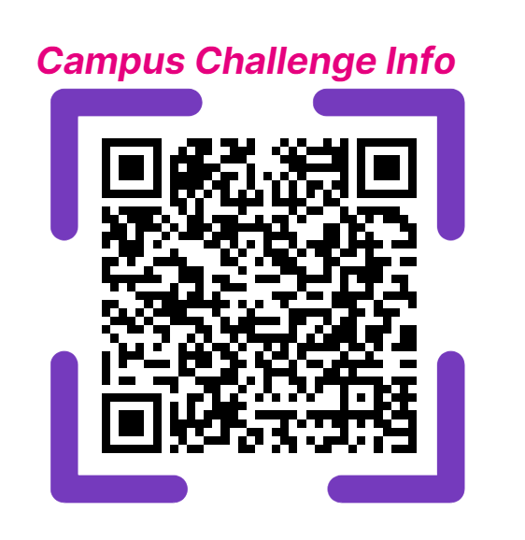
Scan the QR code to find out more:
Pick up your challenge card at a welcome talk, or from the Student Enquiry Centre or SocsBox and be in with a chance to win!

