Slide 1



A novel filtration configuration for targeted humic acid removal from drinking water
Maebh A. Grace, Mark G. Healy, Eoghan Clifford

Slide 2
Overview
Introduction
Why Natural Organic Matter?
Materials and Methods
Filter construction
Results and conclusion
Performance results and conclusions
Our solution

Slide 3

Introduction
NOM in drinking water
Disinfectant
Disinfection by-product formation
Measured as organic carbon
Trihalomethanes
Haloacetic acids
Toxic
Carcinogenic
Chlorine
Ozone

Slide 4
Introduction
Redesign the traditional sand filter using novel media
Reuse of waste material for a cost-effective and sustainable solution
Why target NOM?
Plentiful NOM sources
Highest TTHM recorded:
245 µg L⁻¹
Retrofitting not redesigning
10 % Total Trihalomethane non-compliance in Ireland
Current solutions are expensive and unsustainable
Max allowable THM (mg L⁻¹)
US: 80
Europe: 100

Slide 5
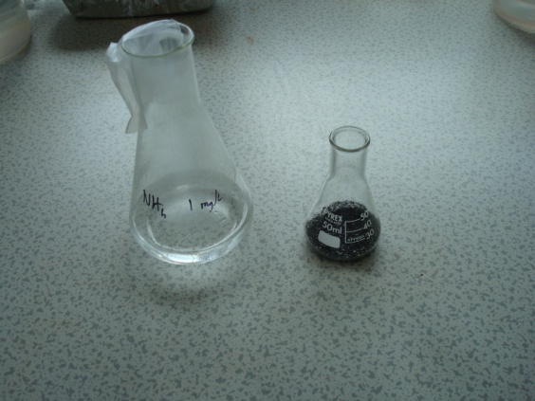
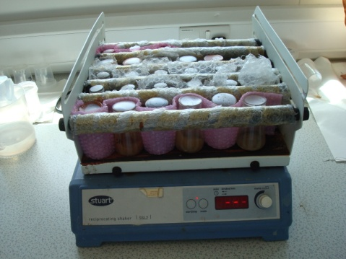
Materials and Methods
Media Classification – adsorption isotherms for DOC
Media | Isotherm | R² | Q_{max} (µg g⁻¹) | 1/n | K
Sand | Desorption
Zeolite | Langmuir | 0.71 | 37
Fly ash | Freundlich | 0.73 |  | 1.17 | 0.262
GAC | Langmuir | 0.42 | 327
Bayer residue | Freundlich | 0.83 |  | 0.68 | 0.019

Slide 6
Materials and Methods
Filter construction and operation
Control
Config 1
Config 2
Bayer
Residue
Flyash
1 m of media as per EPA guidelines
2 loading regimes
  Constant and intermittent
Dosed with a synthetic mix
  Humic acid as TOC source
GAC
Sand
Zeolite
Zeolite
Sand
Sand

Slide 7
Materials and Methods
Humic acid as TOC source
  Representative of DOC from peatland areas
    Relevant for Irish water treatment facilities
  Laboratory grade
  Process to extract and dispose of insoluble fraction
Add to water and mix for 25 min
Centrifuge at 1000 RPM for 30 min
Filter through 0.45 µm filter

Slide 8
Results
Config 1:
Bayer Residue
Zeolite
Sand
Config 2:
Fly ash
GAC
Zeolite
Sand
Loading Regime |  | Average concs mg DOC L⁻¹ | % DOC Removal
Continuous | Influent Concentration | 5.8 ± 2.2
 | Effluent Concentration
 | Control | 4.2 ± 1.9 | 27.6 ± 3.3
 | Config 1 | 3.7 ± 1.8 | 36.2 ± 10.9
 | Config 2 | 1.7 ± 1.6 | 58.8 ± 4.8
Intermittent | Influent Concentration | 6.0 ± 1.7
 | Effluent Concentration
 | Control | 4.5 ± 1.8 | 25 ± 2.5
 | Config 1 | 4.0 ± 1.8 | 33.3 ± 4.8
 | Config 2 | 2.3 ± 1.6 | 61.6 ± 10

Slide 9

Results
Continuous
Intermittent
Depth from surface (m)
% DOC Removal

Slide 10
Results
Config 1:
Bayer Residue
Zeolite
Sand
Continuous
Intermittent
Depth from surface (m)
% DOC Removal

Slide 11
Results
Config 2:
Fly ash
GAC
Zeolite
Sand
Continuous
Intermittent
Depth from surface (m)
% DOC Removal

Slide 12
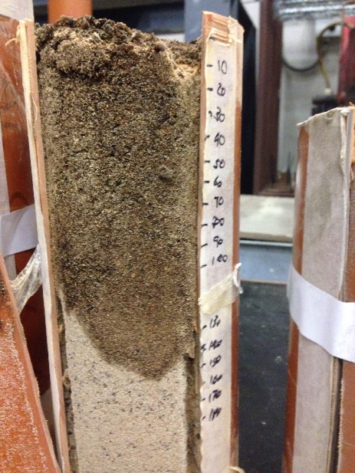
Discussion
Config 2:
Fly ash
GAC
Zeolite
Sand
Both configurations more effective than control
  Configuration 2 most effective
Clogging was observed across all filter configurations
  Humic acid mix: high suspended solids
  Approx. 200 mg L⁻¹
DOC removal decreased over time
  Clogging of upper layers, DOC leaching
  and media saturation

Slide 13
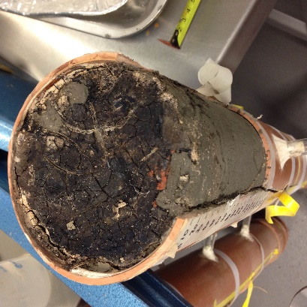
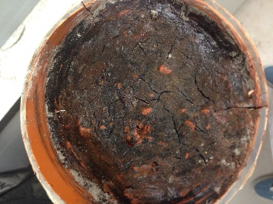
Clogging Issue
K/K_{v}: Normalised hydraulic conductivity
Clogging results for continuously loaded filters
  Constant head permeability test
  Falling head permeability test
Clogging of control extended further below surface
Clogging of config 1 and config 2 was very similar

Slide 14
Outlook for technology adoption
DBP formation potential removed at filtration stage
  Plants can be retrofitted rather than redesigned
Media can become saturated
  Potentially mitigated by replacing the clogging layer
Media may need repositioning, given potential for clogging
Further work involves investigation of other contaminants and media combinations

Slide 15
Conclusions
Config 2:
Fly ash
GAC
Zeolite
Sand
Alternative media may be used for NOM removal
  Bayer residue, fly ash, zeolite and GAC
Sustainable design, using locally available waste materials
Config 2 was most effective
  Clogging did occur
Both configs were more effective than a standard sand filter
A redesign will mitigate clogging, while maintaining a successful and sustainable technology

Slide 16

Questions?
Thank you for your attention
Any Questions?

