Slide 1

Health Literacy Research in Europe and Ireland: The State of the Art
Dr Gerardine Doyle
University College Dublin
FP7 Diabetes Literacy Consortium and HLS-EU Consortium

Slide 2
Overview
The State of the Art in Europe
  European Health Literacy Survey – generation of first data set
  Recent data collection in Portugal, Belgium and Denmark
  Commencement of data collection in Italy
Health Literacy and Health behaviours – evidence from HLS-EU
Health Literacy and Chronic Disease Management
The role of technology and connected health solutions?
Key Messages

Slide 3
The State of the Art in Europe
First time data for 8 European countries – HLS-EU
  Now need to generate the second wave of data - National and EU monitoring of health literacy over time
Key findings
Implications of key findings
  Health literacy is a significant problem – inform policy
  Social gradient - reduce health disparities associated with education and social exclusion
  Design health literacy interventions for vulnerable groups

Slide 4

The objectives were to:
Develop a model instrument for measuring health literacy in Europe
Generate first-time data on health literacy in European countries, providing indicators for national an EU monitoring
Make comparative assessment of health literacy in European countries

Slide 5
Integrated HLS-EU Model of Health Literacy
Life course
Sitauational Determinants
Health service use
Health costs
Understand
Access
Health behavior
Health outcomes
Societal and environmental determinants
Knowledge
Motivation
Competences
Disease prevention
Health promotion
Health care
Health
information
Appraise
Partici-
pation
Empower-ment
Personal Determinants
Apply
Equity
Sustain-
ability
Individual level
Population level

Slide 6
Antecedents
Health Literacy
Demographic
SES, Occupation, Income
Psychosocial
Social support
Cultural
Language,
Religious beliefs
General Literacy
Reading, Numeracy,
Individual Characteristics
Age, Gender
Prior experience with the healthcare system

Slide 7
Percentages of different levels of General Health Literacy, for countries and total sample
0-25 Points
>25-33 Points
>33-42 Points
>42-50 Points

Slide 8
General Health Literacy
Mean Scores by Age and Country
*Pearson’s correlation coefficient,*p<0.05
● Austria | ● Bulgaria | ● Germany (NRW) | ● Greece | ● Spain | ● Ireland | ● Netherlands | ● Poland | ■ TOTAL

Slide 9
General Health Literacy
Mean Scores by Perceived Social Status and Country
*Pearson’s correlation coefficient,*p<0.05
● Austria | ● Bulgaria | ● Germany (NRW) | ● Greece | ● Spain | ● Ireland | ● Netherlands | ● Poland | ■ TOTAL

Slide 10
General Health Literacy
Mean Scores by Financial Deprivation and Country
*Pearson’s correlation coefficient,*p<0.05
● Austria | ● Bulgaria | ● Germany (NRW) | ● Greece | ● Spain | ● Ireland | ● Netherlands | ● Poland | ■ TOTAL

Slide 11
General Health Literacy Index
Mean Scores by Self-Assessed Health and Country
*Pearson’s correlation coefficient,*p<0.05
● Austria | ● Bulgaria | ● Germany (NRW) | ● Greece | ● Spain | ● Ireland | ● Netherlands | ● Poland | ■ TOTAL

Slide 12
Summary of Results
Limited Health Literacy is a relevant problem for European member states (on different national levels)
Not only for health or literacy but also for health literacy there is a considerable social gradient in European member states
Vulnerable groups with specific risks of limited health literacy have been identified
Member states do not only differ in levels of health literacy but also by associations with social gradient indicators

Slide 13
Summary
General Health Literacy (Europe)
Financial Deprivation
Decreasing Health Status
Age
Social Status
Functional Health Literacy (reading/writing)

Slide 14

Current Research

Slide 15
Recent Data Collection: Portugal
General HLS-Portugal Distribution of Health Literacy levels

Slide 16
Recent Data Collection: Portugal

Slide 17
Conclusions of HLS - Portugal
Portuguese General Health Literacy Index: 6th place among HLS Consortium
The younger the respondent, the higher the level of health literacy
The higher the level of education, the higher the level of health literacy
Positive correlation between health literacy and literacy practices, (involve reading a range of different materials, or using information and communication technologies):
  Health literacy cannot be dissociated from literacy in general
  ICT emerged as a strong alternative to disseminate health information and promote/develop healthy behaviours
There is a very vulnerable group of respondents that should be considered and targeted for public health policies

Slide 18
Recent Data Collection: Belgium – HLS-EU-Q16
The Study:
  A study of 9616 members of the largest health insurance fund in Belgium (French and Dutch speaking)
  Part of a larger study on socio-emotional aspects of health
  HLS-EU-Q16 online survey (not face to face)

Slide 19
Recent Data Collection: Belgium – HLS-EU-Q16
Key Findings:
  12% insufficient health literacy
  30% limited health literacy
  58% sufficient health literacy
  Gender finding: Females have better HL than males
  HL decreased with age
  HL increased with educational level
  Flemish had better HL than Walloons or Brussels
  HL is a significant mediator for eating, physical activity and medicine use but not tobacco use
  Alcohol consumption did not vary by education level – not tested for mediation

Slide 20
Recent Data Collection: Belgium

Slide 21
Recent Data Collection: Belgium

Slide 22
Recent Data Collection: Denmark
The objective of the study:
Describe the level of
  the ability to understand health information
  the ability to actively engage with healthcare providers
Examine the association between socio-demographic characteristics and these dimensions of health literacy

Slide 23
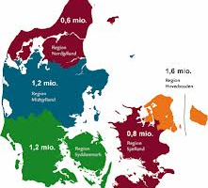
Denmark: Research Design
Design: A cross sectional population based survey study
Sample: A random sample of 46,354 individuals (>25 years) living in the Central Denmark Region
A total of 29,473 (63.6%) responded to the survey

Slide 24
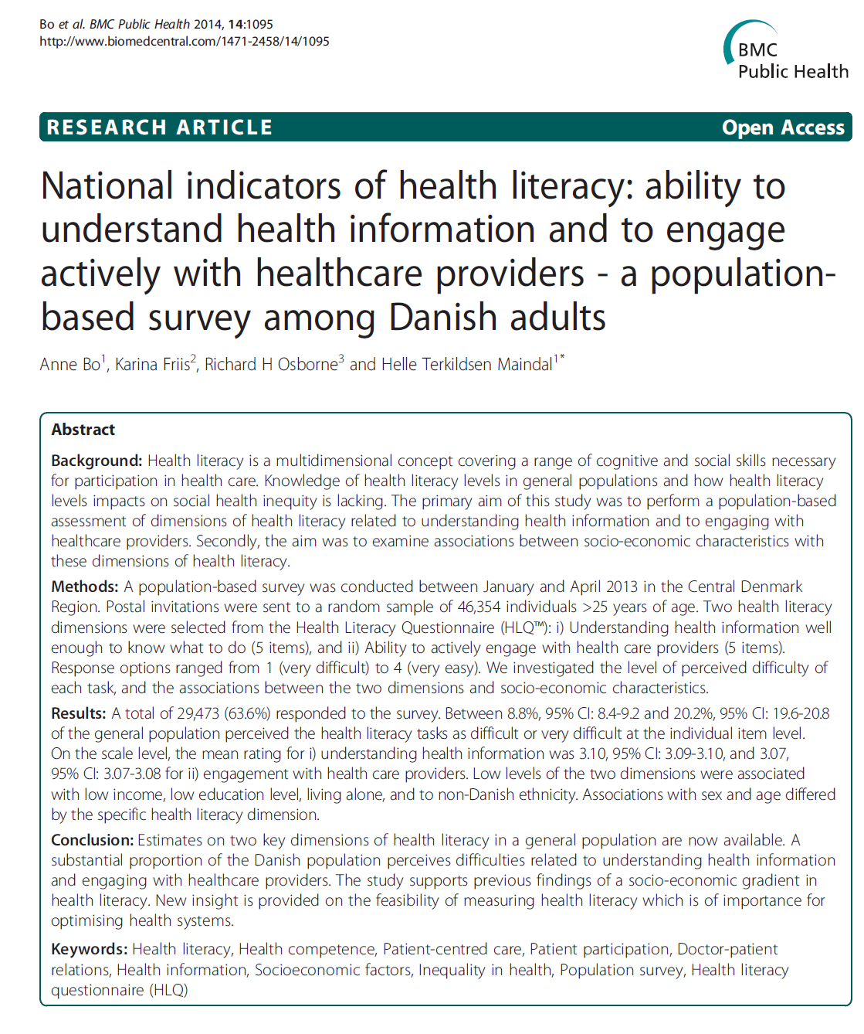

Slide 25

Results – response distribution
 | Item missing |  | Population-weighted proportion in each response category |  |  |  |  | Population-weighted difficulty level of items
Items |  |  | Very difficult | Difficult | Easy | Very easy |  | (% of respondents rating items as difficult or very difficult)
 | % |  | % | % | % | % |  | % | (95%CI)
‘Understanding’
1a | 6.9 |  | 2.6 | 13.4 | 57.2 | 26.7 |  | 16.0 | (15.5 - 16.6)
2a | 7.3 |  | 1.4 | 13.1 | 61.3 | 24.2 |  | 14.5 | (14.0 - 15.0)
3a | 6.7 |  | 2.0 | 10.8 | 58.3 | 28.9 |  | 12.8 | (12.4 - 13.3)
4a | 6.4 |  | 3.2 | 17.0 | 56.0 | 23.8 |  | 20.2 | (19.6 - 20.8)
5a | 7.0 |  | 1.0 | 7.8 | 64.7 | 26.6 |  | 8.8 | (8.4 - 9.2)
‘Engagement’
1b | 6.8 |  | 2.5 | 15.8 | 57.8 | 24.0 |  | 18.3 | (17.7 - 18.8)
2b | 6.5 |  | 1.7 | 12.8 | 57.4 | 28.2 |  | 14.5 | (14.0 – 15.0)
3b | 5.9 |  | 2.2 | 14.4 | 56.2 | 27.3 |  | 16.6 | (16.1 - 17.1)
4b | 7.3 |  | 2.0 | 16.3 | 56.9 | 24.8 |  | 18.3 | (17.8 - 18.9)
5b | 7.0 |  | 1.6 | 13.7 | 59.2 | 25.5 |  | 15.3 | (14.8 - 15.8)
Notes:
So coming to the results…
This table present the response distribution as well as the difficulty level for each item. The difficulty level was defined as the percentage of respondents rating the items as difficult or very difficult.
First we see that missing is generally low, and that all categories were used by a substantial number of respondents
In the the collum to the right we can see that the difficulty level varied between 8 and 20 percent.
The item with the highest difficult level was 4a which was: “Read and understand all the information on medication labels”,
And the second most difficult task was Discuss things with healthcare providers until you understand all you need to

Slide 26
Results – single items by SD characteristics
Education
Age
Income
Notes:
For education, the pattern was very much as we expected. that the lower the education level, the more difficult items are perceived, and the differences between the lowest and the highest educated groups are quite large

Slide 27
Italy
A. Measurement of Health Literacy
HLS-EU-Q has been translated into Italian
HLS-EU-Q 16 or 47 items
Sample size = 1,500 citizens aged 15 years and older
Computer assisted personal interviewing technique (CAPI)
B. Assessing Health Literacy barriers in Italian Health care settings
Three health care settings - North, Central and South Italy
  Ospedale Maggiore Parma
  A.O.S. Andrea di Roma
  A.O.S. Garibaldi di Catania
Data Collection: July-September 2015
Study sponsored by MSD Italy, co-ordinated by Lingomed s.r.l.Ita

Slide 28
Health Literacy and Health behaviours: Evidence from HLS-EU

Slide 29
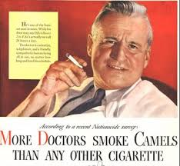
The Curious Case of Health Literacy and Health Behaviour
Functional health Literacy and Reading Ability-based Measures
  No association / inconsistent patterns (BMI, alcohol consumption)
  Frequent negative association (smoking)
  These measures focus on understanding health information only
Some aspects of health literacy are more related to health behaviours than others
  Disease prevention
  Health promotion
  Healthcare
Information Processing pathways; what matters for behaviour?
  Accessing, understanding, evaluating, applying

Slide 30
Health Literacy and Health Behaviour among People aged 50+ in Ireland

Slide 31
Health Literacy and Health Behaviour among People aged 50+ in Ireland
Notes:
The difference here is higher levels of health care utilisation associated with the negative status categories

Slide 32
Information Processing Pathways and Health Behaviour (Smoking and Alcohol)

Slide 33
Health Literacy and Chronic Disease Management
Diabetes Literacy Consortium
‘Enhancing the cost effectiveness of diabetes self management education: A comparative assessment of different educational approaches and conditions for successful implementation’
Applied Research in Connected Health
Costing of dementia care pathway and pre/post study of the deployment of a new connected health solution
IROHLA Consortium
‘Towards Sustainable Health Systems: The IROHLA evidence based guidelines on improving health literacy in the ageing population’

Slide 34
The role of technology and connected health solutions?
Connected Health describes a technology - enabled model of health care delivery where key stakeholders are connected to ensure improved continuity of care and an efficient flow of information
Connected Health model was implemented into the dementia care pathway for 28 patients and their caregivers over a period of 6.5 weeks
Results:
  Compliance with the use of the portal was 77% with no drop outs during the study
  Benefits were seen in Caregiver Strain Index and Caregiver Sleep Quality
  Health literacy of the caregivers was measured (HLS-EU-Q16) both pre and post deployment of the CH intervention
  A positive correlation between increased log-ins to the Information section of the portal with an improved dementia specific literacy score
  If the CH intervention can delay the typical progression of dementia into the mild-moderate and moderate-severe states of disease, the intervention can bring about an improvement in the patients quality of life

Slide 35
Key Research Areas
Responding to the Health Literacy Epidemic
“Nearly half the American population may have difficulties in acting on health information” (Institute of Medicine, 2004)
Research Areas
Health Literacy Screening
Improved communication with low literacy patients
Cost and outcomes of poor health literacy
Causal pathway of how poor health literacy influences health
Emerging areas:
Role of health educators in promoting health literacy
Health communication
Prevalence of limited health literacy
Relationship between HL and health behaviours
Cost-effectiveness studies of health literacy interventions
Connected Health Solutions

Slide 36
Current Areas of Health Literacy Research in Ireland
Health System
Interventions for healthy ageing (FP7)
Health promoting hospitals
Chronic Disease
Type 2 Diabetes (FP7)
Dementia (ARCH)
Individual-level
Pain management
Diet, exercise, risk behaviours
Informal care
Medication adherence
Connected health solutions

Slide 37
Key Messages: Research Agenda
National and EU monitoring of health literacy over time
Health literacy as an instrument to:
  Improve self management of chronic disease
  Thereby generating cost savings
  Offers a simple solution to a complex and costly epidemic
Future research to provide evidence to inform policy
  Longitudinal studies of cost-effectiveness of health literacy interventions, especially in the context of chronic disease and healthy ageing

Slide 38
Key Messages: Actionable Policy
Policies
  Strengthen health literacy to empower individuals and communities in:
    reducing health disparities associated with education and social exclusion (Healthy Ireland: 2013-25)
    achieving better self management of chronic disease and
    changing health behaviours
  To lead to:
    Improved health literacy of the population
    Improved Self Management of chronic disease
    More efficient health service utilisation
    Cost savings – better use of scarce resources
    Sustainable health care

Slide 39
Policies that can strengthen health literacy offer a simple solution to complex and costly health care

Slide 40
Thank you
Acknowledgements:
  The HLS-EU Consortium
  The Diabetes Literacy Consortium
  Prof. Rita Espanha, ISCTE Instituto Universitário de Lisboa, Portugal
  Prof. Stephan van den Broucke, Universite Catholique de Louvain, Belgium
  Prof. Helle Terkildsden, Aarhus University, Denmark
  Dr Marco Musello, Universitá degli Studi di Salerno, Italy
  Royal Irish Academy & Dr Sarah Gibney
  Contact: gerardine.doyle@ucd.ie

