Slide 1


EUACT 2 Debate - Housing and Healthcare in Ireland and the EU
Housing and the EU
Professor Padraic Kenna
8 November 2023

Slide 2
EU and Housing - competence
The EU does not build, rent or sell houses – Member States do.
No EU competence to legislate directly on housing as property (Art 345 TFEU).
But many elements of EU/MS shared policies overlap and impact on housing.
Freedom of movement of persons and capital; non-discrimination on gender; the Single Market; mortgage interest rates; economic governance measures; consumer protection; public procurement; fire, water and construction product standards; environmental protection; State Aid rules; EU social policy and the EU Charter of Fundamental Rights.

Slide 3
Housing and the EU
Directive 2000/43/EC promoted the implementation of the principle of equal treatment between persons irrespective of racial or ethnic origin, and specifically “shall apply to all persons, as regards both the public and private sectors, including public bodies, in relation to: …….(h) access to and supply of goods and services which are available to the public, including housing”.
Directive 2004/113 - the “Gender Directive,” implementing the principle of equal treatment between men and women in the access to and supply of goods and services - includes housing.

Slide 4
EU Policies and Housing
European Commission website:
Housing in Europe: 2022 Interactive edition
How we live: whether we live in a house or a flat and whether we own or rent - size and quality of housing and environmental impact.
Housing cost: the evolution of house prices and rents in the last decade and affordability.
Construction: data on the evolution sector and data on most built up areas in Europe.

Slide 5
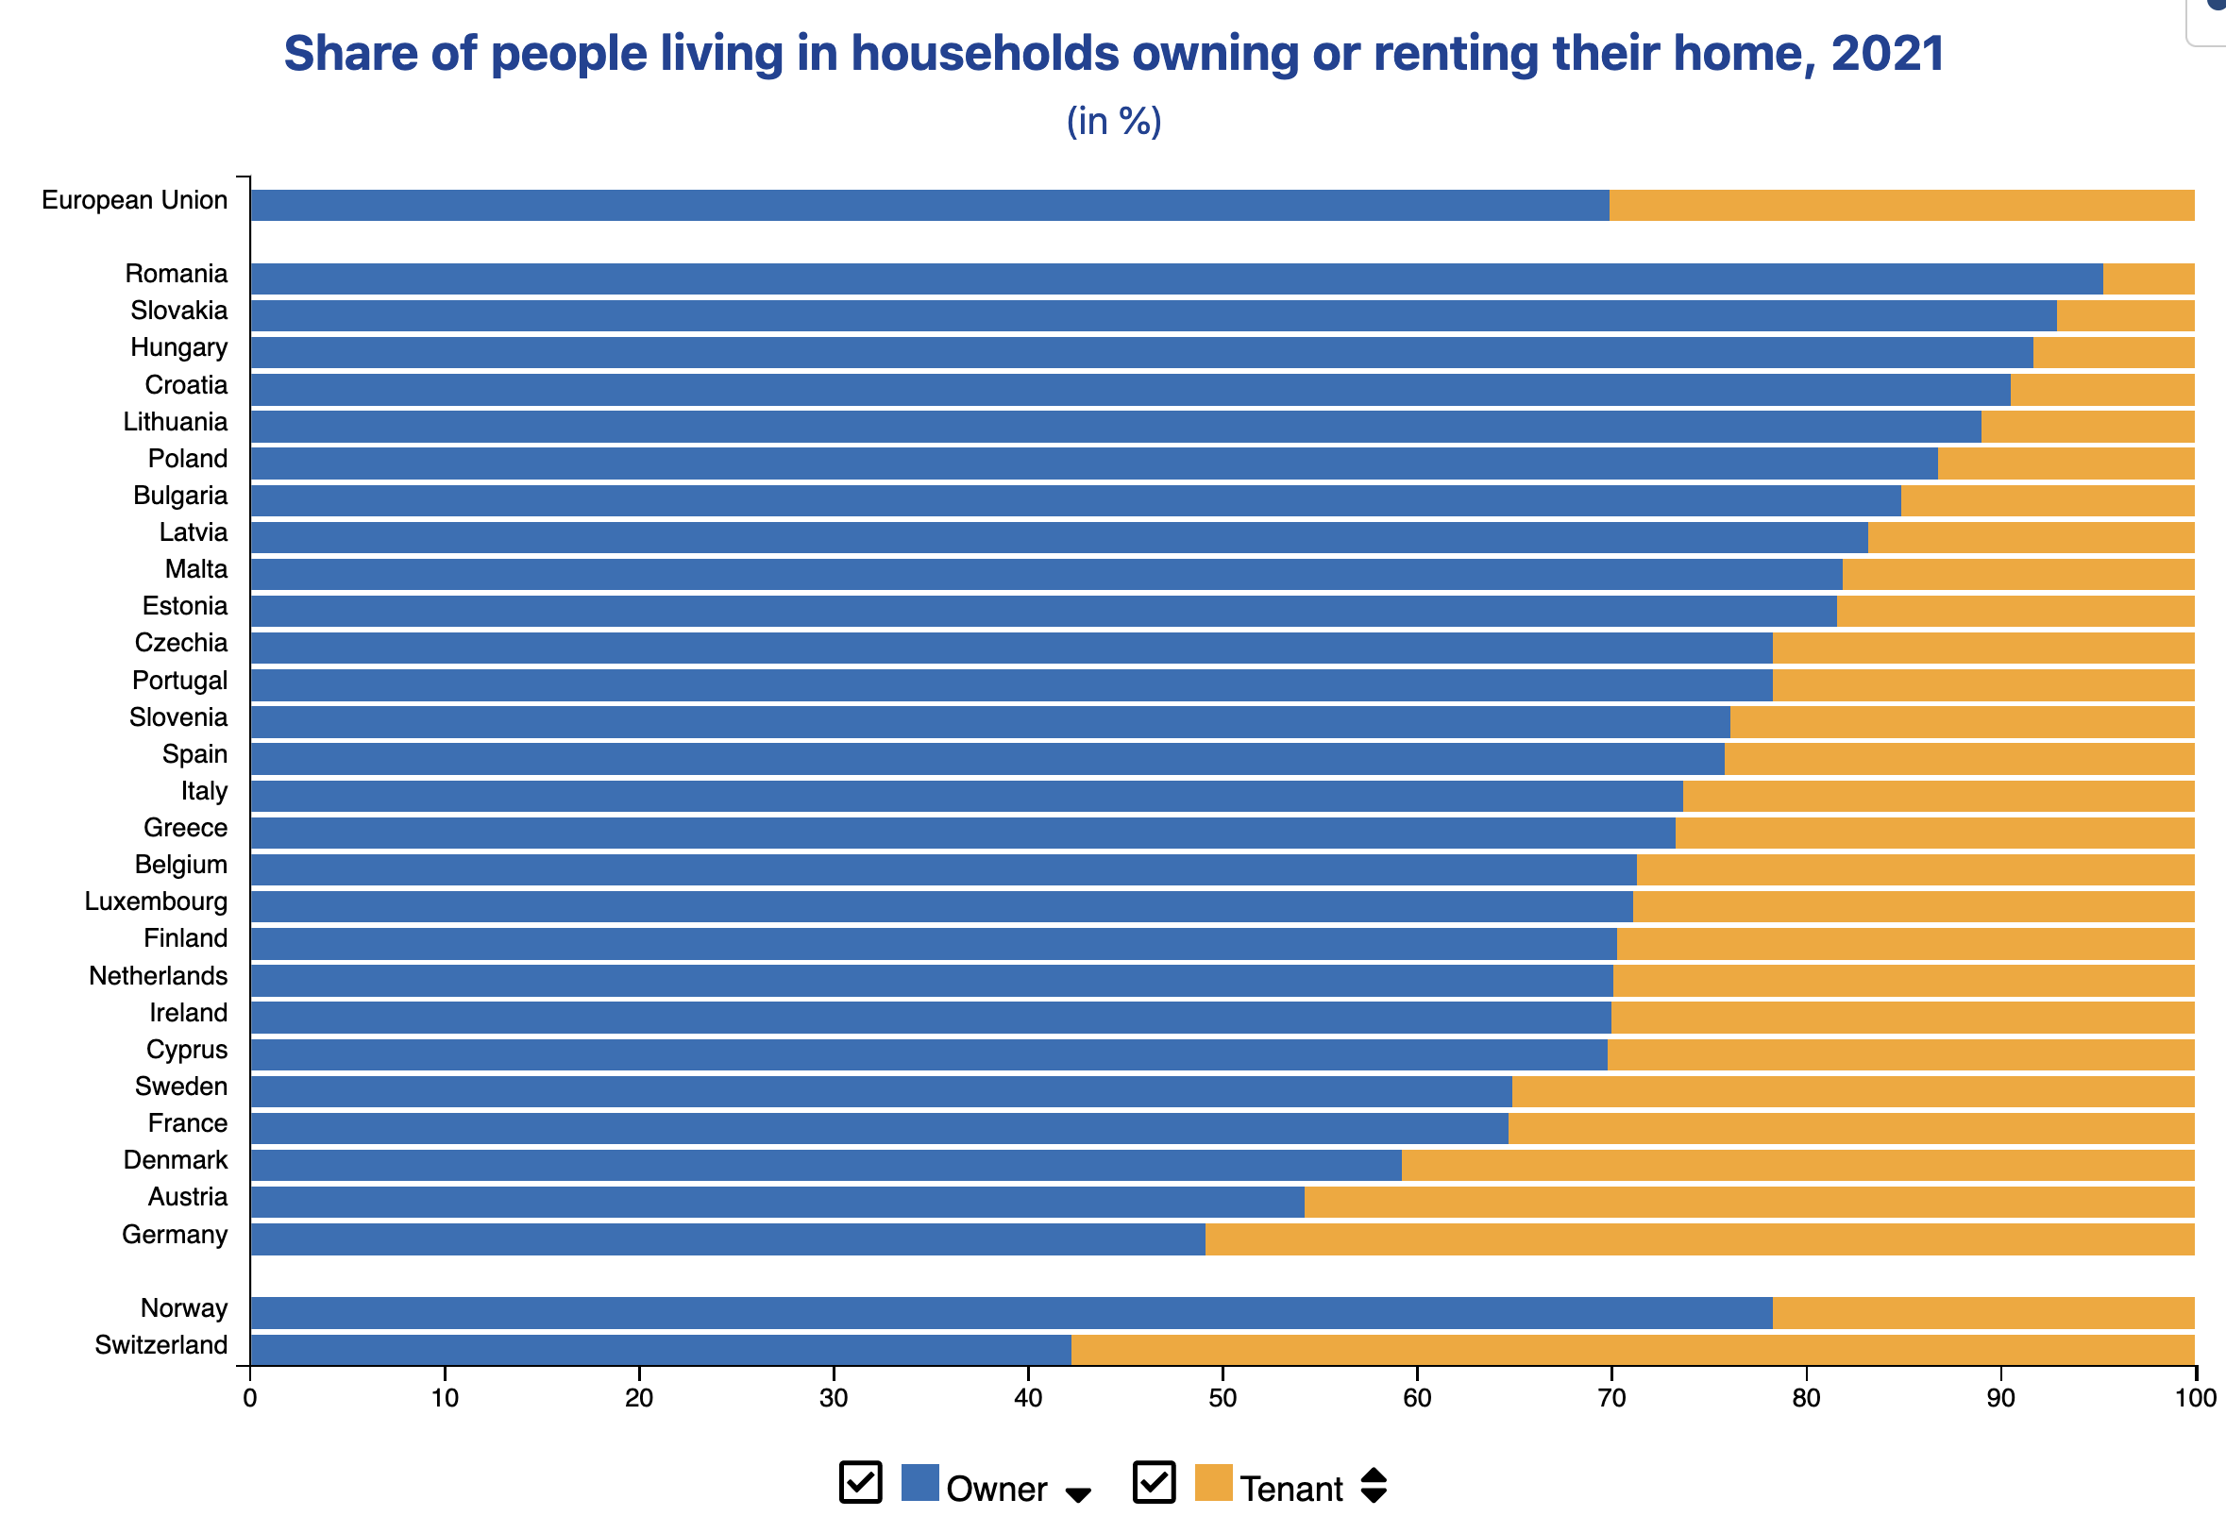

Slide 6

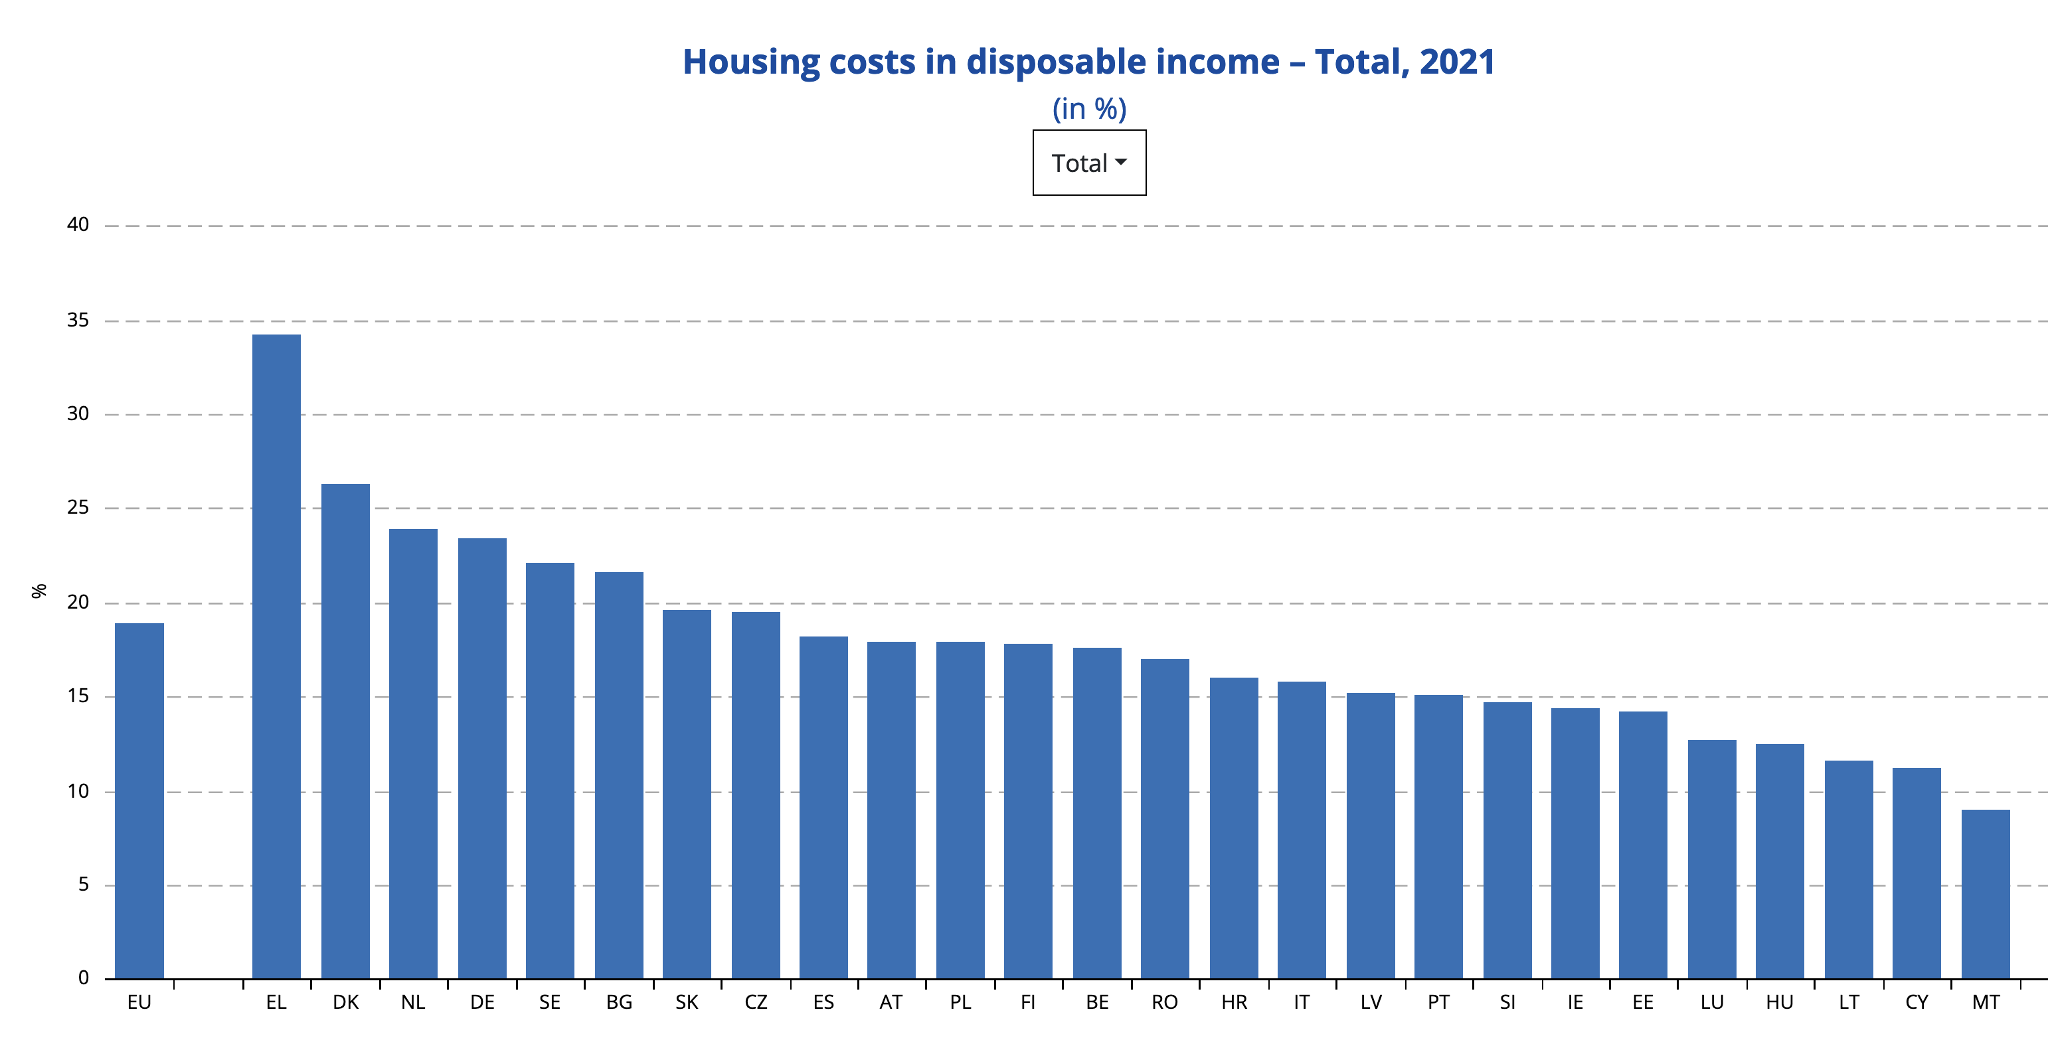

Slide 7
Housing and the EU
Housing – is a lived experience – averages can mask particular difficulties – nowhere more so than in housing
In 2021, the share of housing costs in disposable income was on average 19% in the EU, while specifically for people at-risk-of poverty that share stood at 38%.
Access to affordable and secure housing across EU (and globalised) cities is an important issue
Pressures of financialization – seeking high returns on “safe” investment
Major impact on people’s expectations – to rent – to own – to share

Slide 8
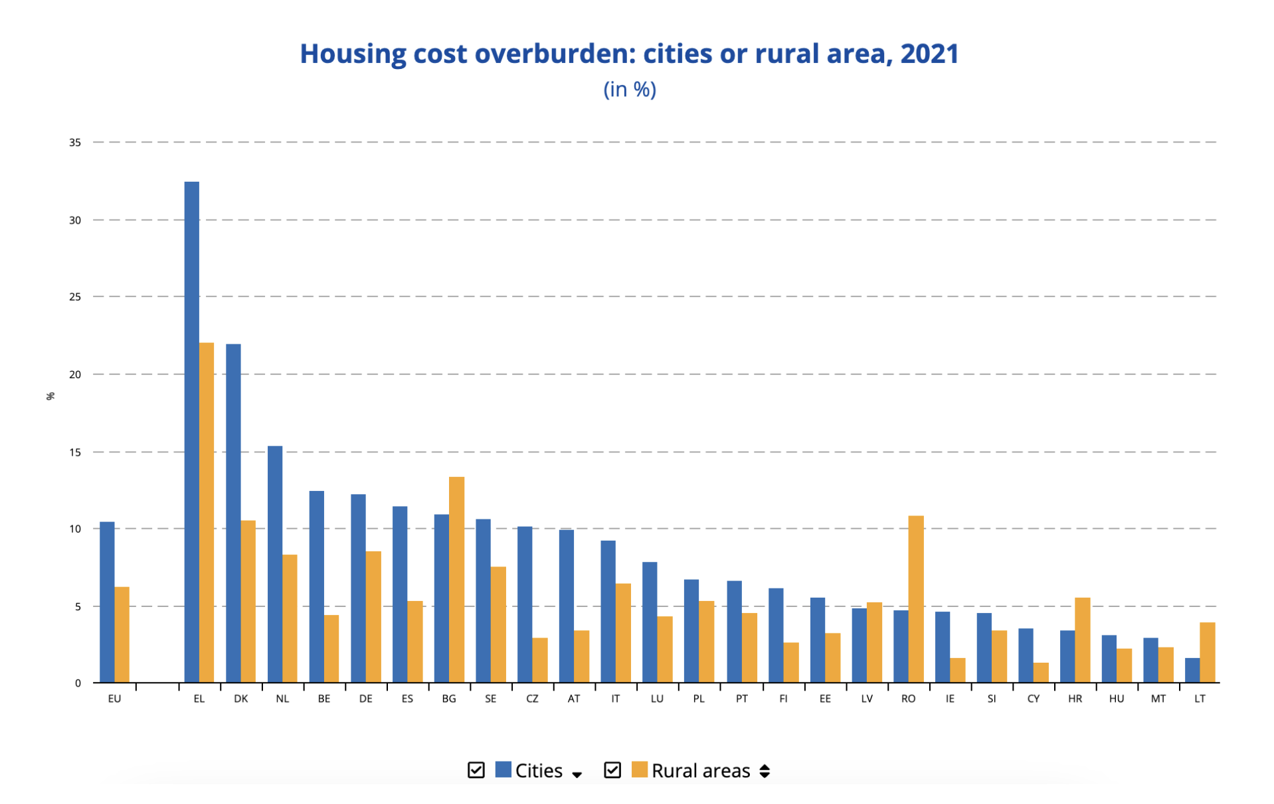
The housing cost overburden rate is the percentage of the population living in households where the total housing costs ('net' of housing allowances) represent more than 40 % of disposable income ('net' of housing allowances).

Slide 9
Climate Change
Housing is responsible for one-quarter of EU energy consumption
Greenhouse gas emissions come from households when burning fossil fuels for heating their homes, preparing warm water, cooking and air conditioning
75% of EU housing is not energy efficient and 85% of this will be in use in 2050
The European Green Deal is harmonising regulations governing climate law - 2050 climate-neutrality objective into EU law.
The EU Renovation Wave aims for 35 million buildings to be renovated by 2030 with funding of at least €115 billion

Slide 10
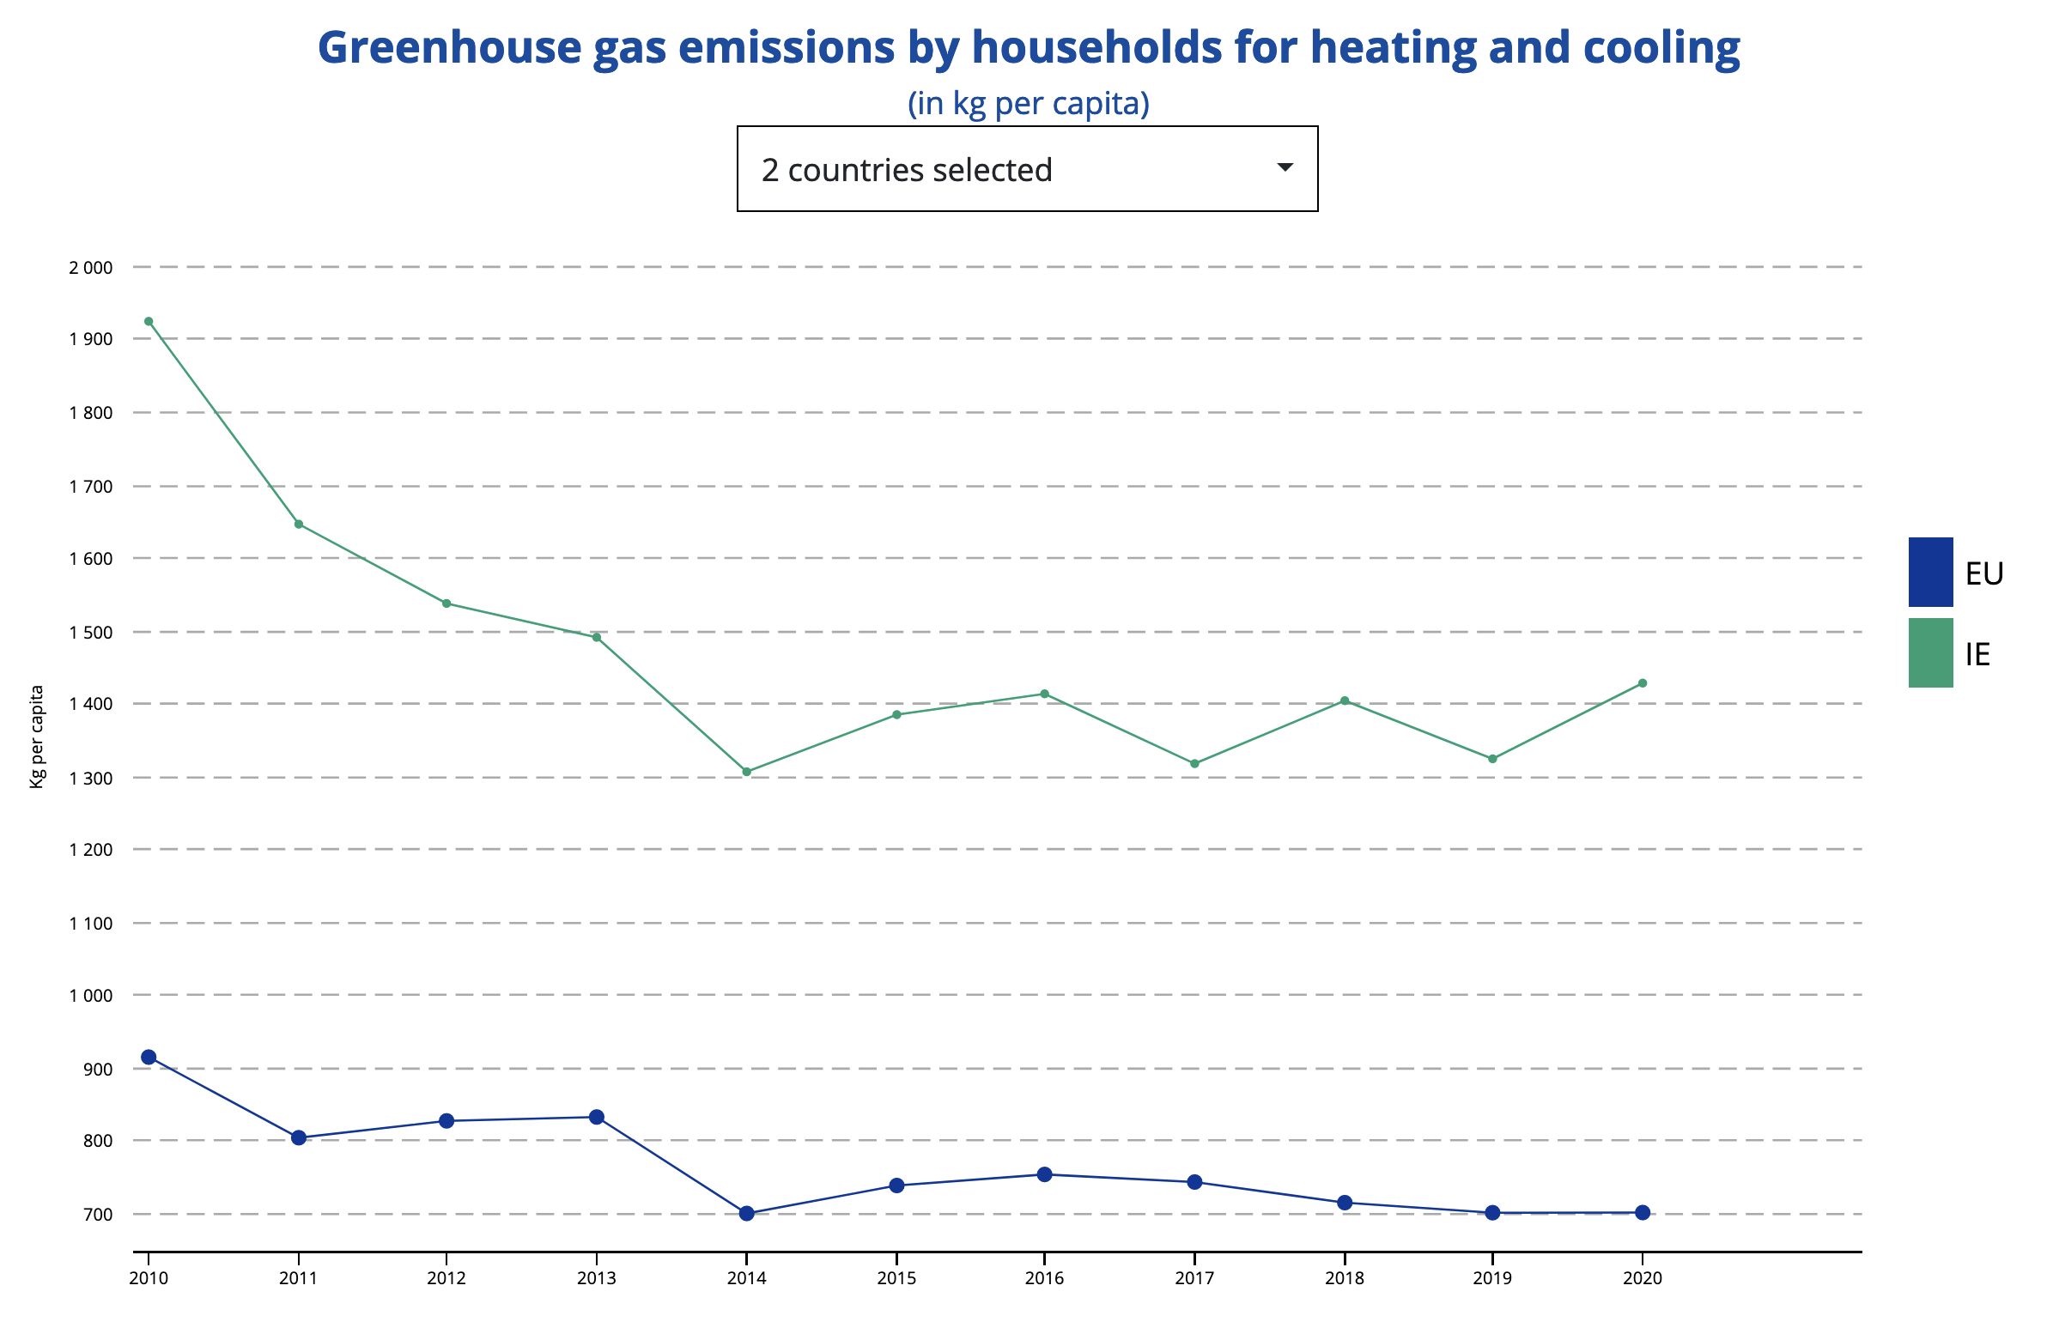

Slide 11
Housing and the EU
Following the GFC (2008/9), macro-economic stability and governance measures led to Single Supervisory Mechanism - direct supervision of lenders from ECB – action on NPLs - monitoring of house prices.
Euro area interest rates low –mortgages – controls on reckless lending to prevent price bubbles and housing crashes.
Mortgage Credit Directive 2014 – changed national mortgage laws – increased consumer protection.

Slide 12
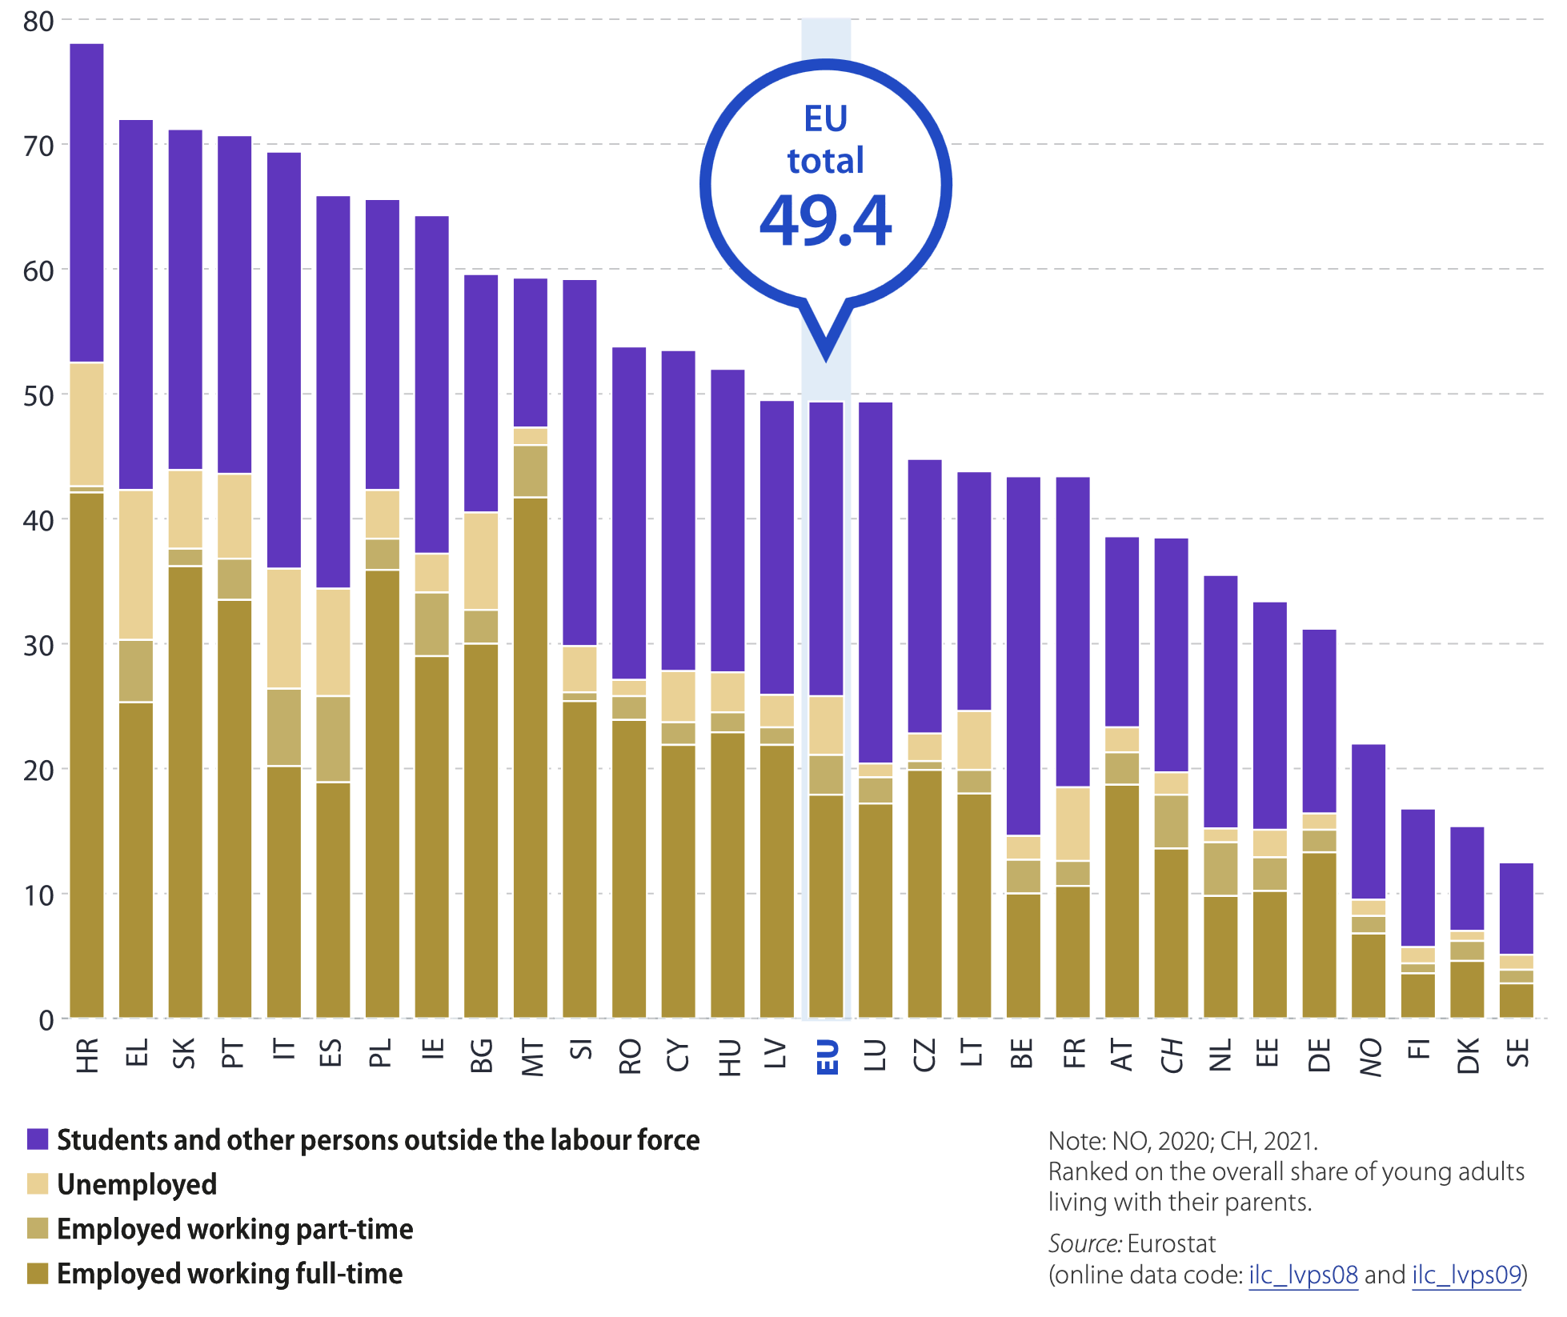
Share of young adults 18-34 living at home (Eurostat 2022)

Slide 13
EU Coordination of Economic Policies (economic governance)
“Through the European Semester, the European Commission provides Member States with policy support, guidance and orientation on how to design efficient national policies aimed at ensuring citizens’ access to affordable and accessible social housing by stressing housing supply shortage, dysfunctional housing markets, macroeconomic imbalances and insufficient stock of social housing”.
(Commissioner Nicolas Schmit, speech to European Parliament, Monday, 13 January 2020)

Slide 14
EU Social Policy and Housing
Social policy is MS competence, but Art 151 TFEU – MS social policies on social protection and combatting social exclusion can be supported by EU funding through EU programmes for housing related measures.
European Pillar of Social Rights for fair and well-functioning labour markets and social protection - Principle 19 “access to social housing or housing assistance of good quality shall be provided for those in need” informs the European Semester.
Lisbon Declaration on the European Platform on Combatting Homelessness – MS commitment to ending homelessness by 2030.
European Parliament Report (2021) on ‘access to decent and affordable housing for all’ .
The

Slide 15

Full Report here
Video

Slide 16

European Housing Studies
new online course - free

