Slide 1
Be Well
Habits with Impact

Slide 2
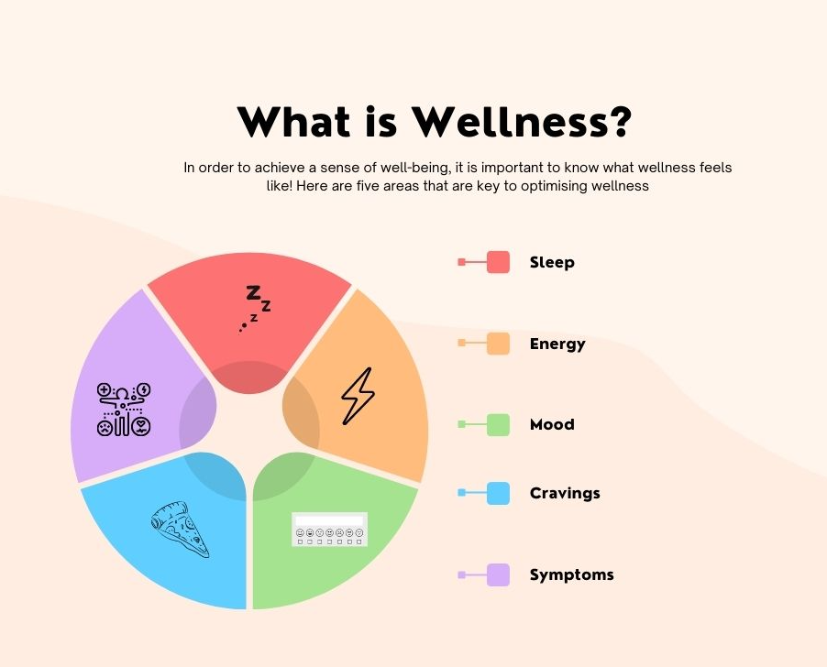

Slide 4
RESILIENCE
The ability to cope from or adjust easily to misfortune or change

Slide 5
01
Habit 1
It starts with Sleep

Slide 6
Why Resilience starts with Sleep
Mental Health
Proven to enhance mood, brain function & motivation
Immune System
Cravings
Quality Sleep strengthens Body’s Immune system.
Ghrelin & Leptin - Better Sleep leads to healthier cravings

Slide 8
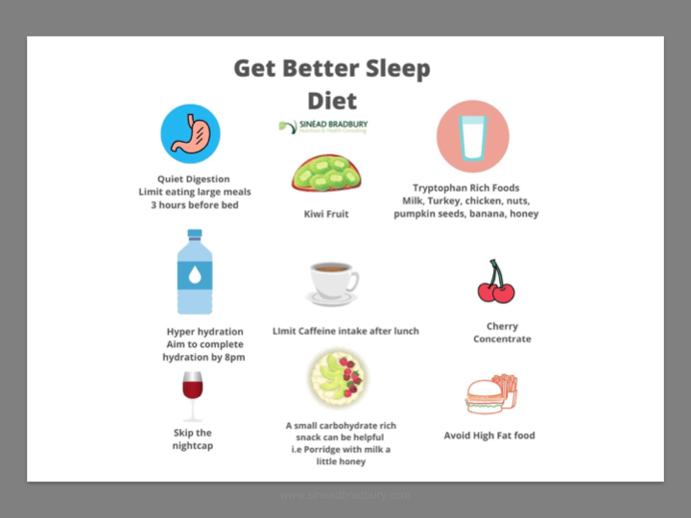

Slide 9
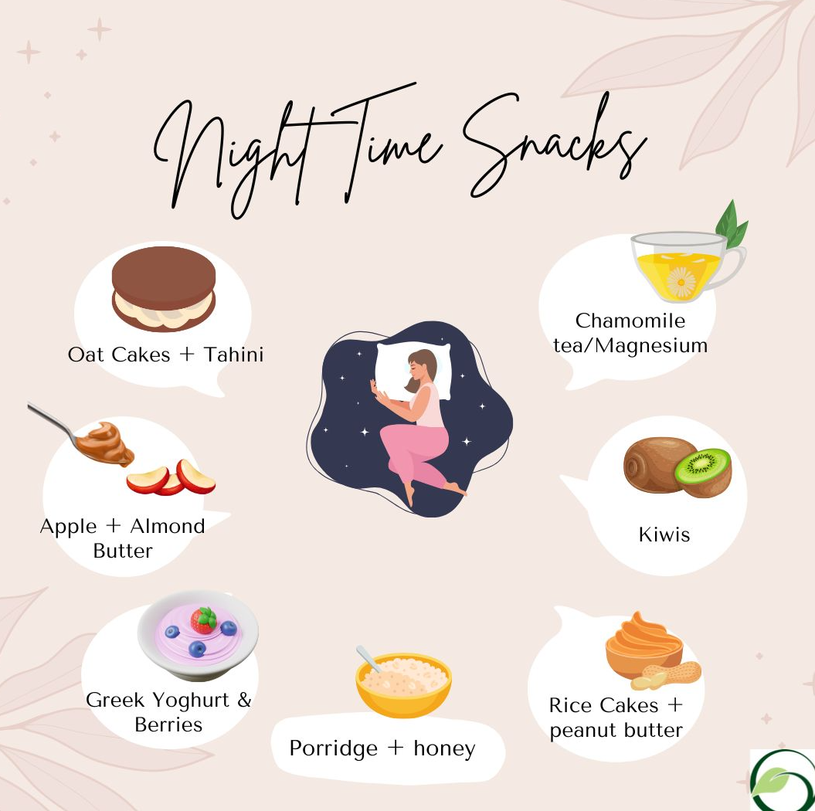

Slide 10
Sleep Formula
10
3
2
No Caffeine
No Large Meals
No Work
1
0
No Screens
No Snooze Button..

Slide 11
Kind Breaks - Time to Disconnect from work and reconnect with your breath, surroundings, nature, loved ones, pets, nourishing food, hydration
Sympathetic Nervous System
Parasympathetic Nervous System
Fight or Flight
Rest & Digest

Slide 12
02
Habit 2
Food Power

Slide 13
Food that will support strength & resislience
Gut Health
Immunity
Balancing Blood Sugars

Slide 14
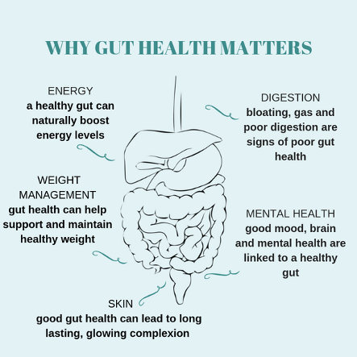
Why Gut health matters
An imbalance in gut bacteria has been found to contribute to chronic diseases such as IBS and diabetes. Studies are linking mental health, depression and weight gain to imbalances in gut bacteria. 70% of your immune system is in your gut

Slide 15
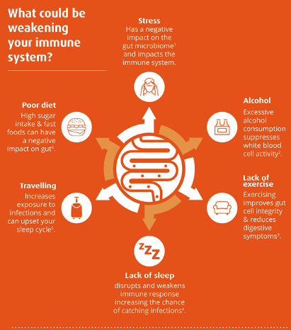
Taking care of our Immune System
Immune Function & Resilience
Impaired Immunity means you are are out of action, out of work, out of sport
Protect Yourself

Slide 16
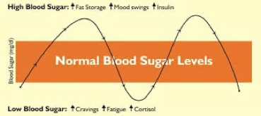
Balance Your Blood Sugars to empower your decision making
Helps make you more resilient to stress
Prevents type 2 diabetes
Can improve your physical and mental performance

Slide 17
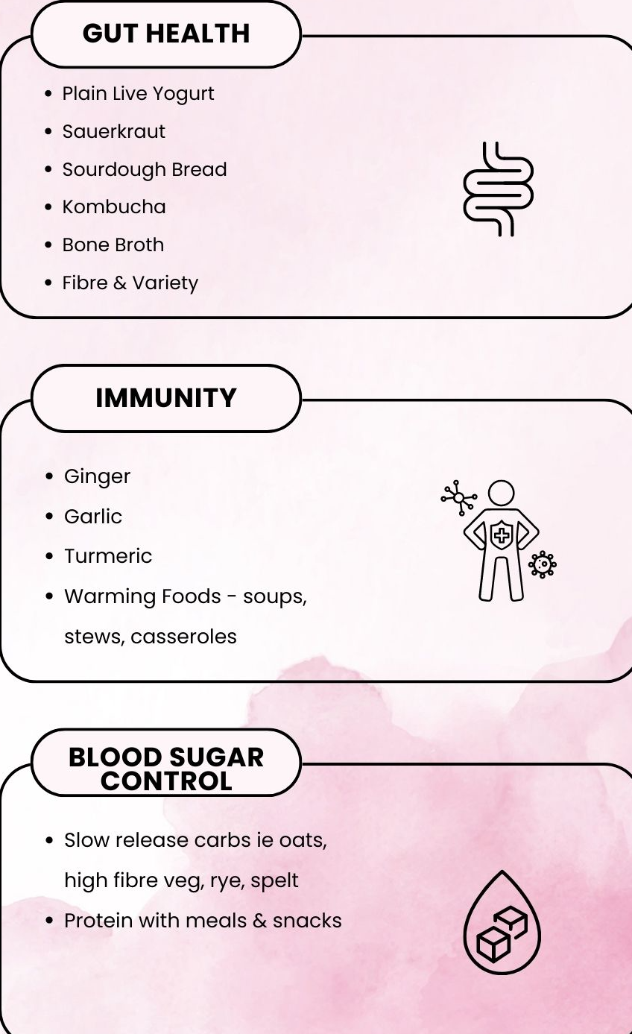
Foods to Support
Include each day to optimise gut health, immune function, balance blood sugars

Slide 18
03
Habit 3
Movement

Slide 19
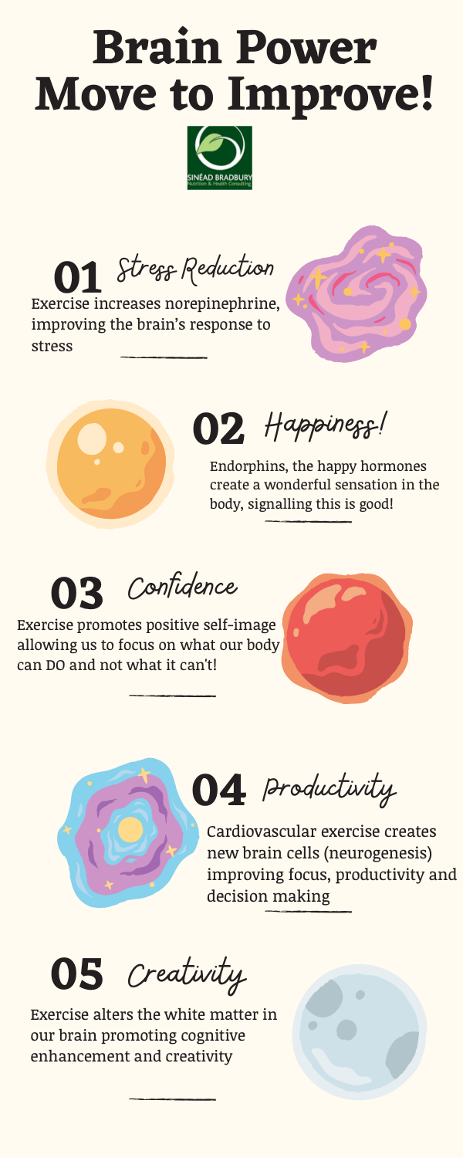
Foods to Support
The World Health Organisation (WHO) recommends at least 150–300 minutes of moderate-intensity aerobic physical activity; or at least 75–150 minutes of vigorous-intensity aerobic physical activity; or an equivalent combination of moderate- and vigorous-intensity activity throughout the week.

Slide 20
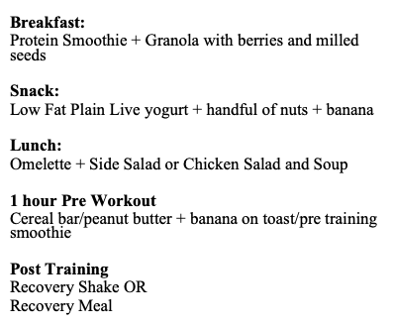
Fuelling Correctly for Moderate to Intense Exercise

Slide 21
Recovery Snacks
Egg Based: 2 eggs + 2 slices of wholegrain toast, ½ avocado Smoothie: 150mls Greek Style yogurt, 250ml milk, 14g mixed berries Overnight Oats: 80g oats, 250ml milk, 1 tbsp chia seeds, 1 tbsp honey Large baked potato: 5 tbsp baked beans, 25g cheddar cheese

Slide 22
Supplements to Consider- IF DEPLETED
Vitamin D
Quality Multivitamin
Probiotic
Omega 3

Slide 23
04
Habit 4
Nutrition for Now - The Menopause

Slide 25
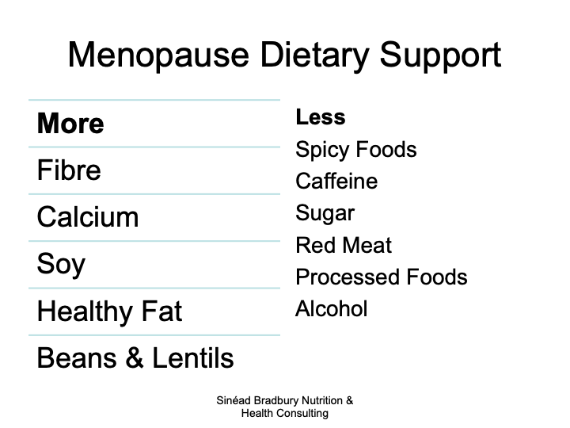

Slide 28
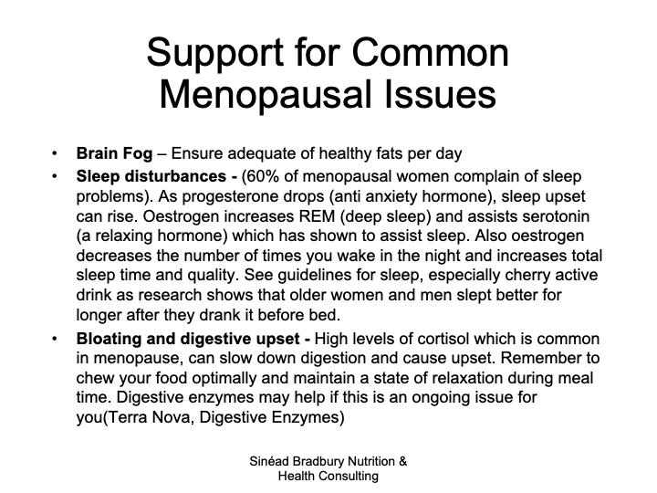

Slide 29
Exercise & Menopause - What to Focus on

Slide 30
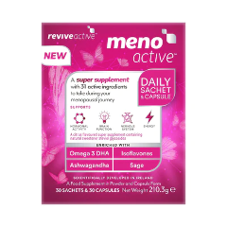
Supplement Support

Slide 31
Your body. Your Job.
•Tune into ‘You’
•Start with Sleep!
•Know what’s ‘Gut for you’
•Protect Your Immune System
•Balance Blood Sugars
•Move for your Mind!
•Supplement Wisely
•Adapt Your Nutrition for Your Needs
•Enjoy the Process. It never ends!

Slide 32
Be Well
The Power is in DOING not just KNoWING
@sineadbradburynutrition

Slide 33
Thank you for joining us today!
- Human Resources Office

