Slide 1
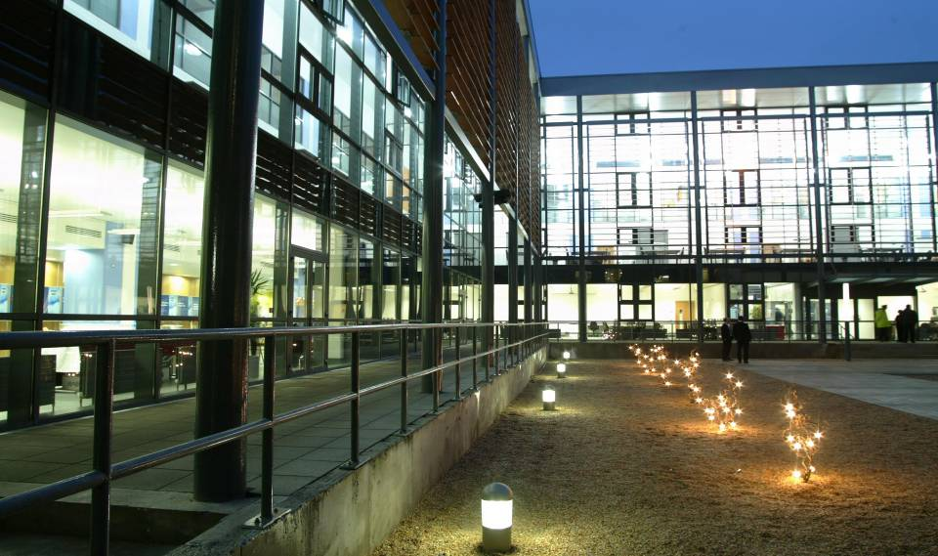
Visiting Student Academic Advisory 2022/23
Welcome to the J.E. Cairnes School of Business and Economics
‘Study Business in Ireland’
Marie McArdle & Mairéad McKeon - September 2022

Slide 2
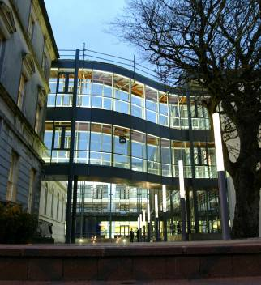
J.E. Cairnes School of Business & Economics
150 years tradition of business education
2000+ Undergraduate and Postgraduate students
90 permanent teaching staff
5 Research Centres
Administration & Support Services

Slide 3
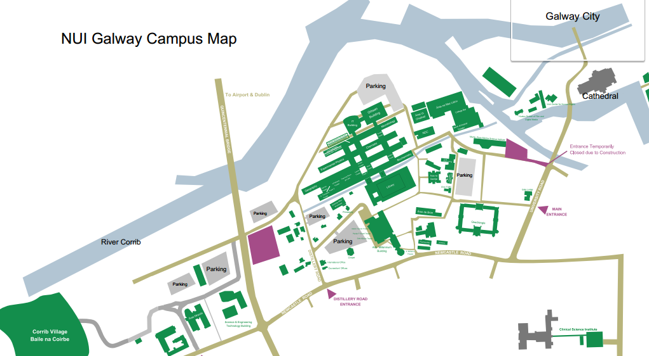
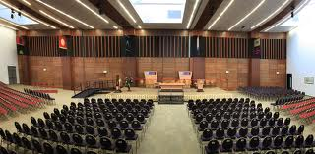
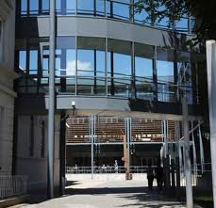
Notes:
Different campus map

Slide 4
University Structure
NUI Galway
College of Arts, Social Sciences, & Celtic Studies
College of Business, Public Policy, & Law
College of Engineering & Informatics
College of Medicine, Nursing, & Health Sciences
College of Science
School of Law
Shannon College of Hotel Management
J.E Cairnes School of Business & Economics
Accountancy & Finance
Business Information Systems
Economics
Management
Marketing

Slide 5
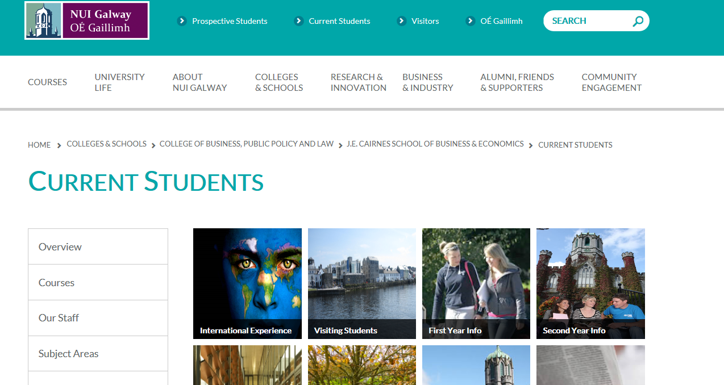
Module information
Booklet for module descriptions will be available in the Bailey Allen Hall tomorrow after your International Orientation session.
https://www.nuigalway.ie/business-public-policy-law/cairnes/currentstudents/visitingstudents/

Slide 6
Course Selection
Courses taken will be chosen from the schedule of courses for the second and final years of the three year full-time B.Comm. undergraduate programme.
Please note the following: * Courses offered on a year-long basis can only be taken by students visiting for the full academic year. * The lecture timetable will contain course clashes – always consult timetable.

Slide 7
Course Selection
The staff of the School will be available to assist the incoming students regarding choice of courses.
Each course is assigned a weight (5 or 10 ECTS), which generally corresponds to the number of lecture hours per week. The normal weight of courses taken by NUI Galway students is 30 ECTS per semester.

Slide 8
Courses available for Erasmus and study abroad students
Study Business in Ireland - Business modules available for 22_23

Slide 9
Double Degree Students
Please ensure you are registered under the course instance 4BC9
As a Double Degree student you must register for final year of the BComm Programme
Final Year BComm Advisory will be held next week. Information will be posted on Blackboard
If you have any queries please email cairnesconnect@nuigalway.ie

Slide 10
Timetable – a closer look
Url link to Visiting Student Timetable:
http://www.nuigalway.ie/business-public-policy-law/cairnes/currentstudents/timetables/

Slide 11
Assessment
Assessment is mainly by a written final examination of two or three hours, although some courses may combine final examination with assessment by course work such as projects or essays carrying up to 50% of the available marks. Marks are awarded out of 100%.
Examination Standards:
40% or above: Pass
50% or above: Second class honours, grade 2
60% or above: Second class honours, grade 1
70% or above: First class honours

Slide 12
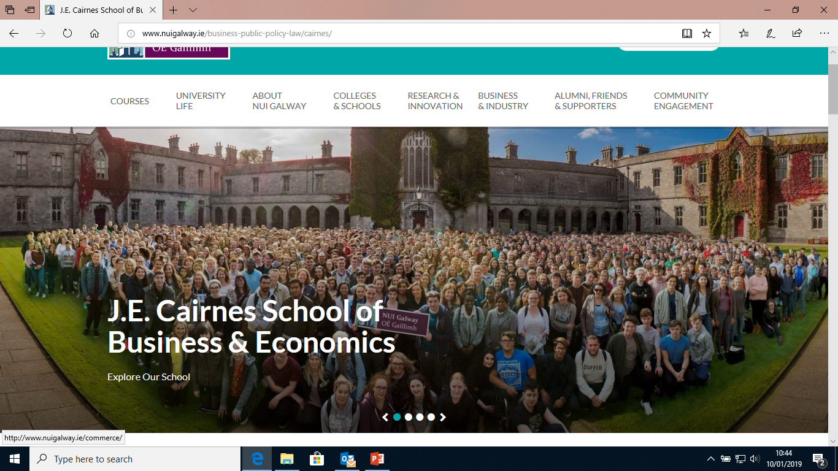
School’s website for more information
http://www.nuigalway.ie/cairnes/

Slide 13
‘Like’ us on Facebook and you will get other updates https://www.facebook.com/JECairnes

Slide 14
Useful contacts in the J.E. Cairnes School of Business & Economics
Marie McArdle & Mairead McKeon
Ms. Raphael McLoughlin
Study Abroad Officers (for double-degree student queries)
email: cairnesconnect@nuigalway.ie
Vice-Dean of Internationalisation
Email: murray.scott@nuigalway.ie
Erasmus School Administrator -
email: raphael.mcloughlin@ nuigalway.ie
Associate Head of Internationalisation
Email: emer.curtis@nuigalway.ie
Dr Murray Scott
Dr Emer Curtis

