Slide 1
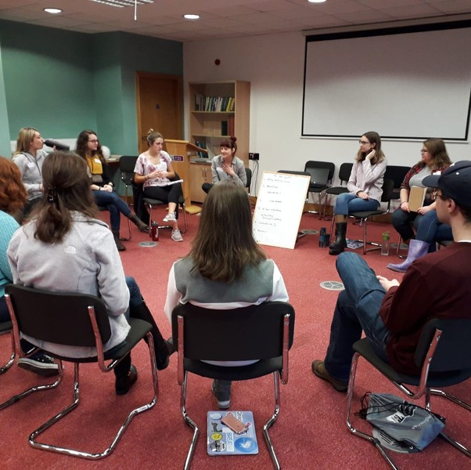


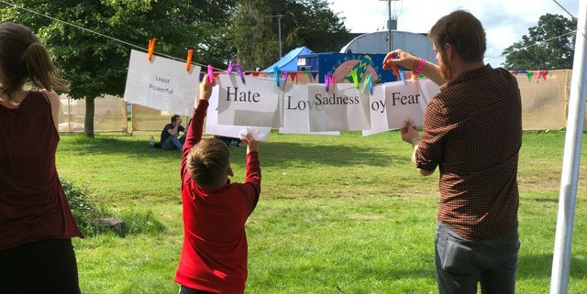
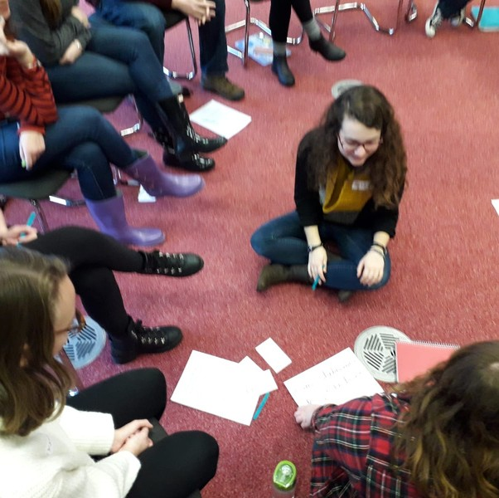
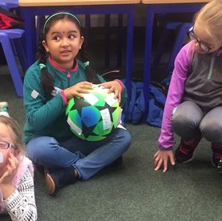
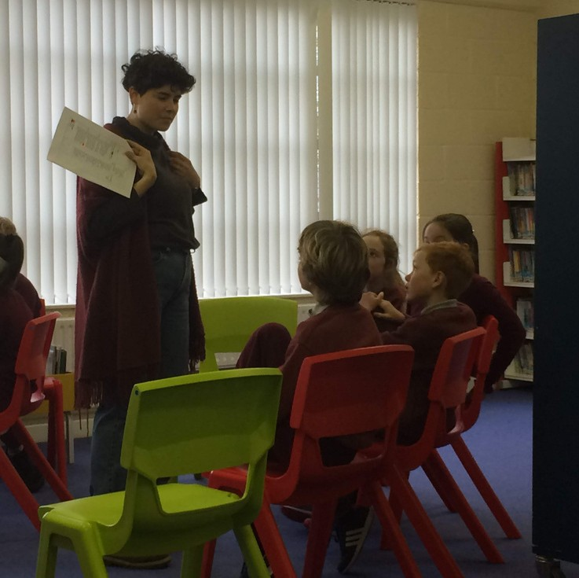
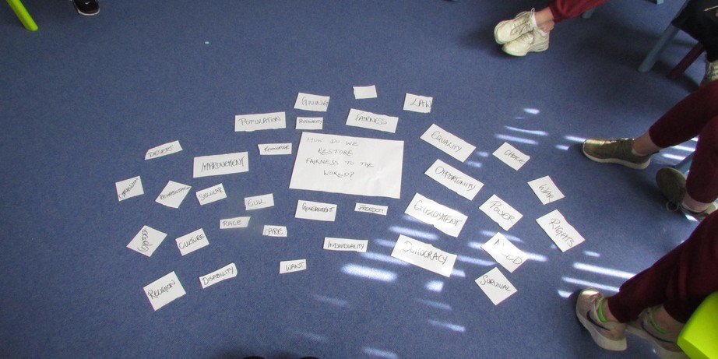
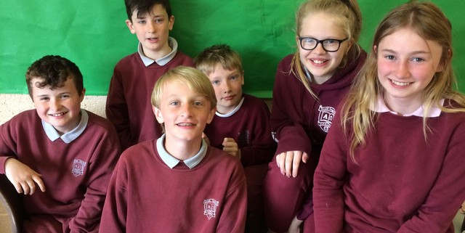
Philosophy
In Irish Schools
-PI2108
-PI2109

Slide 2
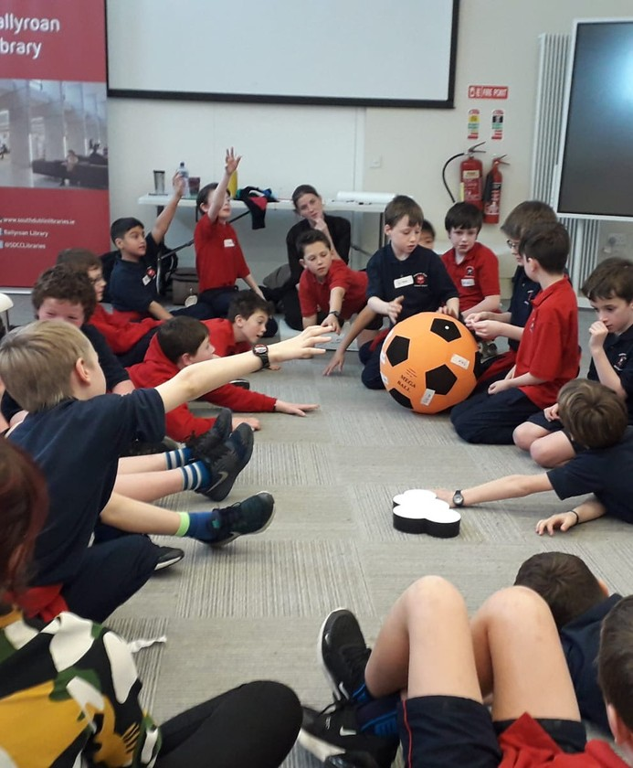
PI2108 (semester 1) & 2109 (semester 2) are part a wider set of 'philosophical dialogue’ projects we run in the Philosophy Discipline.
Our projects aim to bring Philosophy into formal and non-formal educational settings outside the university.
PI2108/2109 are service-learning modules for JYA students.
Local community: Students will be assigned to one of our partner primary schools (elementary school).
Small seminar format with a capped registration (21)
Students form close working ties with the instructors, with one another, and with the local community.

Slide 3
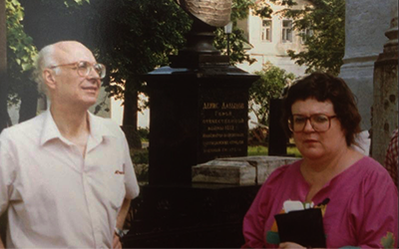
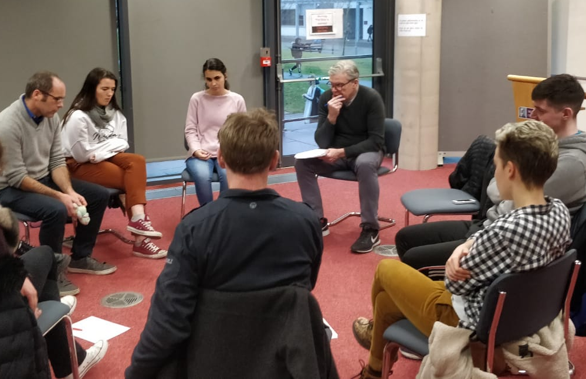
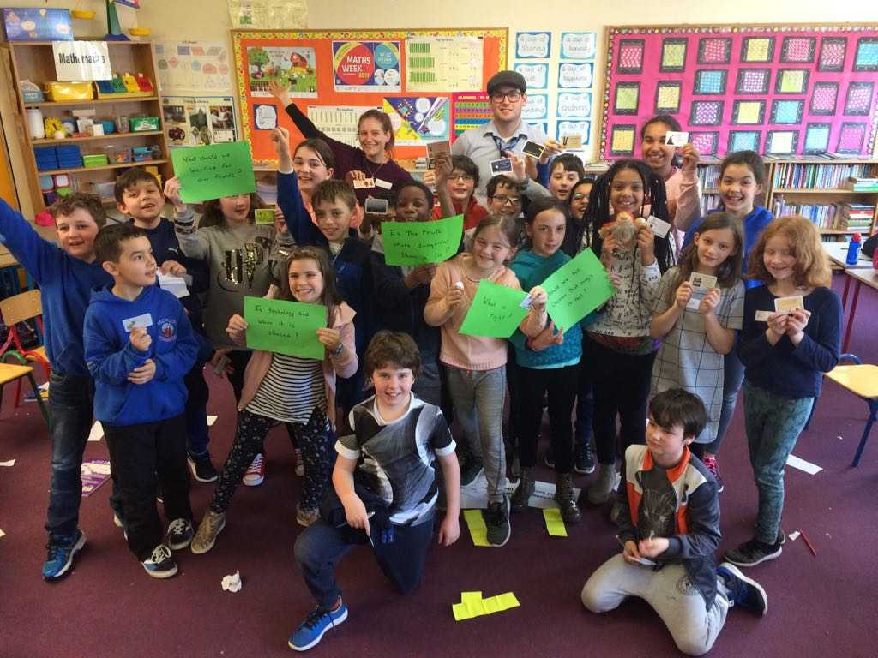
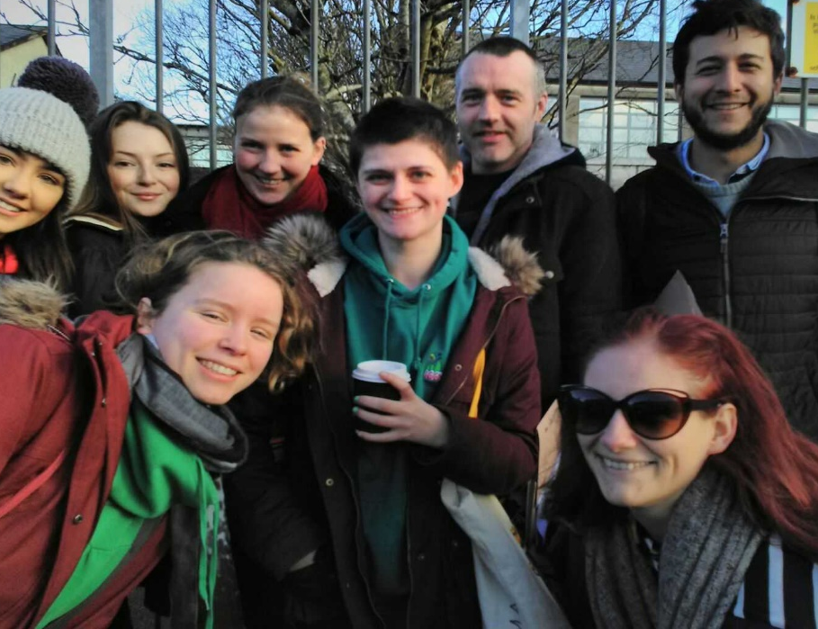
You gain:
Knowledge of the P4C pedagogy - central tool – using the
community of philosophical inquiry to embed critical, creative, and caring thinking. A form of inquiry-based collaborative learning.
Facilitation skills -organization and support structured
dialogue using the rules and methods of philosophical inquiry.
Cognitive apprenticeship – theory into practice,
lesson planning, classroom management, teamwork,
problem-solving, learning by doing (experiential)
Experience of public philosophy - recognizing the
value of connecting academia to our social and civic
worlds – enhancing community engagement and partnership.
Matthew Lipman
&
Ann Margaret
Sharp

Slide 4
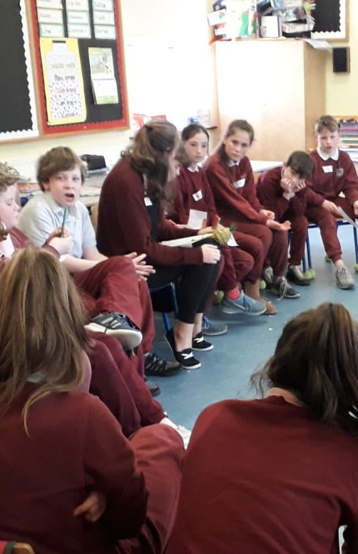
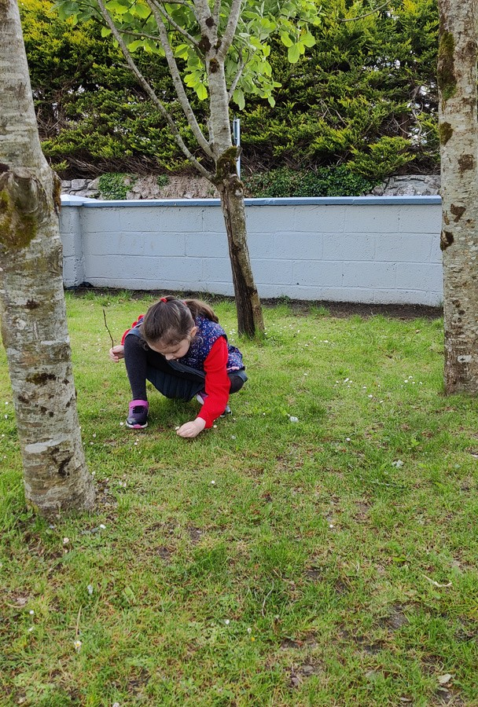
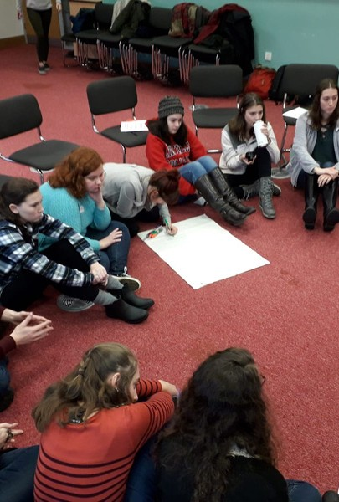
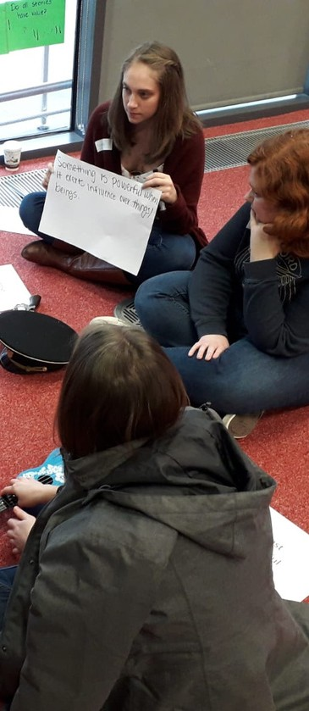
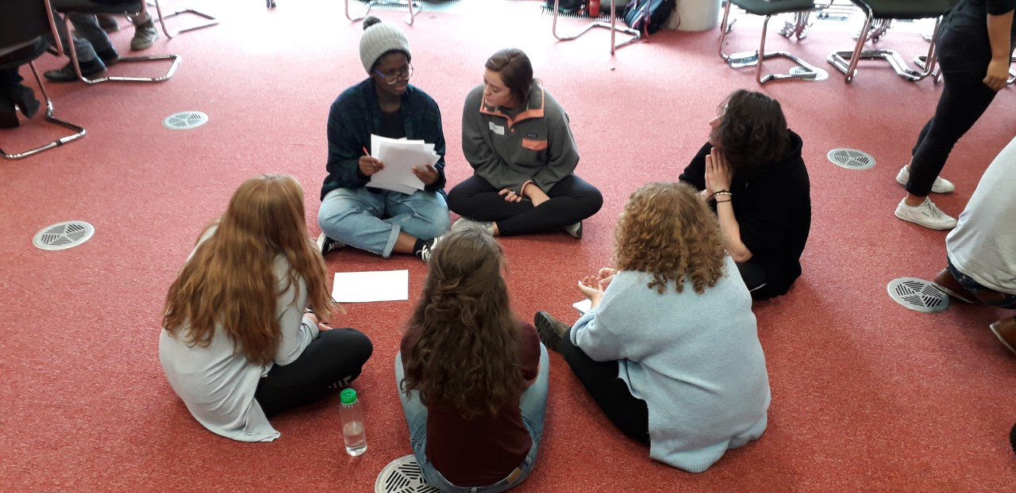
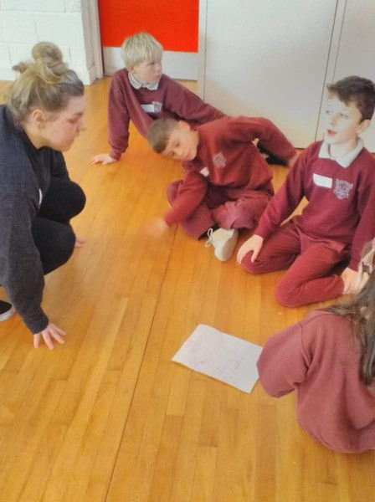
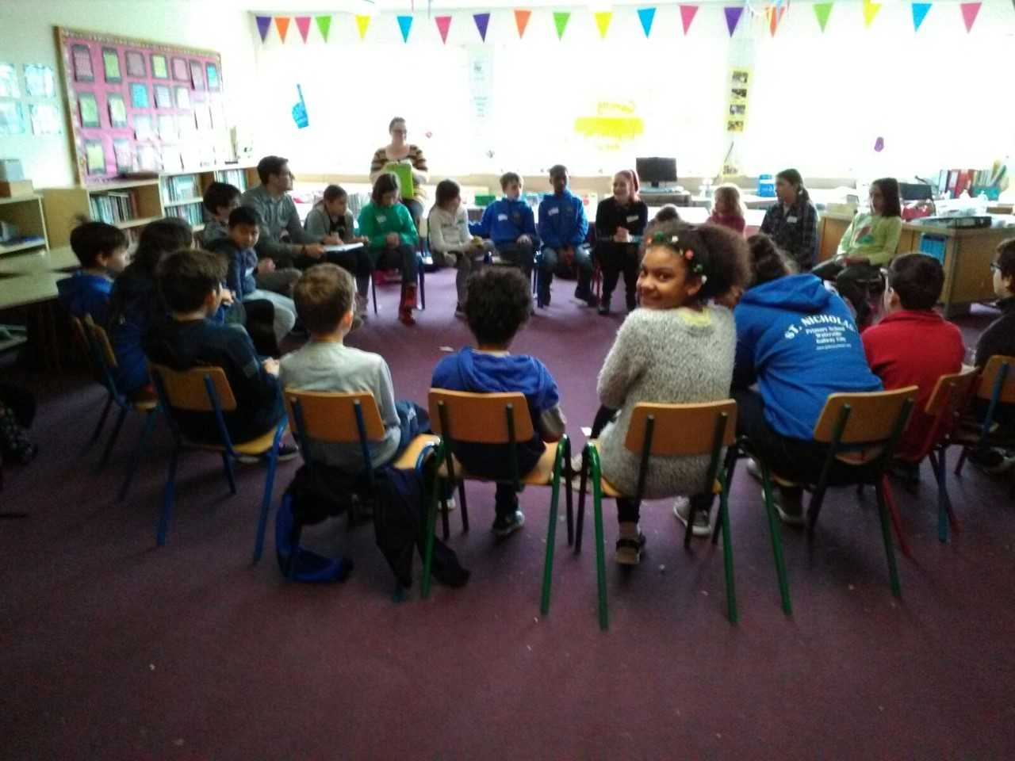
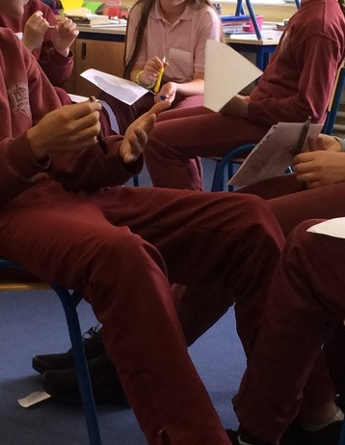
What happens when you facilitate a CPI?
Stimulus
Concepts
Question-making
Voting
Inquiry
Review

Slide 5
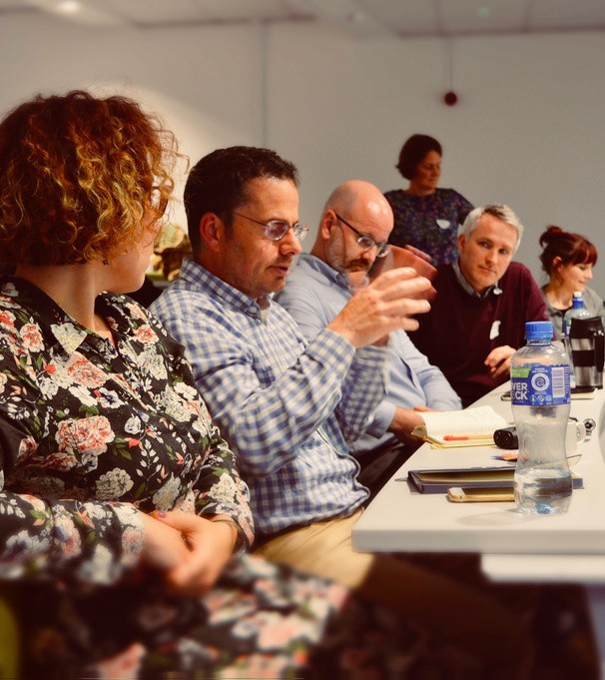
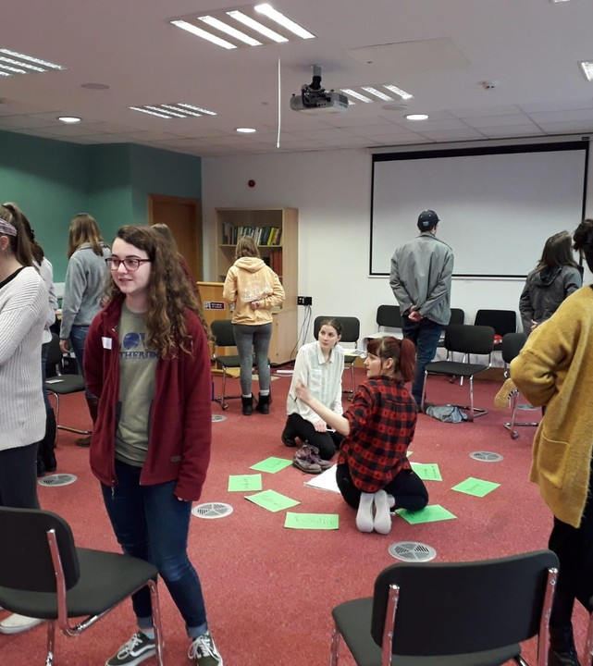
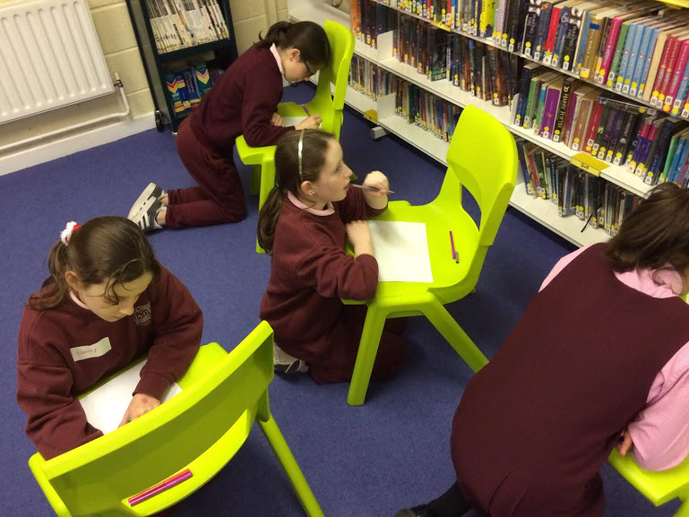
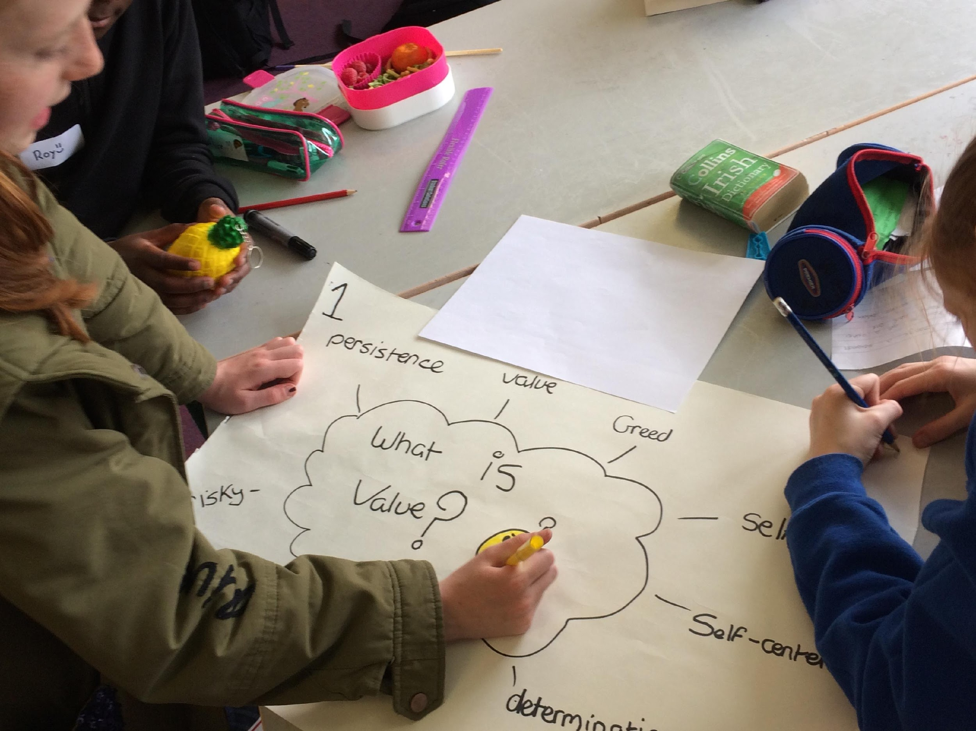
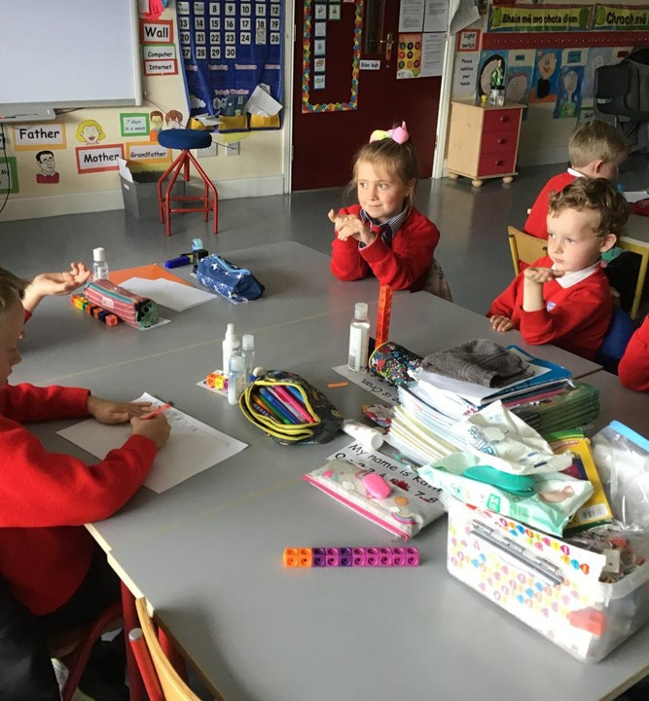
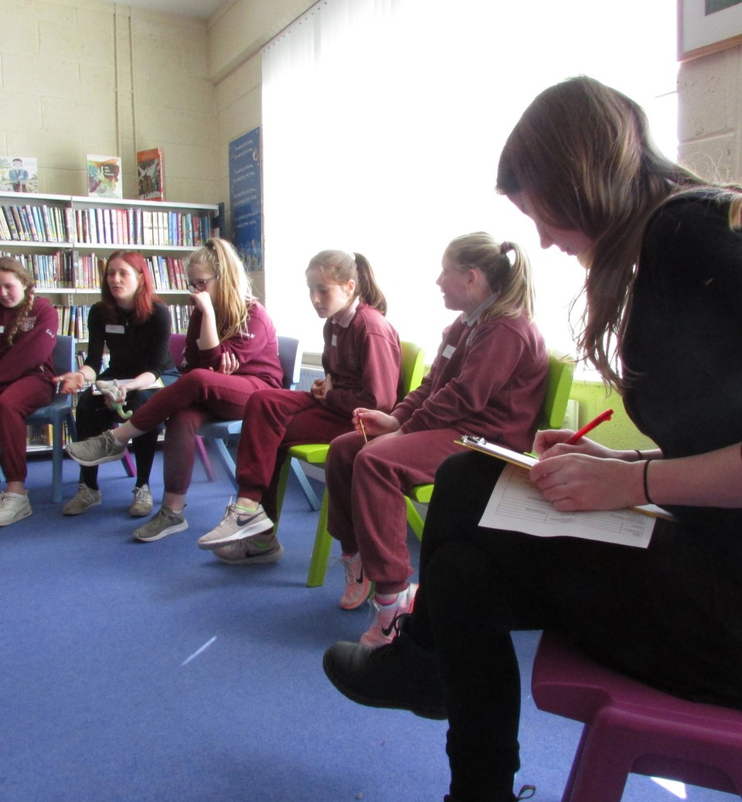
Practice
On campus weekend training event (end of Wk 5) to deepen and develop facilitation skills
Delivering six P4C sessions in a local school, supported by active mentoring.
Theory
Reflection
Lectures on the Philosophy for Children (P4C) Pedagogy, its relationship to education and to philosophy as an academic discipline.
Exploring what happened in the classroom through group dialogue, reflective journaling, and assignments.

Slide 6
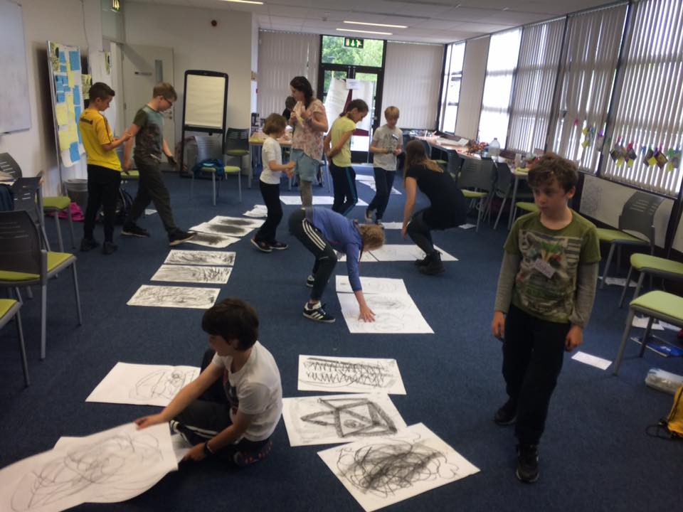
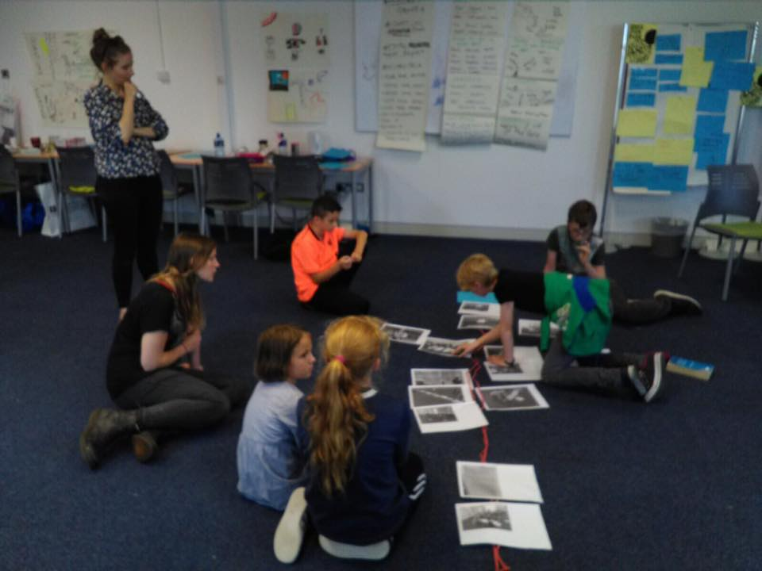
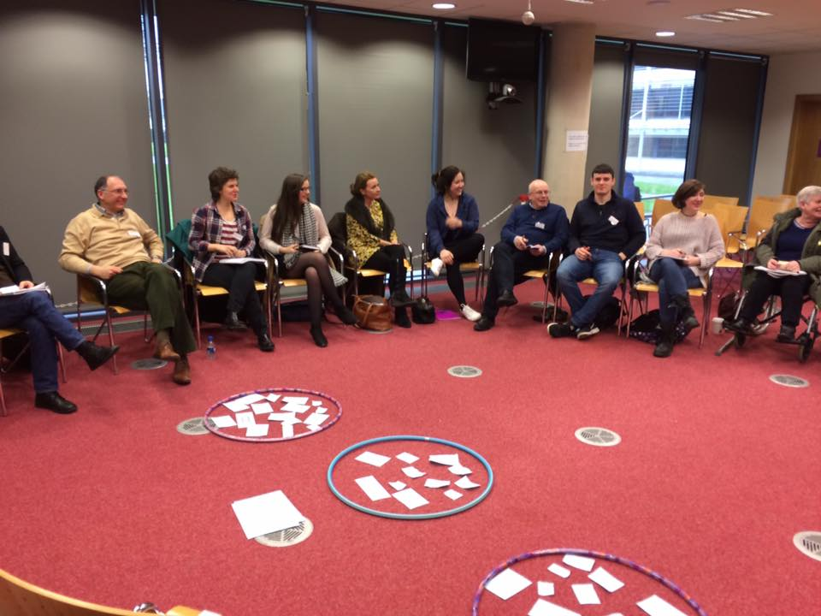
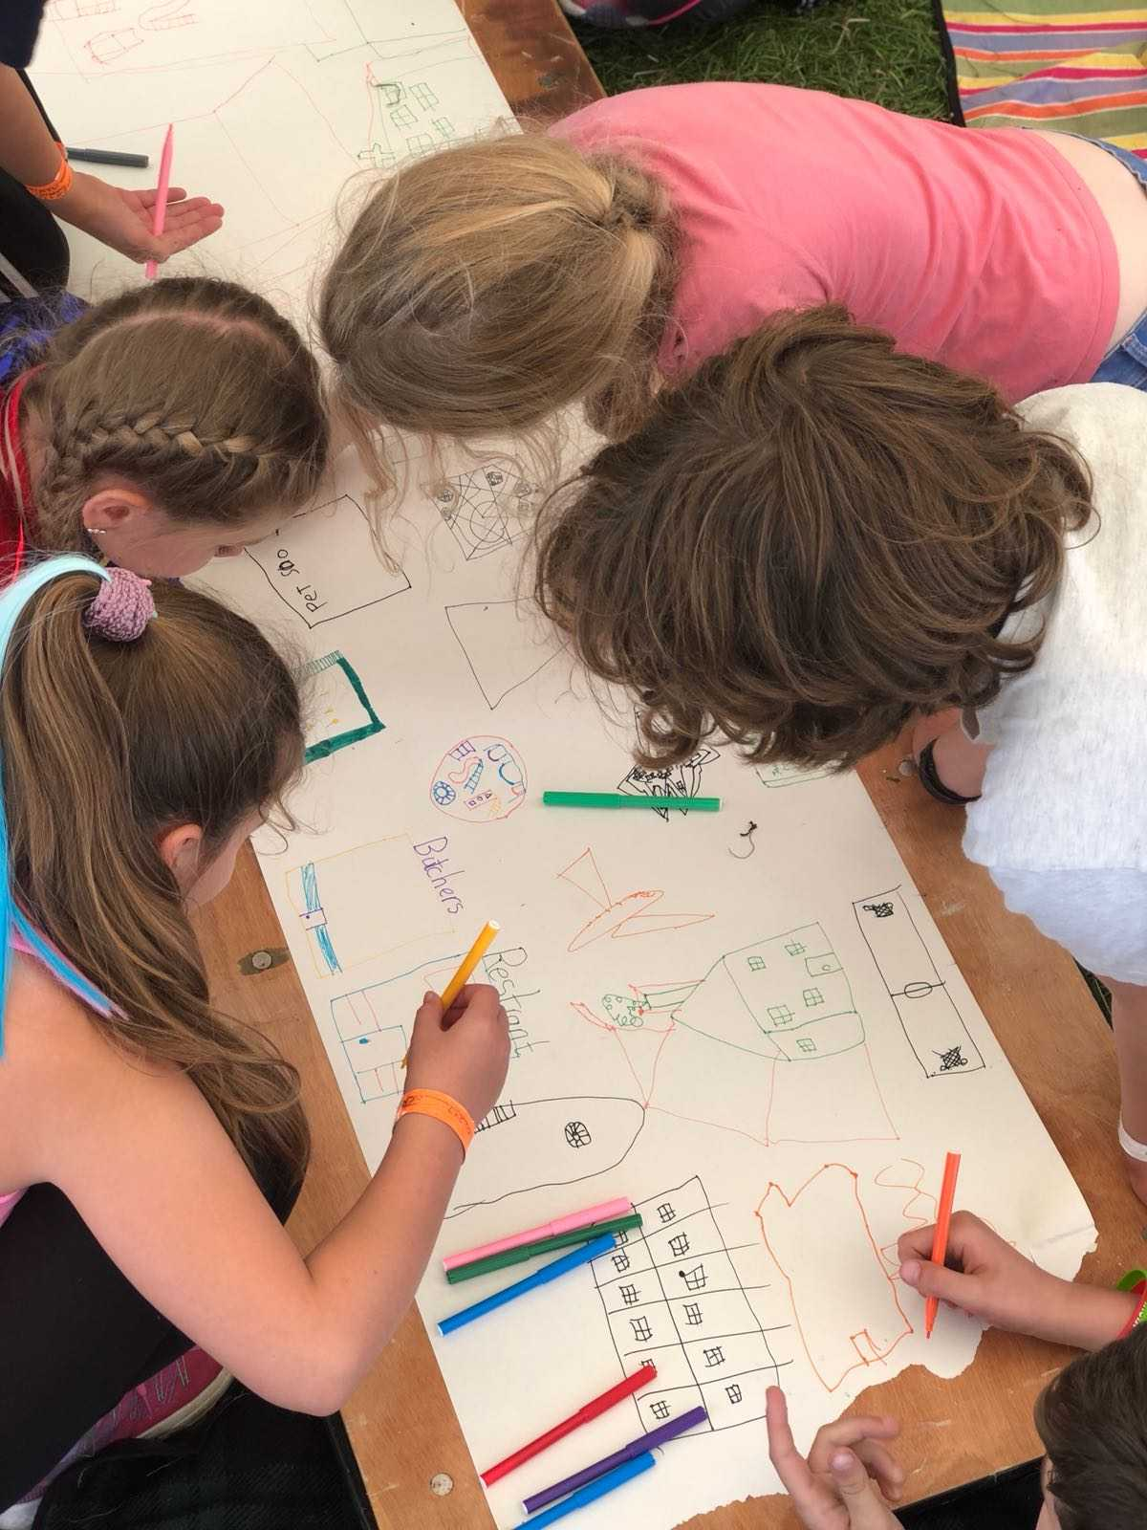
Reflective Portfolio Entries: 30%
Two guided reflections on the relationship between theory and practice
Participation: 36%
Session Planning Assignment (Group): 34%
Lesson planning Delivering sessions
Report on session

Slide 7
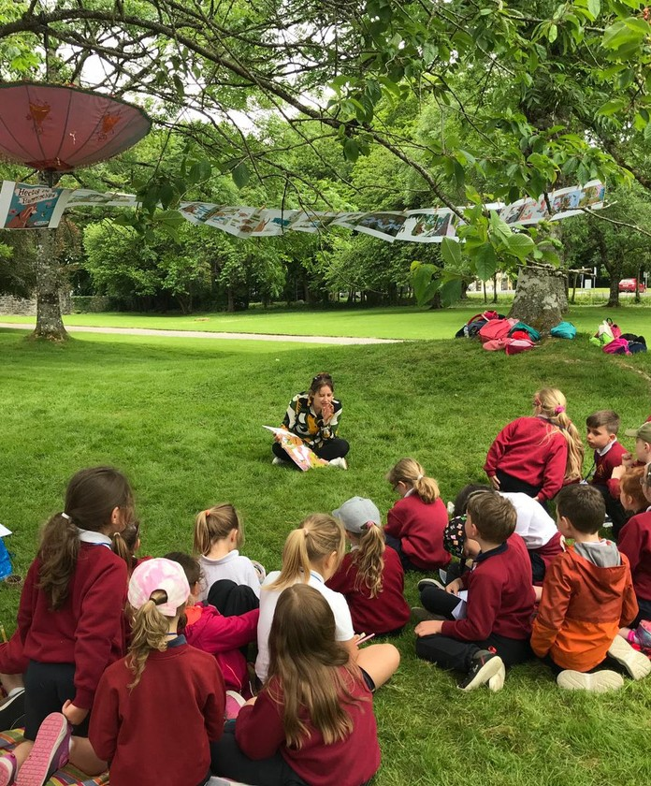
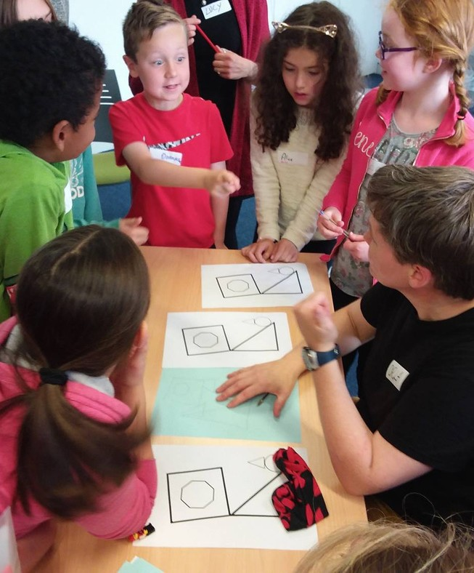
Who teaches this course?
Co-taught Practitioners Researchers
Teaching and learning innovators
Dr Lucy Elvis (above) & Dr Orla Richardson (right)

Slide 8
Who typically takes this module?
What can this module give students?
Meeting Requirements
Philosophy
Developing Skills
Education majors
Liberal Arts Students Communication Majors Psychology Students Philosophy Students
Testing theory in practice
Classroom Management
Critical Reflection & Problem Solving
Facilitation Argument Literacy
Education
Service Learning

Slide 9
The project in numbers since 2017
'Doing philosophy is not a matter of age, but of ability to reflect scrupulously and courageously on what one finds important.'
Matthew Lipman
-Over 1000 learners
-Over 600 students
-Across different contexts:
P4C as Service-learning
P4C as Peer-assisted learning
P4C with Postgraduates
P4C as a research method in Children’s Studies
P4C in non-formal education settings – art galleries, libraries, music festivals, youth groups, and philosophy camps.

Slide 10
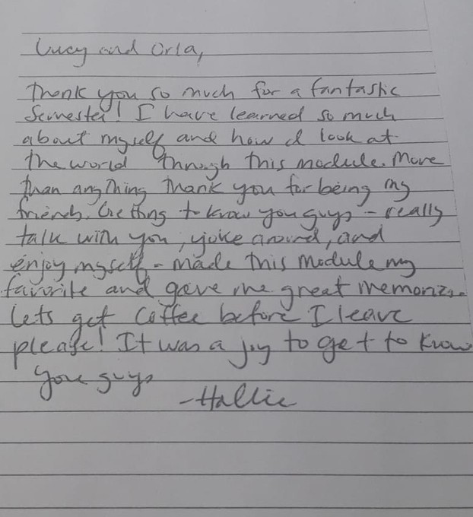
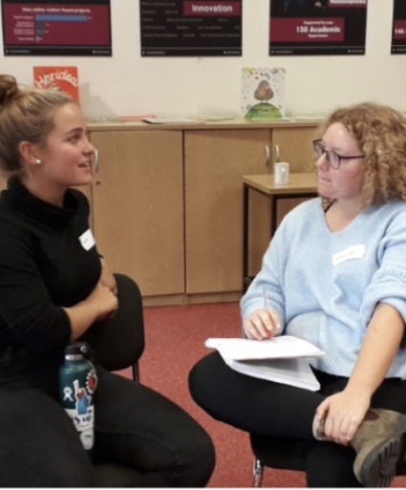
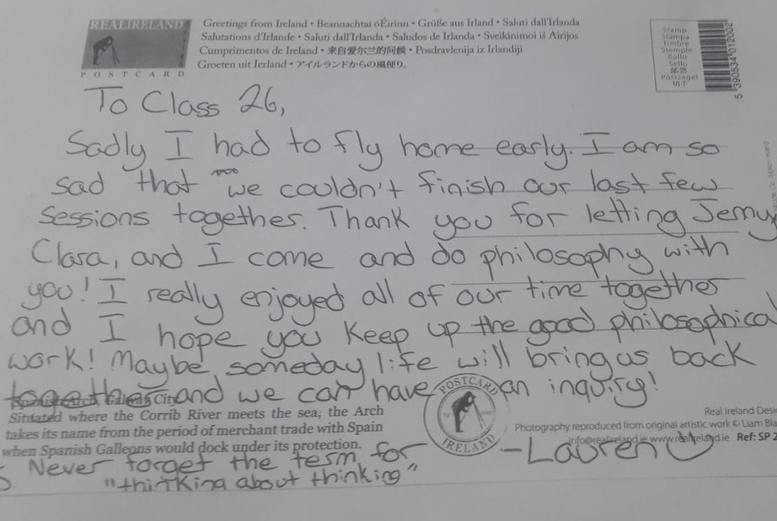
What do students say?
Hallie
Liberal Arts- Williams College
'I've just graduated summa cum laude [.....] I felt compelled to reach out and say thank you! Not only was studying at NUIG a highlight, but teaching P4C will forever hold a place in my heart.'
Lauren
Sam, Psychology Major
Georgetown
Psychology-
Trinity College

Slide 11
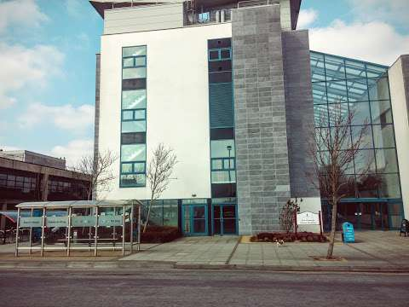
Our first live class meeting is:
Thursday (08/09/22)
9.00am -11am in Orbsen Room 214
If you want to take this module,
attendance on the first day is vital
Email for further details or if you have any questions:
Orla.Richardson@nuigalway.ie

