Slide 1
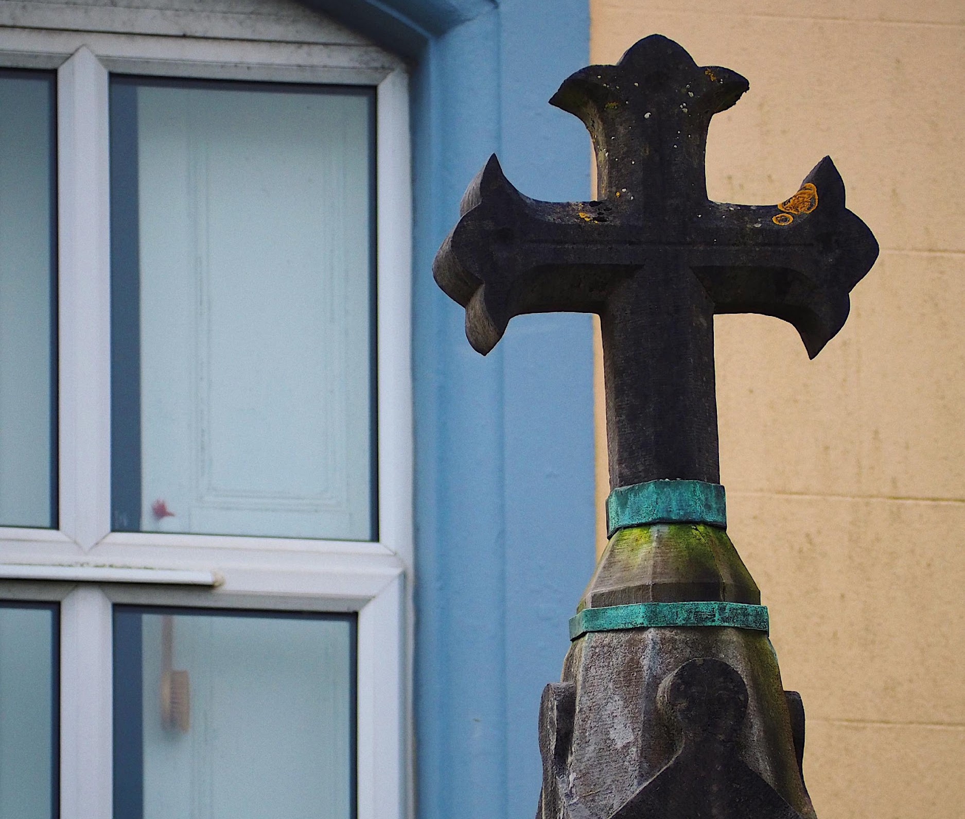
GALWAY INSTITUTIONS

Slide 2
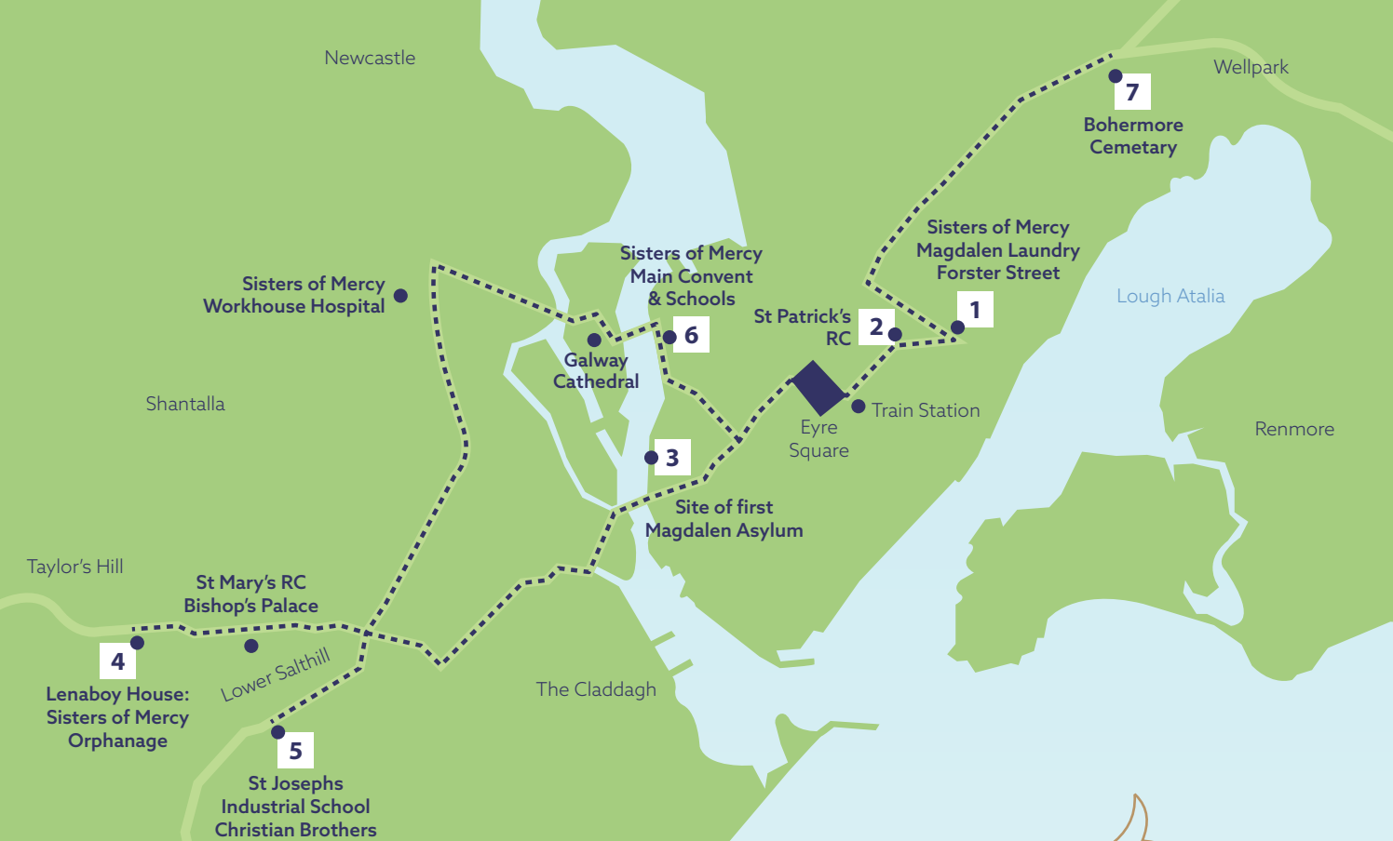
Map of the Main Sites Related to the Magdalene Laundry in Galway City in the 20th and Late 19th Centuries

Slide 3
Tuam Mother and Baby Home
2,219 women and 3,251 children
978 children died - 80% before their first birthday
The high rate of infant mortality in Tuam MBH was never discussed at GCC meetings
Notes:
Extra Information
MBH could be run by either the local health authorities or religious orders/ private institutions
Tuam was run by Galway local authorities but the Sisters of Bon Secours were responsible for the day to day running of the institution
Galway county council went against the views of the Department of Health and allowed the Sisters of the Bon Secours to keep children in the institution until they reached either five (boys) or seven (girls) years old
In 1935 a maternity unit was opened in Tuam after GCC concluded that unmarried mothers should not be allowed give birth in the Central hospital
GCC argued that the presence of unmarried mothers deterred ‘respectable’ married women
3

Slide 4
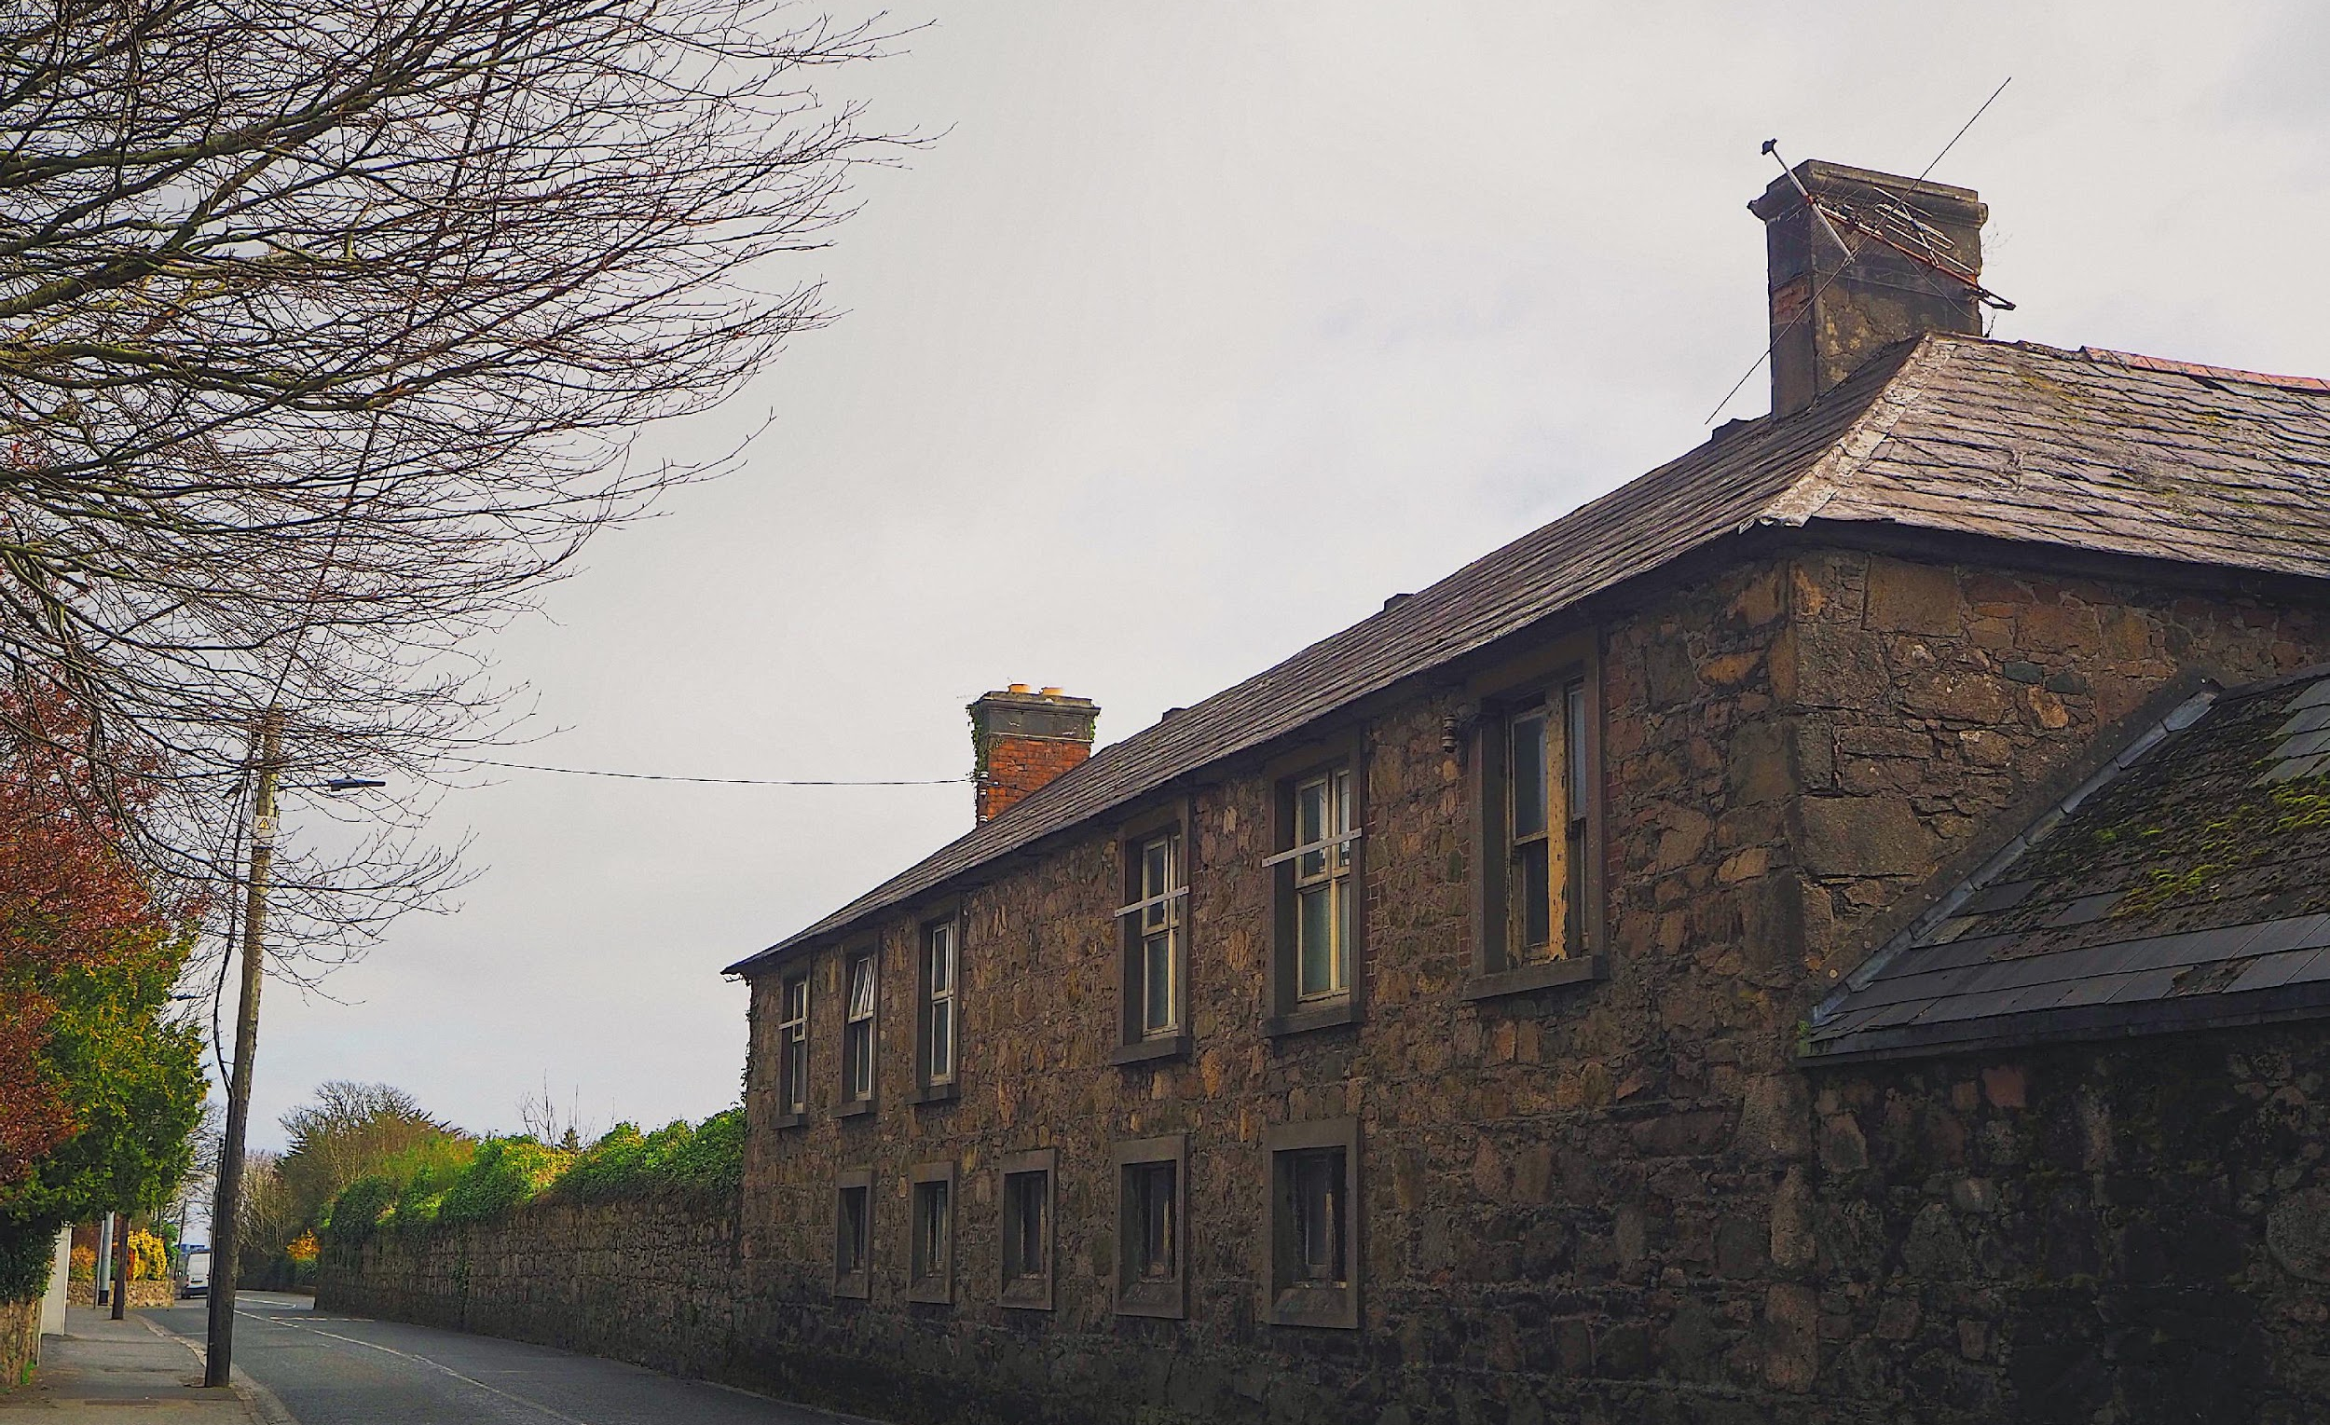
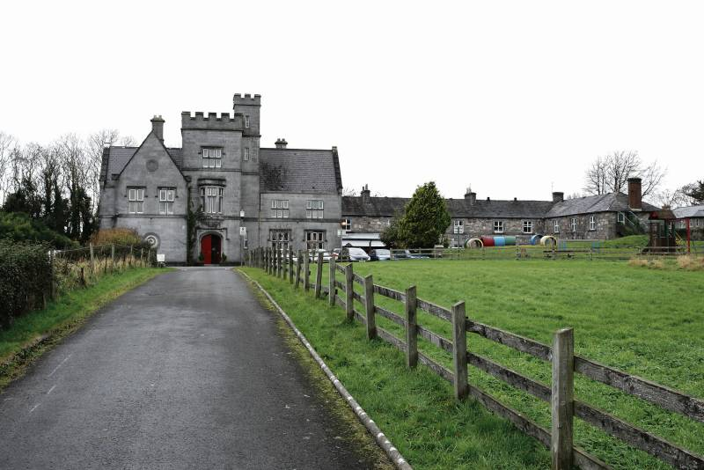
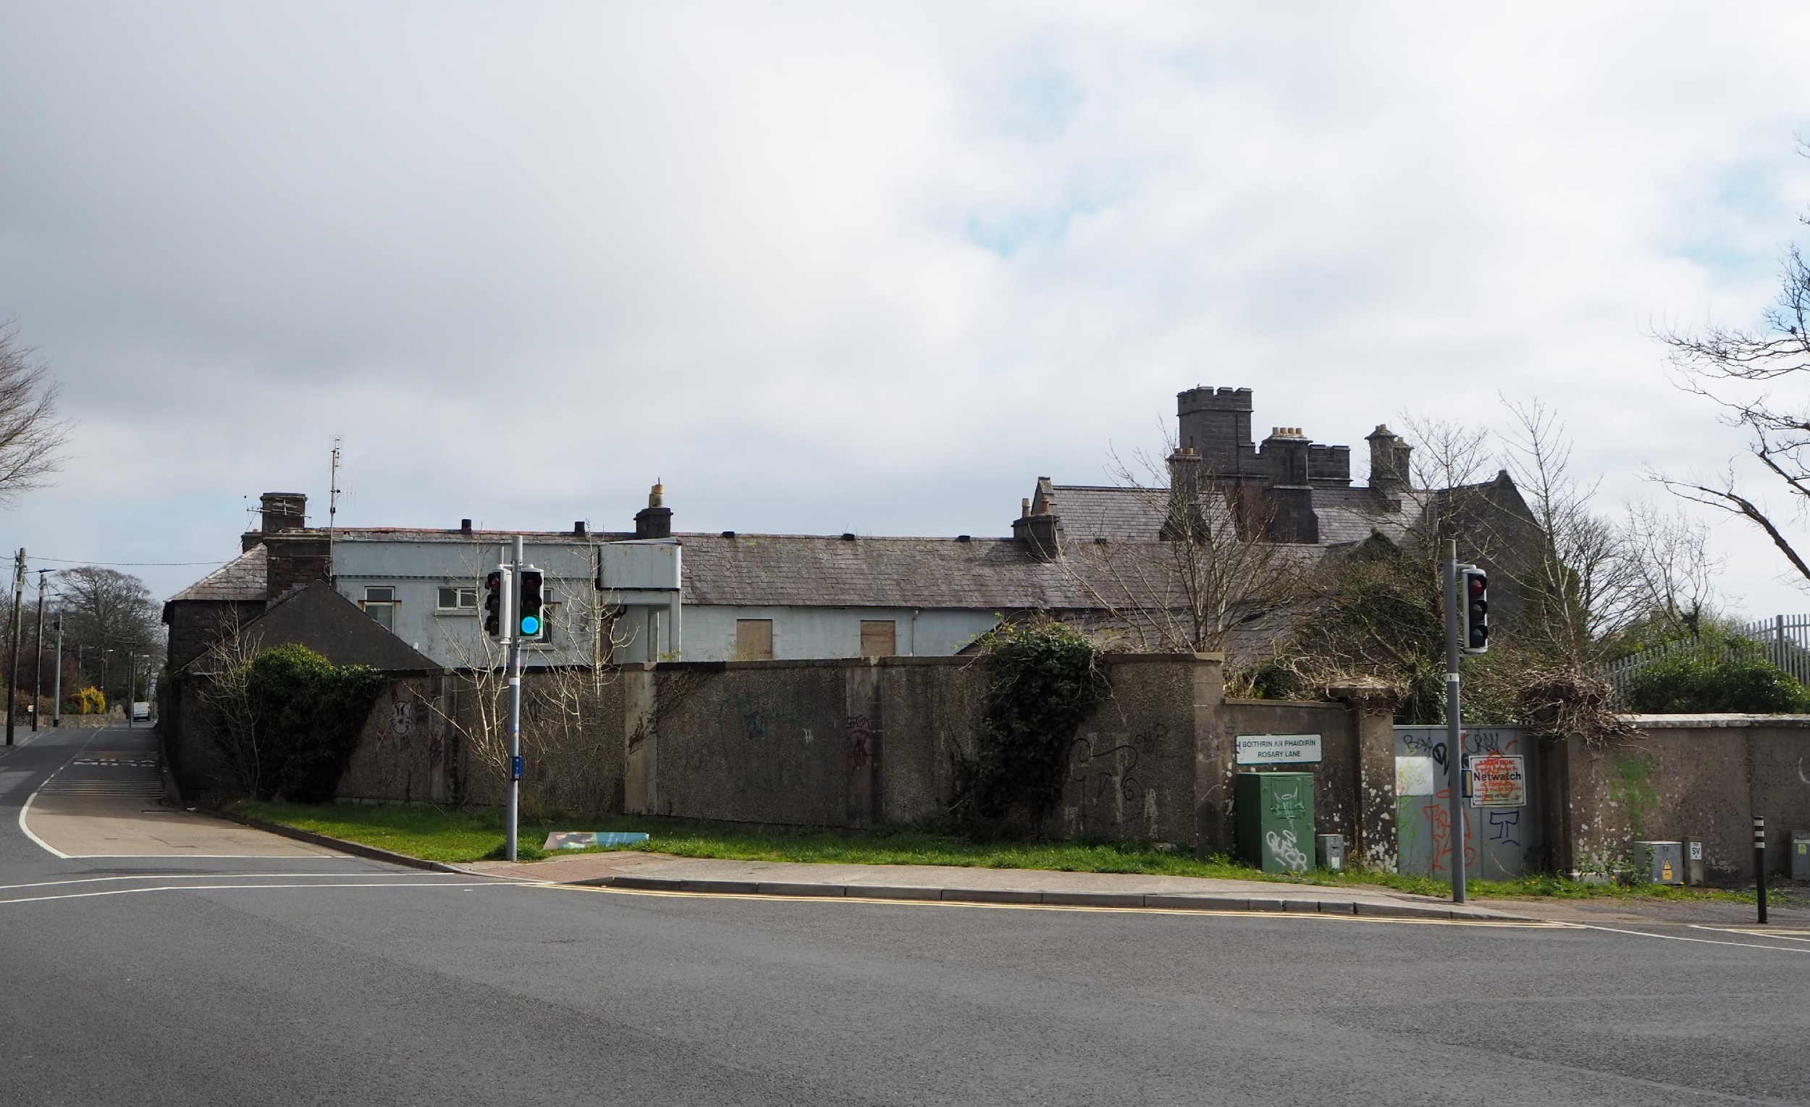
St. Anne’s Industrial School,
Taylor’s Hill, Salthill Galway

Slide 5
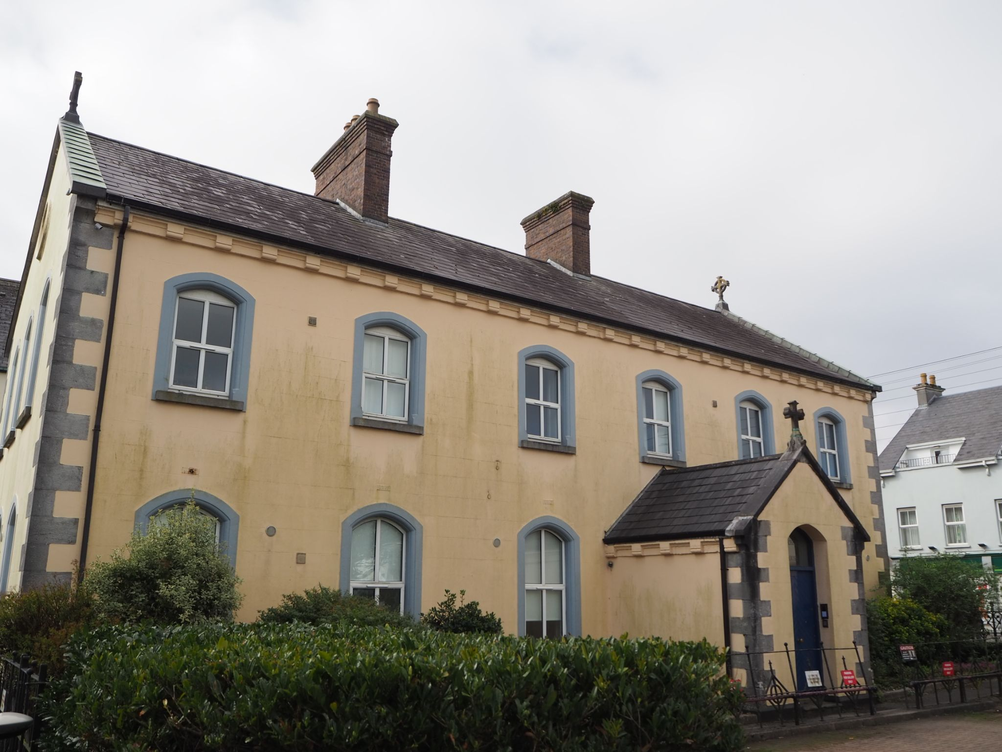
St Joseph’s Industrial School Salthill

Slide 6
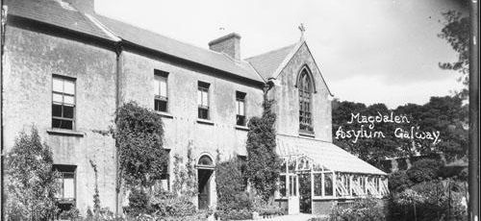
Sisters of Mercy Magdalene Laundry
The Magdalene Laundry was first established in Galway in 1824 and was managed by the Ladies of the Saint Magdalene Society. The Sisters of Mercy took over the operation of the institution in 1845, until the institution closed in 1984.
The former convent of the Sisters of Mercy Convent was given to the Galway Charity Cope, where it was renovated into a refuge for domestic violence victims.

Slide 7
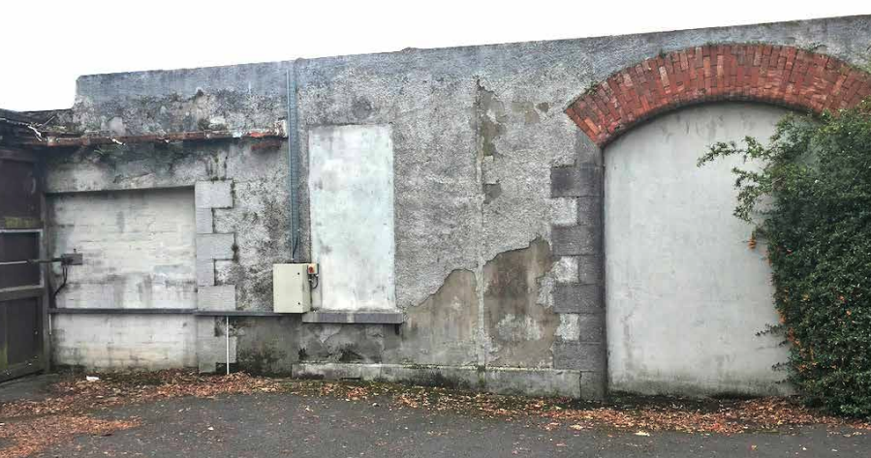
The west boundary wall of the Convent site is one of the only surviving portions of the 20th century laundry building.

Slide 8
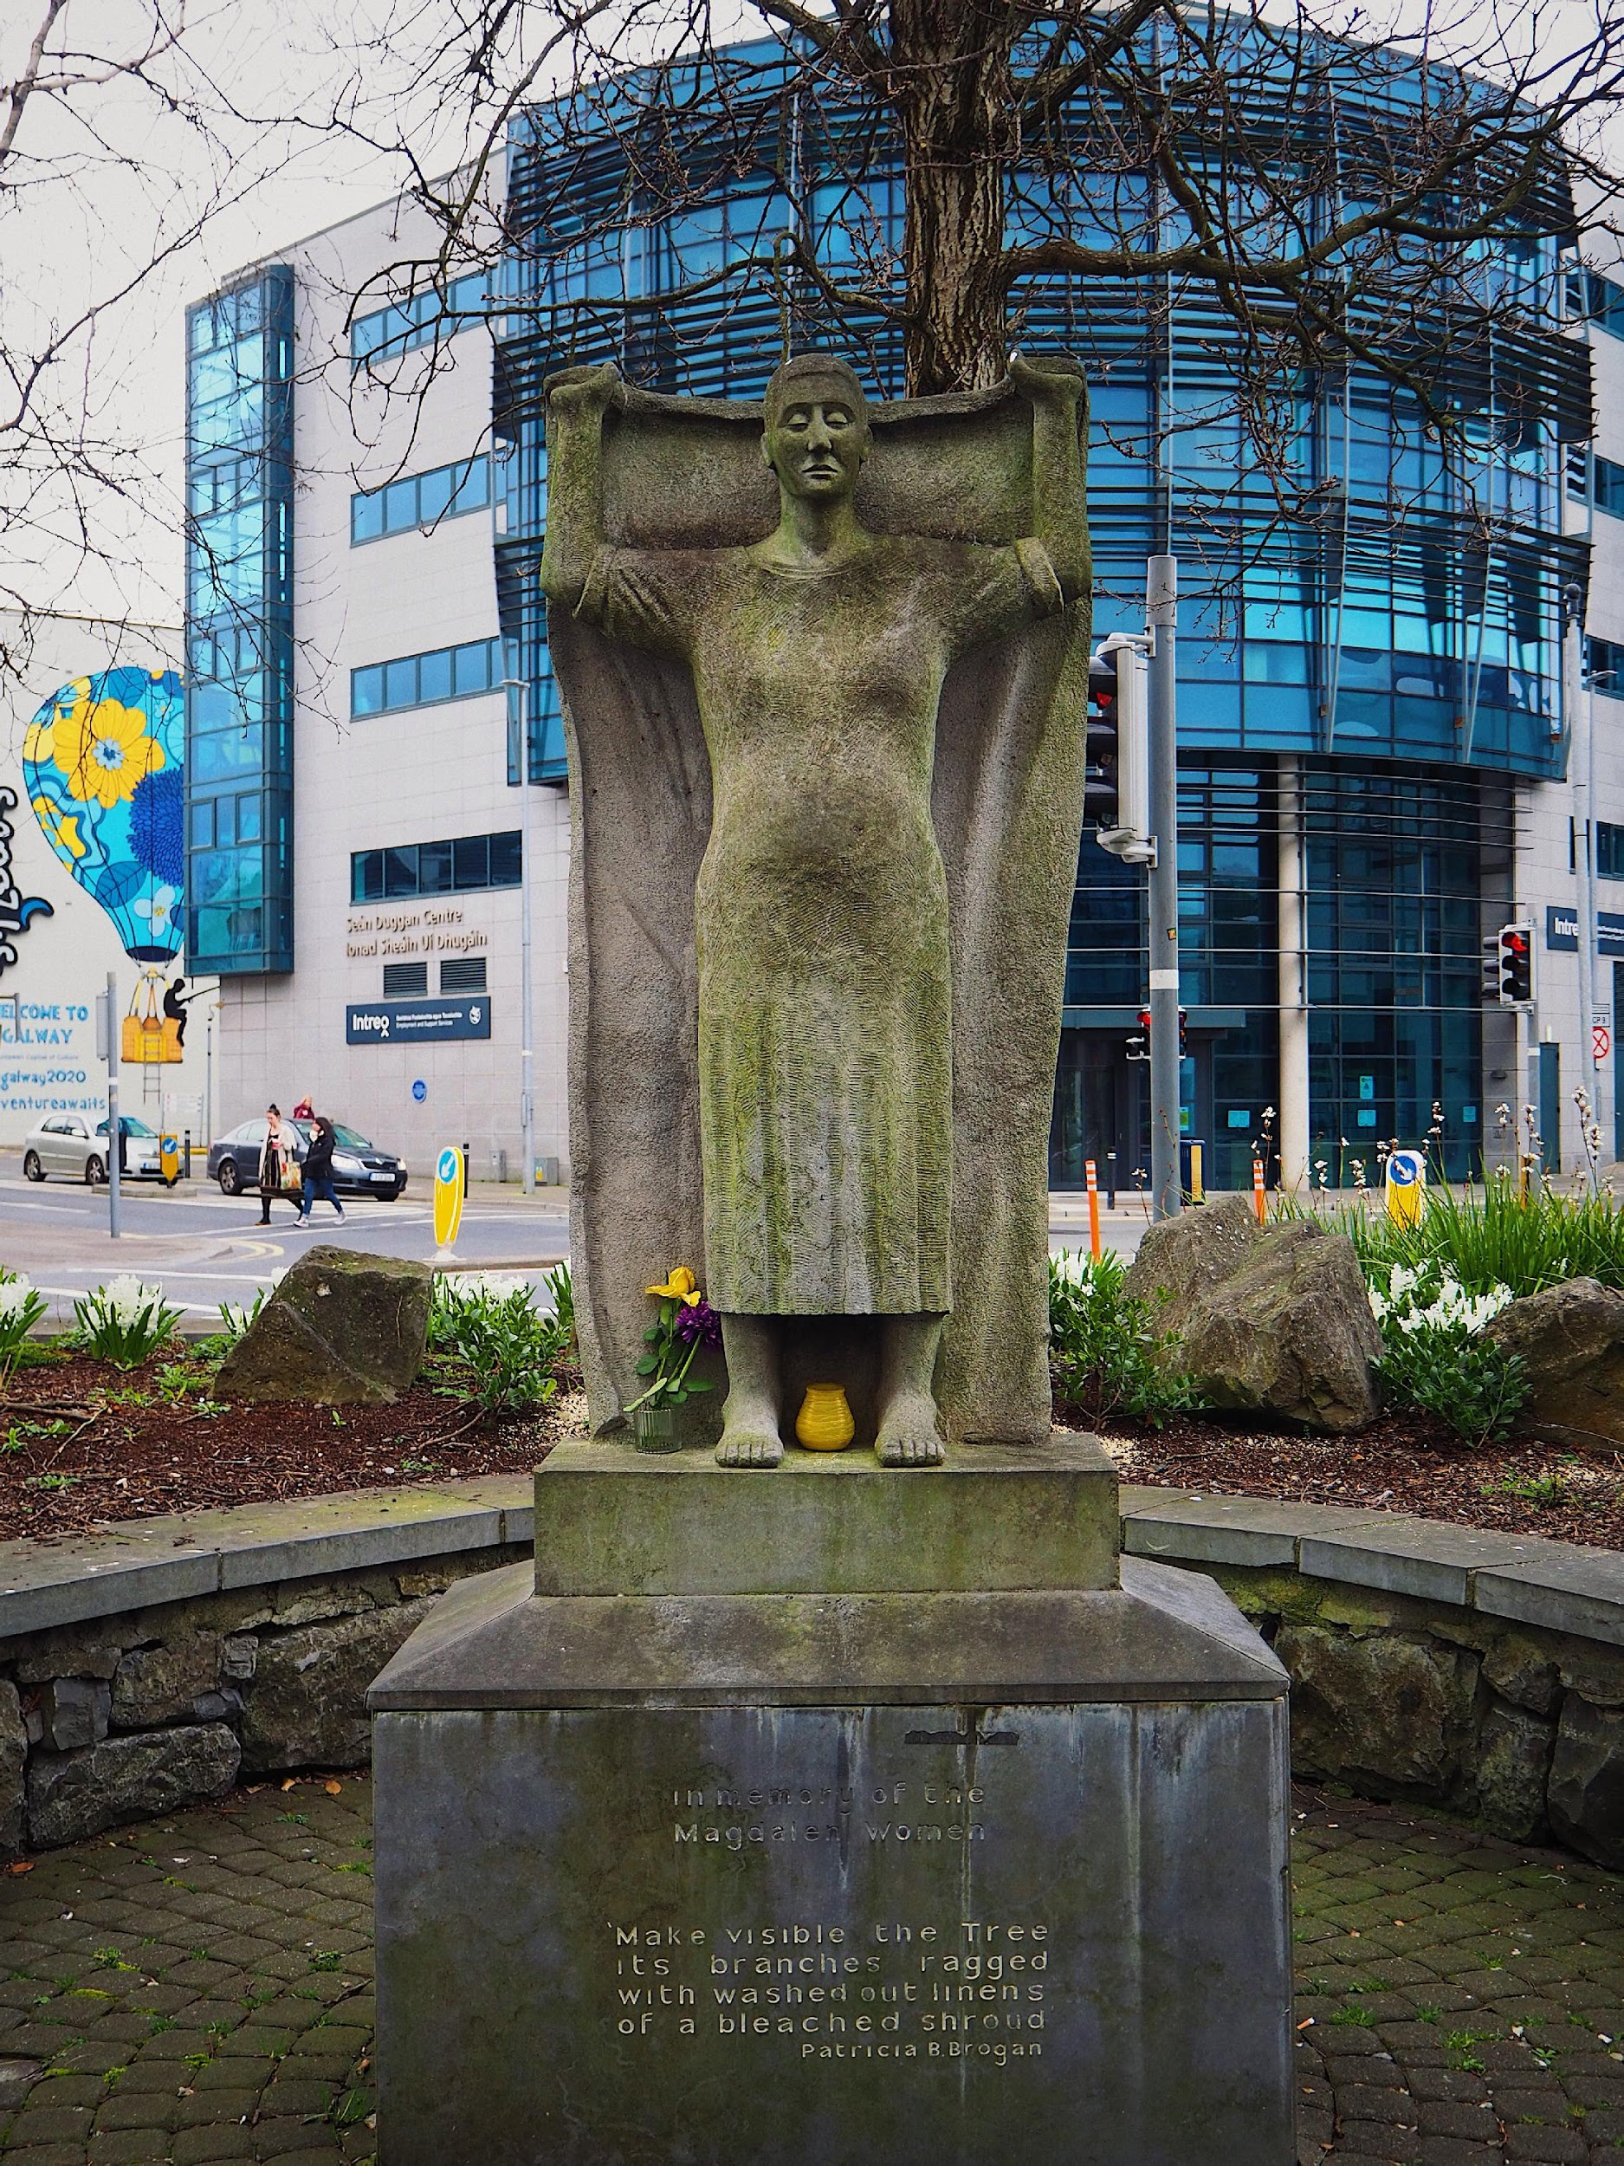
Memorial near the site of the former Galway Laundry
Poem:
In memory of the Magdalene Women
‘Make visible the tree
Its branches ragged
with washed out linens
of a bleached shroud’
Patricia Burke Brogan - 2008

