Slide 1


BASSAI
Leveraging Artificial Intelligence to Increase STEM Graduates Among Underrepresented Populations
Josette Riep, Presenter
Dr. Annu Prabhakar, Advisor
BEGIN
OUR JOURNEY
Notes:
Thank you and acknowledgements
Importance of STEM
Research – journey of discovery

Slide 2
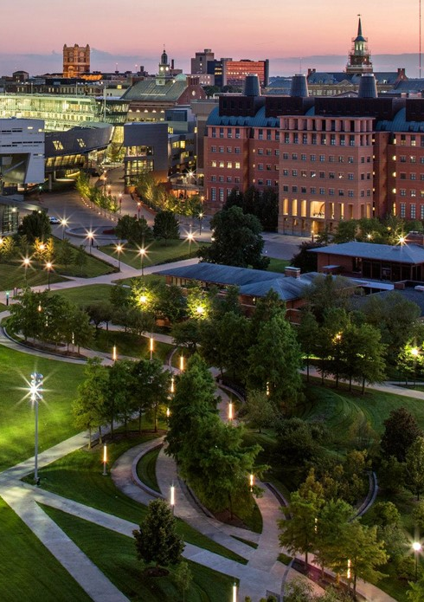

NEXT LIVES HERE
Inclusion, Impact & Innovation
46,000+ Students
Student to Faculty ratio = 16:1
R1 University
#67 among top 100 public US
#148 among National Universities
Digital Transformation
  Bearcat Promise
  Uniquely positioned to bridge the digital divide
  (embrace, empower, excel)
Notes:
Midst of the 4th industrial revolution
Combination of AI, Robotics, IOT, genetic engineering, quantum computing…
Next Lives Here – University uniquely positioned
Opportunity to bridge divide (embrace, empower, excel)

Slide 3
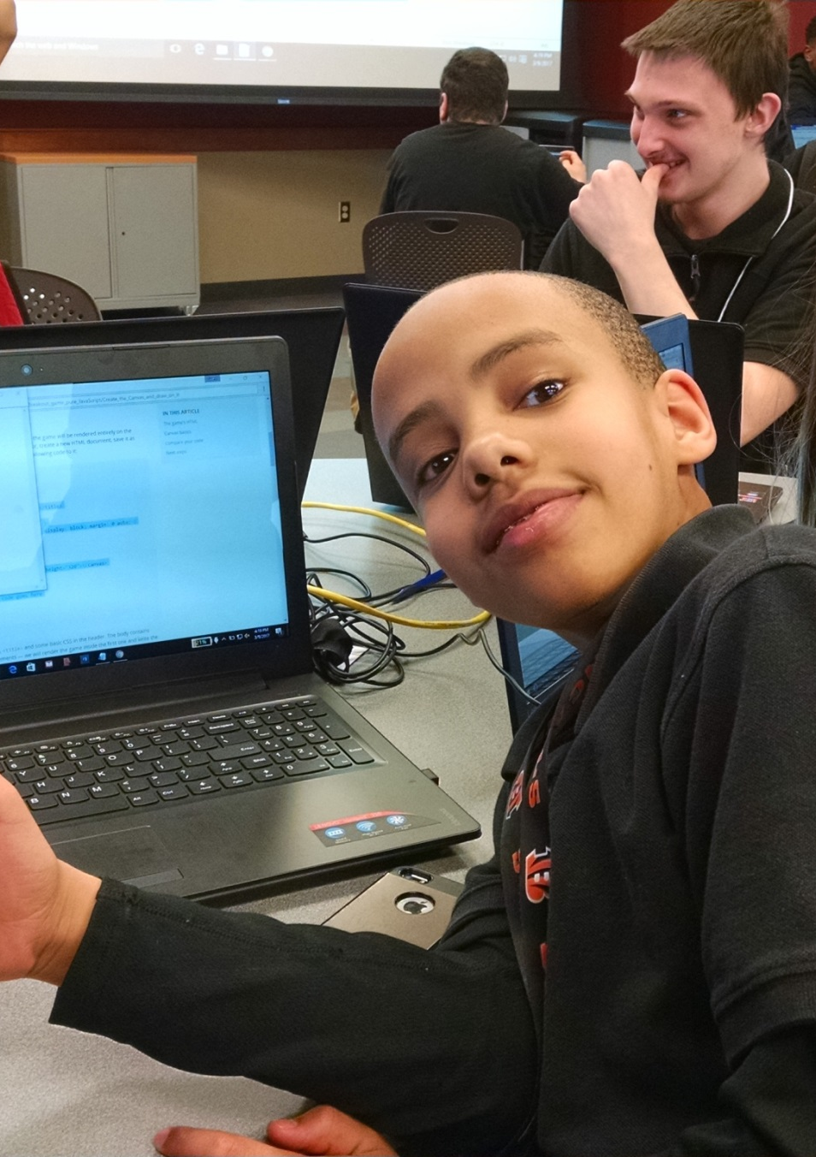
THE WHY
We have a unique opportunity to bridge the digital divide and ensure that otherwise unrecognized talent is embraced in a manner that empowers communities and enables regions to excel..
Notes:
Midst of the 4th industrial revolution
Combination of AI, Robotics, IOT, genetic engineering, quantum computing…
Next Lives Here – University uniquely positioned
Opportunity to bridge divide (embrace, empower, excel)

Slide 4
STATE OF AIML
Industry Wide | Higher Education
91.5% of leading businesses invest in AI | AI in the Education Market size exceeded $1 billion in 2020.
97 million specialists needed in the AI industry by 2025 | Expected to grow by more than 40% between 2021 and 2027.
Global AI market value is expected to reach $267 billion by 2027. | As of 2020 only a minority of universities had an established AI strategy.
15.7 trillion influx into the global economy by 2030. | Most prevalent use of AI in Higher Ed is associated with academic integrity (plagiarism, proctoring).
Elimination of 85 million jobs and create 97 million new ones by 2025. | 36% of Educause surveyed institutions use DAs and Chatbots. An additional 17% were either in planning or early implementation.
37% of businesses and organizations employ AI | 22% of Educause surveyed institutions leverage AI for student success (academically at risk, early warnings).
2018 Gartner report predicted that through 2030, 85% of AI projects will provide false results caused by bias | Limited interest in leveraging AI for institutional activities such as curriculum planning.
BACKGROUND
STAT

Slide 5
Examples of AI BIAS
System | Description
COMPAS (Correctional Offender Management Profiling for Alternative Sanctions) | Used in the USA to predict which criminals are more likely to re-offend in the future.
97 million specialists needed in the AI industry by 2025 | Predict where crimes will occur in the future based on the crime data collected by the police such as the arrest counts, number of police calls in a place, etc.
Amazon’s Recruiting Engine – Biased against Women | Created to analyze the resumes of job applicants applying to Amazon and decide which ones would be called for further interviews and selection.
Google Photos Algorithm - Biases against black people | Found to be racist when it labeled the photos of a black software developer and his friend as gorillas.
Healthcare | An algorithm used on more than 200 million people in US hospitals to predict which patients would likely need extra medical care heavily favored white patients over black patients.
BACKGROUND
STAT

Slide 6
Reasons for Bias in AI
Limited (not enough) training data.
Bias introduced by humans developing algorithms.
Inability to extract bias from historically-biased data.
Lack of diversity in the AI workspace.
Lack of audits/review (i.e., AI fairness frameworks/toolkits).
BACKGROUND
STAT

Slide 7
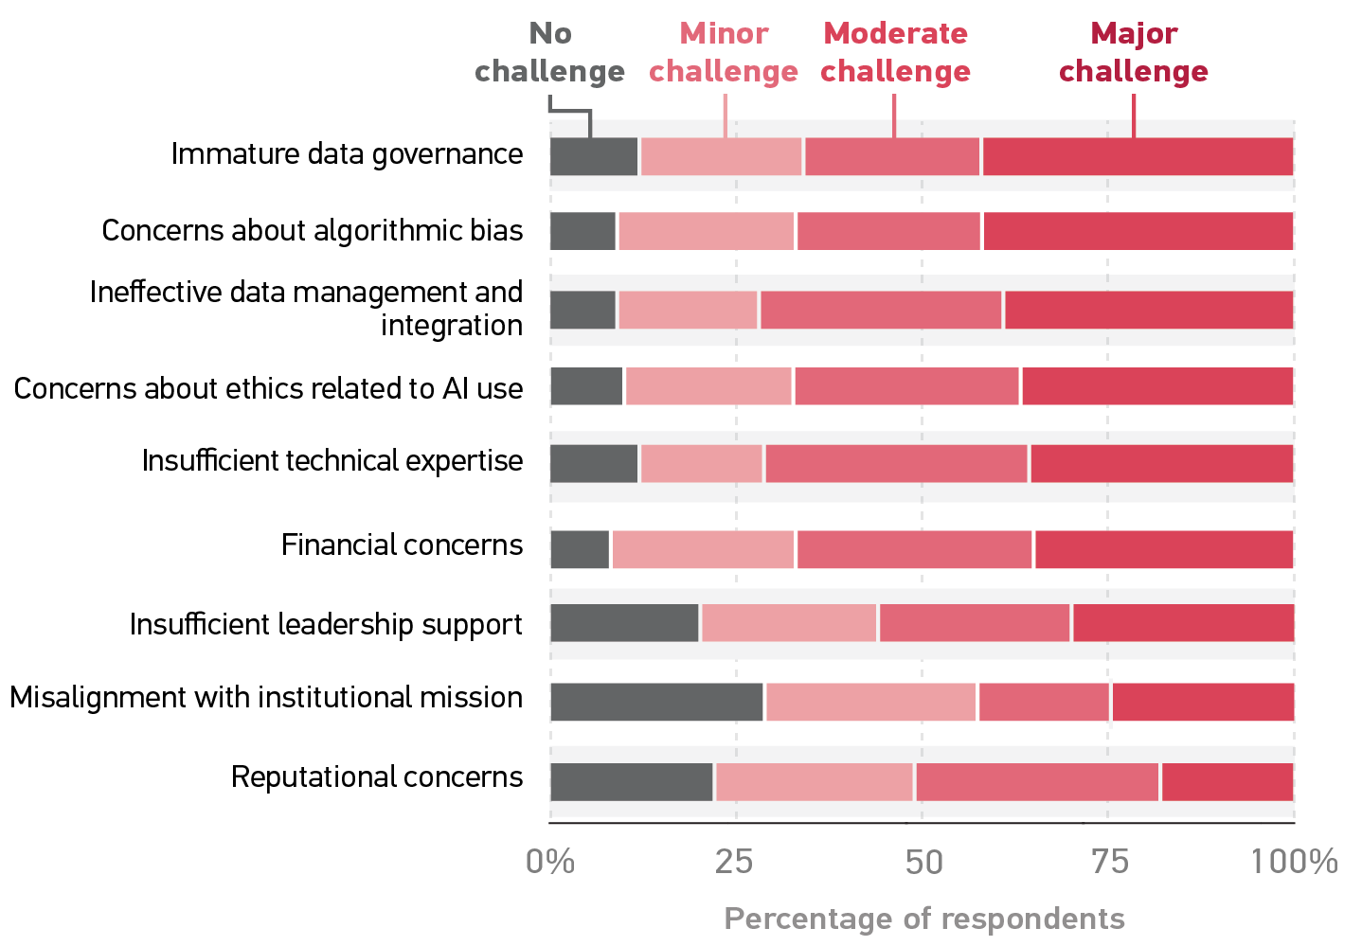
Challenges in Higher Ed AI Adoption
BACKGROUND
STAT
Educause Survey Results 2021

Slide 8
AI Opportunities in Higher Ed
Recruitment
Admissions & onboarding process
Retention
Support/augmentation of resources for faculty
Curriculum augmentation (online tools such as Alex)
Academic monitoring - student success
BACKGROUND
STAT
Educause Survey Results 2021

Slide 9

STEM CASE STUDY
OVERVIEW
LITERATURE REVIEW
METHODS
MODEL DESIGN
FINDINGS
NEXT STEPS
Independence all rights reserved © 2020

Slide 10
ABSTRACT
Higher educational institutions are challenged with producing enough STEM graduates to keep pace with the growing demand in STEM related fields.
This study focuses on leveraging Artificial Intelligence and Machine Learning (AIML) to better understand barriers to success, personalize student experiences, and provide pathways of graduation attainment for African Americans.
OVERVIEW
STAT

Slide 11
Computer & Information Technology Projections 2019 - 2029
DATA FACTS
100%
OVERVIEW
IT remains one of the fastest-growing and most segregated professions.
Since 1990 STEM occupations have significantly outgrown overall job growth.
59%
15%
11%
3.7%
All
IT
IT Research Science
SOURCE: U.S. BUREAU OF LABOR STATISTICS

Slide 12
 | Decline in Year to Year Growth
 | White | Black | Hispanic | Asian
2011 | 16,205 | 3,982 | 5,121 | 1,828
2012 | 9,338 | 3,991 | 4,581 | 2,167
2013 | 14,325 | -10 | 3,468 | 2,209
2014 | 3,589 | 706 | 3,753 | 3,325
2015 | 11,345 | 1,745 | 5,089 | 2,093
2016 | 5,364 | 1,305 | 5,585 | 3,105
2017 | 4,051 | -2,238 | 4,136 | 4,332
DATA FACTS
The annual growth of STEM graduates is alarmingly small.
African Americans show the smallest annual growth.
Alarmingly, African Americans are the only group to show a decrease in STEM graduates year to year.
Overall, the trend in STEM graduates is heading in the wrong direction.
OVERVIEW
SOURCE: NATIONAL CENTER FOR EDUCATIONAL STATISTICS

Slide 13
 | Decline in Year to Year Growth
 | White | Black | Hispanic | Asian
2011 | 16,205 | 3,982 | 5,121 | 1,828
2012 | 9,338 | 3,991 | 4,581 | 2,167
2013 | 14,325 | -10 | 3,468 | 2,209
2014 | 3,589 | 706 | 3,753 | 3,325
2015 | 11,345 | 1,745 | 5,089 | 2,093
2016 | 5,364 | 1,305 | 5,585 | 3,105
2017 | 4,051 | -2,238 | 4,136 | 4,332
OVERVIEW
SOURCE: NATIONAL CENTER FOR EDUCATIONAL STATISTICS

Slide 14
DATA FACTS
Employment in computer and information technology occupations is projected to grow 11% from 2019 to 2029.
The growth of IT far exceeds the average for all jobs.
OVERVIEW
SOURCE: NATIONAL CENTER FOR EDUCATIONAL STATISTICS

Slide 15
AFRICAN AMERICANS & STEM
Rural and Urban Technology Deserts
35.3% Computer Science Majors Exit Post-Secondary Education
OVERVIEW
44% of Engineering Majors Exit Post-Secondary Education
Less than 5% of the IT workforce
Notes:
Key indicators of challenges:
Digital divide impacting rural and urban
Number of students who exist T&E
Low representation in the workforce

Slide 16

AFRICAN AMERICANS & STEM
HARVARD
1636
Establishment of 1st US University
TIME LINE
1ST HBCU
Cheney was established as the 1st HBCU in Pennsylvania. Focus on secondary education.
1837
1896
OVERVIEW
SEPARATE
Separate but equal law necessitated growth of HBCUs and government funding.
1964
INNOVATION AGE
STEM graduation rates and employment for African Americans significantly low
10+ Million Jobs in STEM
TITLE VI
2021
The Civil Rights Act and Title VI invalidated separate but equal and over the next several decades desegregation initiatives occurred glacially.
1.1 Million jobs in STEM
Notes:
In order to understand challenges, historical context is important:
First school in US 385 years ago
African Americans excluded on scale
1st HBCU 1837 (initial emphasis on secondary edu until mid 1800s)
1900s separate but equal expansion of HBCUs (1950s 40k+ students) – GI Bill(1944) excluded AA
1960s – civil rights and title VI – challenges with enforcement for decades
2021 – massive growth in STEM and entire generations excluded (HBCU 3% , 27% stem grads)

Slide 17
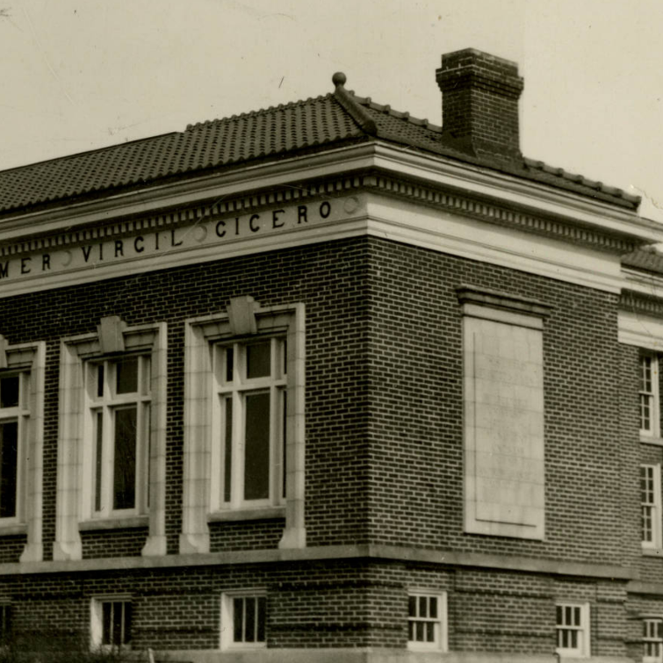
HBCU SUCCESS
3% of colleges in universities in the United States
27% of African American STEM graduates
Holistic approach to education
Focus on providing access and opportunity to African Americans
High-need student mentoring program
The Faculty in Residence (FIR) program
OVERVIEW
Wilberforce

Slide 18

RACIAL TRAUMA
RACIAL BATTLE FATIGUE STUDY
Overt and implicit forms of racism and bias
400 African American, Hispanic and Latino student participants
Findings from Franklin’s racial battle fatigue study showed the majority of students were mistreated, excluded, or witnessed discrimination
Increase in negative behavioural activities including sleep deprivation, procrastination, and poor eating habits
OVERVIEW
Find Me

Slide 19

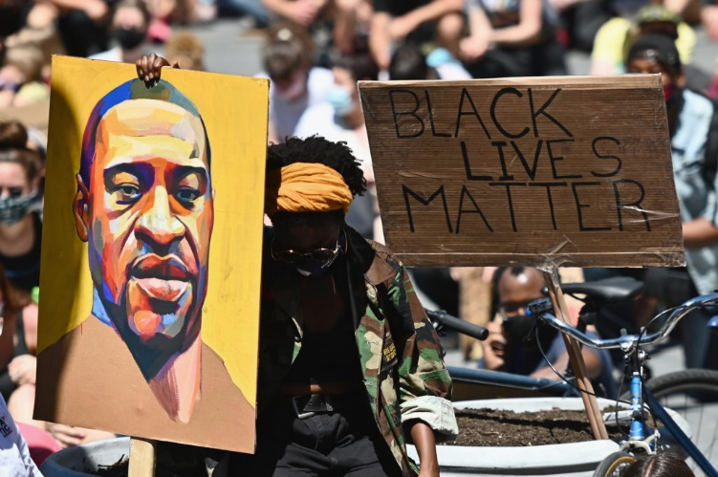



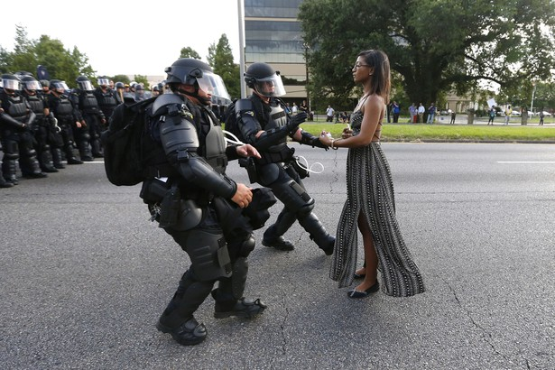

BLACK LIVES MATTER
Impact of societal barriers and generational fight for justice cannot be discarded. It matters!
?
Independence all rights reserved © 2020
Notes:
Generational battles for equity and centuries of racial trauma
Cannot underestimate impact
Social media has provided more visibility to longstanding trauma
Holistic approach (not just academic focus) required

Slide 20

RESEARCH QUESTION
What factors contribute toward better graduation outcomes for African American students?
How can artificial intelligence (AI) be used to identify success patterns that ultimately help African Americans overcome barriers to graduation?
?
Independence all rights reserved © 2020

Slide 21
LITERATURE REVIEW
WORKS
Summary and assessment of related works
START

Slide 22

DATA FACTS
Research has identified many contributors to the lack of STEM graduates including:
Perceived lack of interest in STEM programs
Less than successful college recruitment strategies
Lack of finances
Unidentified or unaddressed skills gaps
Inability to fully engage in the higher education experience
LITERATURE

Slide 23
DATA FACTS
Research has also shown that a significant number of African American students who pursue a STEM degree either change majors or drop out. Data supports evidence of what some call the invisible wall that generally occurs during the 3rd – 5th of year of study.
LITERATURE
 | Left PSE with no degree | Total switched | Total persisted | Total
 | (%) | (%) | (%)
Race/ethnicity = Black or African American
Estimates
Time of entrance into STEM field
Entered STEM | 35.1 | 37.4 | 27.5 | 100%
Time of entrance into mathematics field
Entered MATH | ‡ | ‡ | ‡ | 100%
Time of entrance into physical science field
Entered PHY | 48.5 | 33.8 | 17.8 ! | 100%
Time of entrance into biological/life science field
Entered BIO | 21.7 | 44.2 | 34.1 | 100%
Time of entrance into engineering/technology science field
Entered ENG | 44.3 | 25.3 | 30.4 | 100%
Time of entrance into computer/information science field
Entered COMP | 35.3 | 36.7 | 28 | 100%
SOURCE: NATIONAL CENTER FOR EDUCATIONAL STATISTICS
Notes:
White: 50 (eng) 36 (comp)

Slide 24
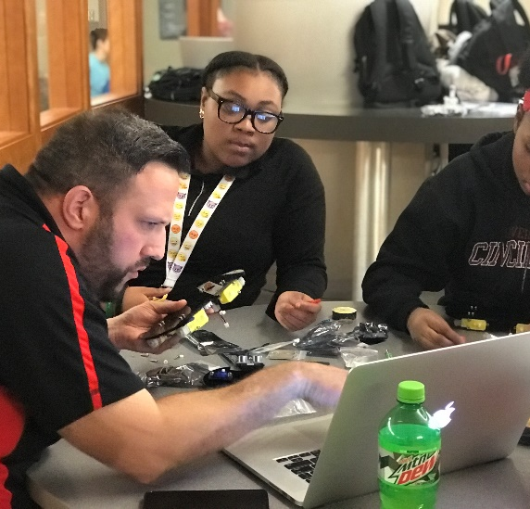
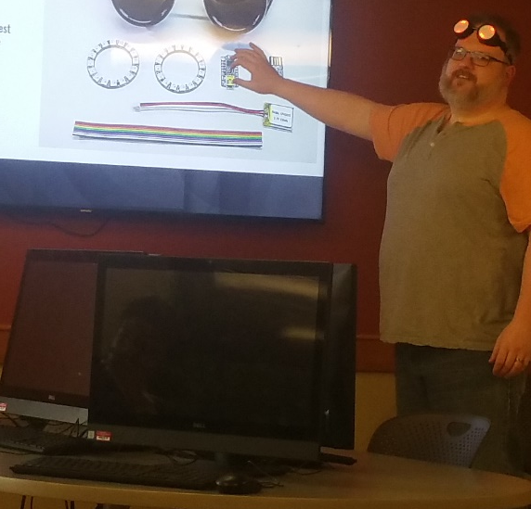
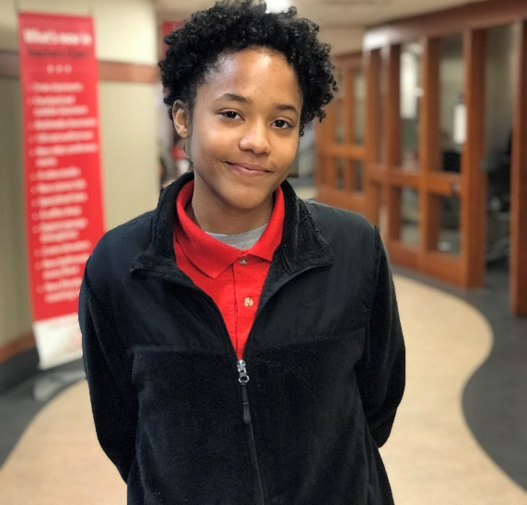
RELATED WORKS
Some studies have shown glimpses of success through a variety of initiatives including:
MENTORING
PARTNERSHIPS
INTERNSHIPS / CO-OPS
Successful STEM Mentoring Initiatives for Underrepresented Students provides a series of case studies on the advantages of mentoring programs
Methods including AI-driven adaptive learning may provide pathways to successfully increase the number of African American STEM graduates.
Notes:
Mentoring, public private partnerships and internships all documented as having some level of impact
Metrics still have not changed significantly
Challenges with scaling resource intensive programs and activities

Slide 25
RELATED WORKS
There have been many applications of AI within higher education. Researchers in 2019 highlighted hundreds of higher-education focused AI implementations that span several core areas including:
Intelligent tutoring systems (ITS)
Adaptive group formations for collaboration
Intelligent virtual reality
Example: Pounce at GSU addressed the Summer Melt for underrepresented students leveraging AI
Notes:
ITS have been around for some time and gaining popularity in many areas
Ex: ALEK (math tutoring module)
Use of VR has been documented in example studies
GSU example (pounce successfully leveraged conversational tech & AI reduce summer melt)
18% summer melt challenge
3700 student participants with only 6.6 Opting out of the program. 21% reduction in failed summer matriculation.
Getting students in the door is key, now the challenge is how to we keep them there and ensure success.

Slide 26
METHODS & DATA
METHODS
Research methodology & longitudinal study data
START

Slide 27
This research is a quantitative study that utilizes educational data provided by NCES (National Center for Educational Statistics)
Data source: Beginning College Students
2011 - 2017
Traditional & Non-traditional
29,070 - 22,540 Full Respondents
80+ Categories
Surveyed 3 times over 6 years
Transcripts & Other Institutional Data
Includes College/High School Info
1,970 institutions
  Source: https://nces.ed.gov/pubs2020/2020522.pdf

Slide 28
STEM ENROLLMENT BY RACE
HIGHEST
SUMMARY OF FULL RESPONDENTS
The data consists of over 22,500 full responses spanning 6 years. The four highest populations by race include White, Black, Hispanic and Asian. White student representation is significantly higher than other populations. 4,240 or 18% of the over 22,500 full respondents selected a STEM related program.
22% 19.8% 19.7% 39%

Slide 29
NCES STUDY DATA CATEGORIES
Attendance and enrollment Certification Demographic characteristics Disabilities & Health Education: Attainment Education: Attendance Education: Courses Education: Experiences Education: Graduate Education: Majors Education: Program Education: Services Education: Tests Education: Transfer Educational expectations Employment Employment: Benefits Employment: Description Employment: Employer | Employment: Future Employment: History Employment: Satisfaction Employment: Search Employment: Status Family Family: Finances Finances Finances: Assets Finances: Debt education Finances: Debt other Finances: Expenses Finances: Income Finances: Support Financial aid Financial aid type Financial aid: Application Financial aid: Borrowed cumulative Financial aid: Debt and repayment | Financial aid: Direct Loans Financial aid: Federal Financial aid: Federal grants Financial aid: Federal loans Financial aid: Graduate Financial aid: Grants Financial aid: Institutional Financial aid: Loans Financial aid: Need Financial aid: Net price Financial aid: Other Financial aid: Package Financial aid: Perkins Financial aid: Private loans Financial aid: Ratios Financial aid: Stafford Financial aid: State Financial aid: Total Financial aid: Work study High school Institution price | Institution type Institution: expenses Institution: location Institutional characteristics Language Occupational code Parent and family: Support Parents and family Postbaccalaureate education Pre-k-12 teaching: Entrance Pre-k-12 teaching: Exiting Pre-k-12 teaching: Experiences Pre-k-12 teaching: Qualifications Pre-k-12 teaching: Subject taught Public service participation Student's characteristics Student's family Teaching experiences Undergraduate education
HIGHEST

Slide 30
STUDY PROCESS
Data Analysis
Summaries & Visualization
Modeling & Classification
Data Preparation – Synthetic Data
Insights
& Predictive Analytics
HIGHEST
PREDICTIVE ANALYSIS USING AI/ML

Slide 31
SYNTHETIC DATA
Information is created leveraging algorithms that mimic real world information.
Leveraged as a substitute for low level information where information is not accessible.
METHOD
Supports adherence to security requirements and limits the need to share private information.
Examples Uses of Synthetic Data:
Financial predictions (origin)
SYNC Framework by Cornell
MIT Synthetic Data Vault

Slide 32


CLASSIFICATION PROCESS
HIGHEST
Testing
Synthetic Data Generator
Available
Summary Data
Synthetic Data
Training
Prediction Analysis/Output
Inspect/Validate
AIML
Synthetic Data Generation
Data Classification

Slide 33
MODEL DESIGN
MODEL
Model assessment, selection and design
START

Slide 34
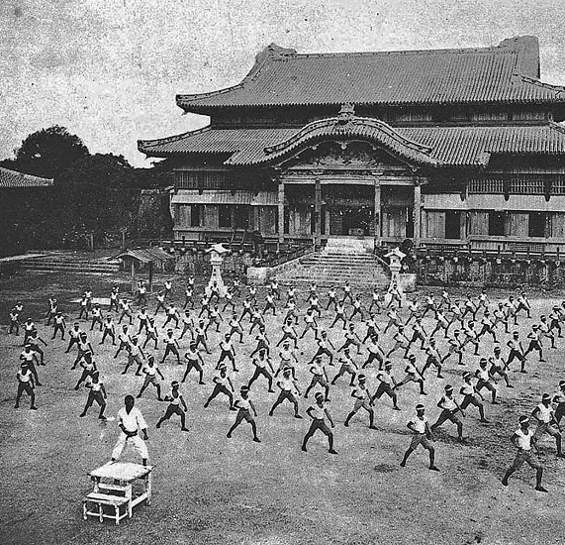
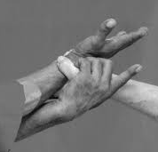
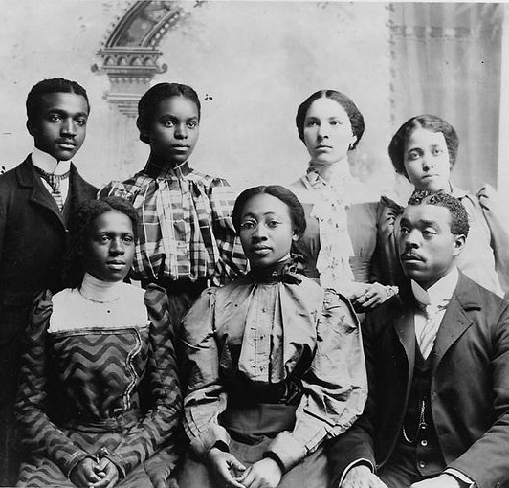
BASSAI
Bias Aware Services Supported Through Artificial Intelligence
HISTORY
TRANSLATION
CONTEXT
INSERT NAME
This research focuses on identifying barriers that contribute to historical and present-day inequities in STEM enrollment and graduation attainment. BASSAI encompasses aspirational research, tools and methodologies that enable students to break through historical barriers by identifying success factors and building innovative support interventions using AI.
Notes:
History:
Bassai one of the oldest Kata in MA.
Transcends many styles and nationalities (Japan, Korea, Okinawa, pieces from China)
Series of self defense moves and techniques (implementation varies by style and person)
Taught in Okinawa by Matsumura and Shorin temple
Oppressed by Japan and later by US (no weapons)
Katas practiced to defend king
Translation – Breaking the Enemy Fortress (breaking holds, traps, etc.)
Context
Oppressed people finding ways to break barriers = AA Experience
To Break barriers in STEM – looking or combinations, series of techniques

Slide 35
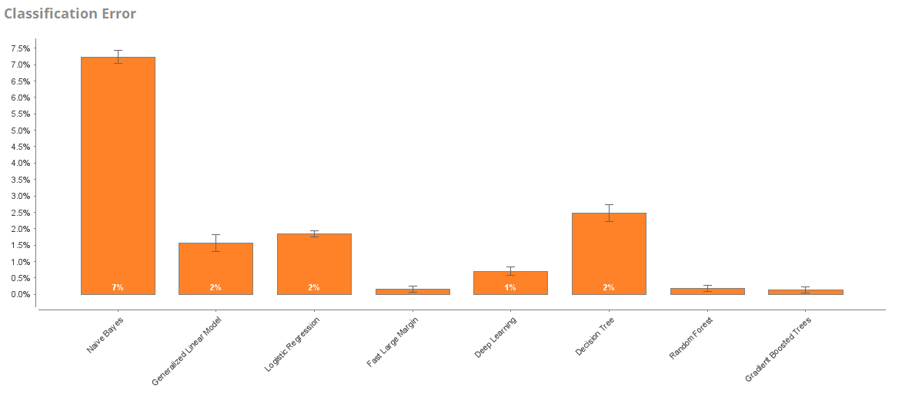
BASSAI
Initial Modeling Results
HIGHEST
Notes:
In order to find the optimal model
Leveraged Data and tested against multiple supervised method
Identify top performers based on classification error and accuracy

Slide 36
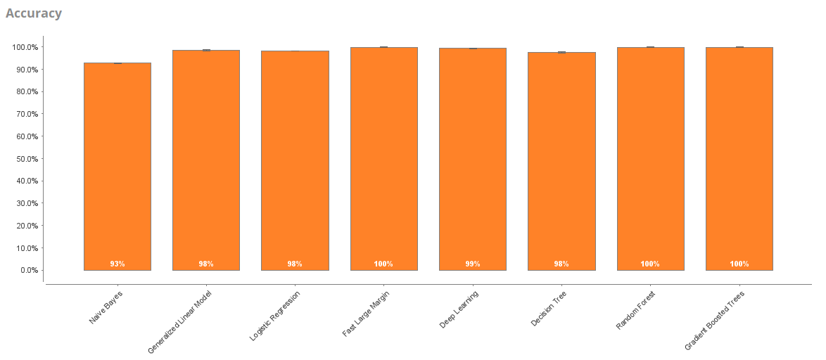
BASSAI
Initial Modeling Results
HIGHEST

Slide 37
BASSAI
HIGHEST
LOGISTIC REGRESSION
Supervised learning model best used to predict binary outcomes. Input values are combined linearly using weights.
 | MODEL ACCURACY | CLASSIFICATION ERROR | CLASS PRECISION (BACHELORS)
LOGISTIC REGRESSION | 98.20% | 1.80% | 99.89%
GRADIENT BOOSTING | 99.90% | 0.10% | 100%
RANDOM FOREST | 99.80% | 0.20% | 100%
GRADIENT BOOSTED TREES
Tree model that strengthens the accuracy of decision trees by creating a series of weaker decision trees that build upon one another with the goal being that each successive tree becomes a stronger predictor of outcomes.
RANDOM FOREST
Ensemble tree model consisting of independent trees created using varying subsets of training data. The independence is a key feature of this model. Strong candidate to address population dominance and model bias.

Slide 38
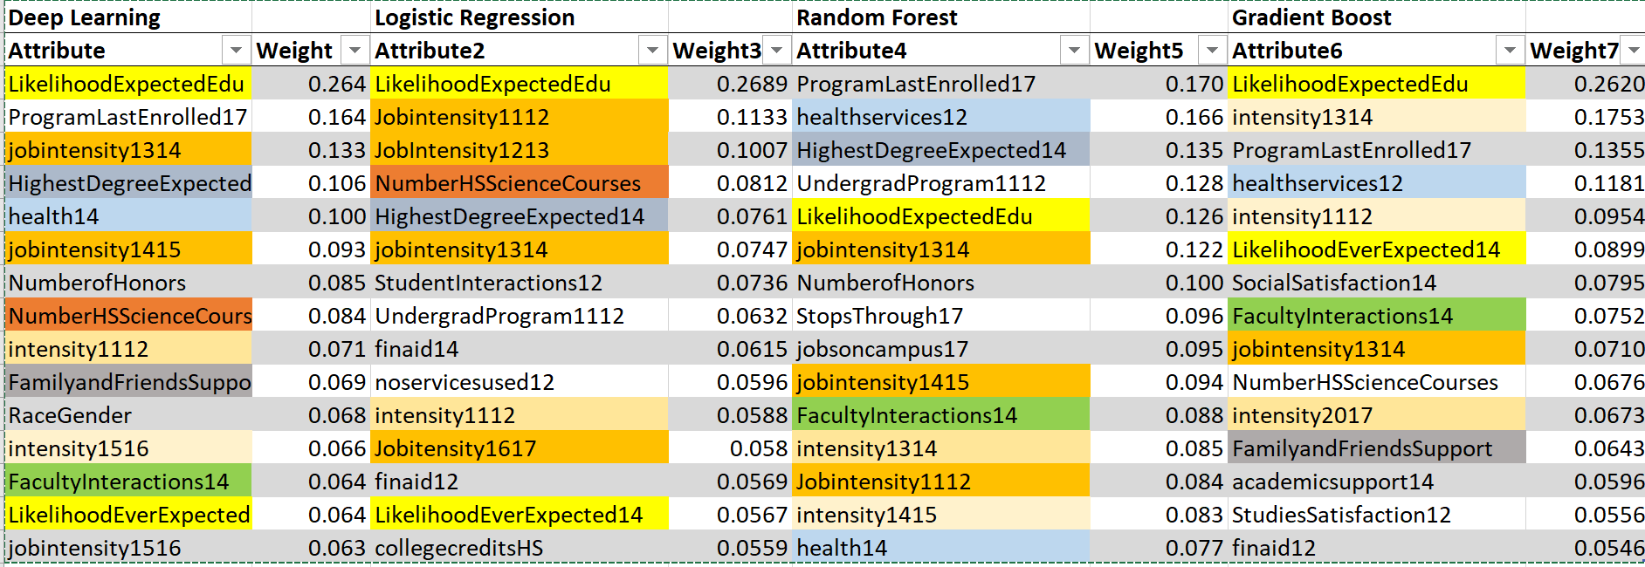
BASSAI
Weighting Comparison
HIGHEST
Notes:
Subset of weights from 4 models
Dominance of certain weights spanned models

Slide 39
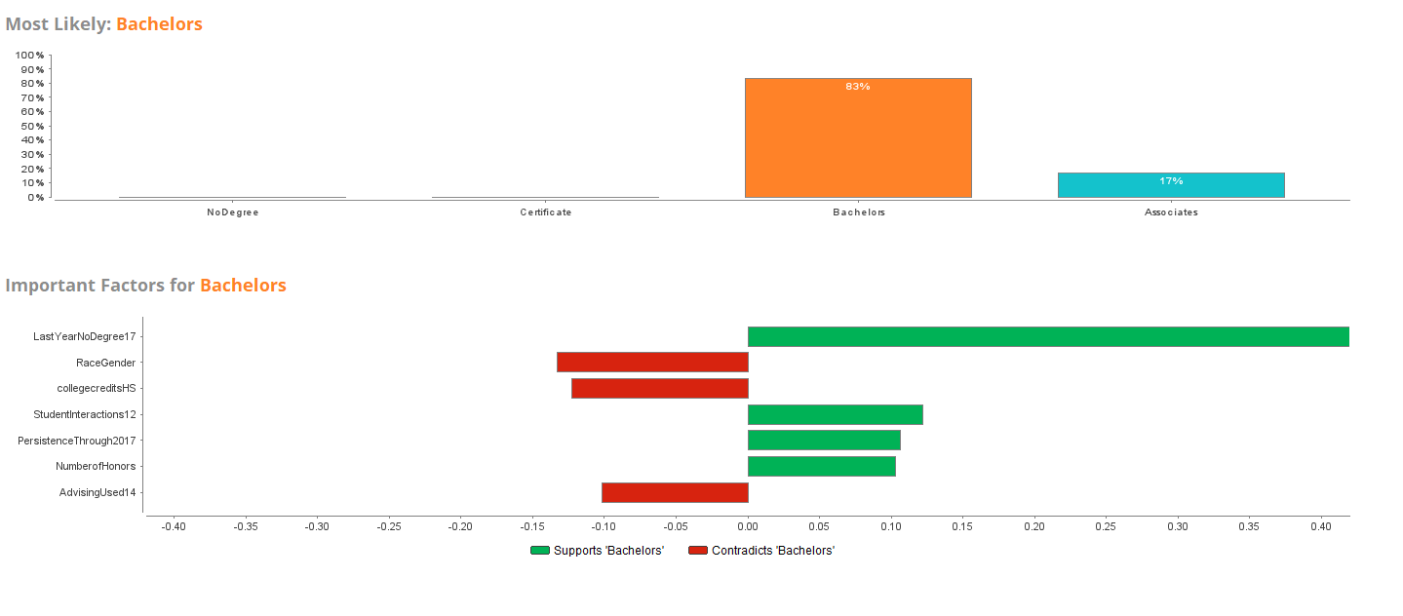
BASSAI
Logistic Regression (all)
HIGHEST
Notes:
Following results are based on 3 models run against Black Only population and optimized to increase black grads
When models are run against Black/White or All weighting and the top 7 important factors vary
Logistic Regression model appeared to be less sensitive to adjustments in weighting parameters
Mental health appeared only when running by black only

Slide 40
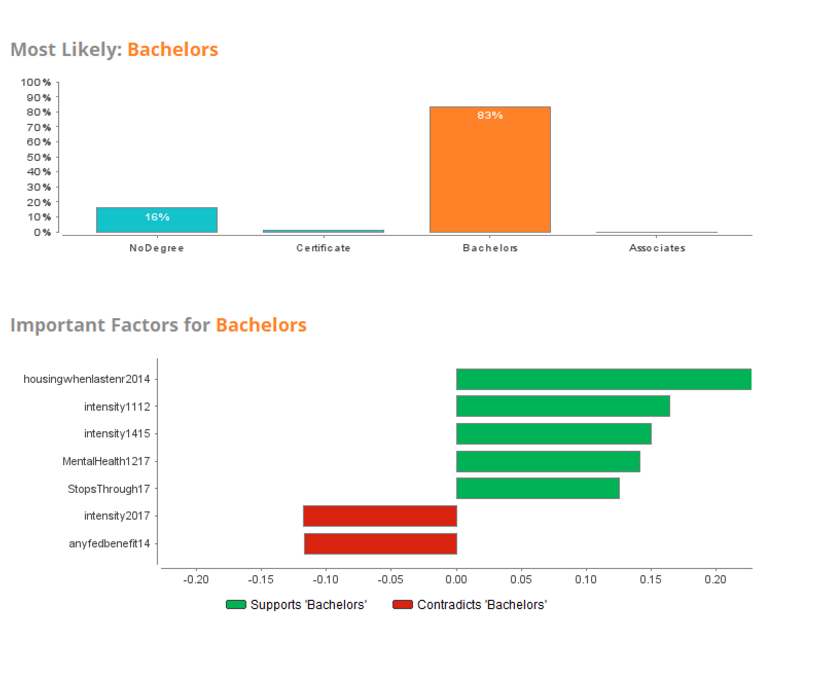
BASSAI
Logistic Regression (AA Only)
HIGHEST
Notes:
Following results are based on 3 models run against Black Only population and optimized to increase black grads
When models are run against Black/White or All weighting and the top 7 important factors vary
Logistic Regression model appeared to be less sensitive to adjustments in weighting parameters
Mental health appeared only when running by black only

Slide 41
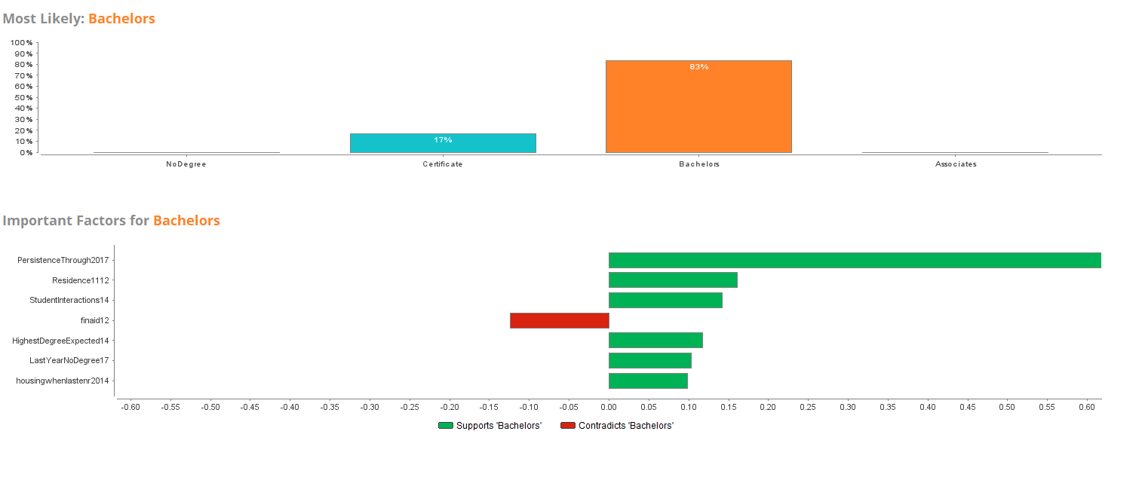
BASSAI
Gradient Boosting (all)
HIGHEST
Notes:
Gradient boosting showed a little less sensitivity to weighting adjustments
Heaviest weighted actors changed with inclusion of health and faculty interactions near the top
Also showed importance of income
Binary grouping was a hinderance

Slide 42
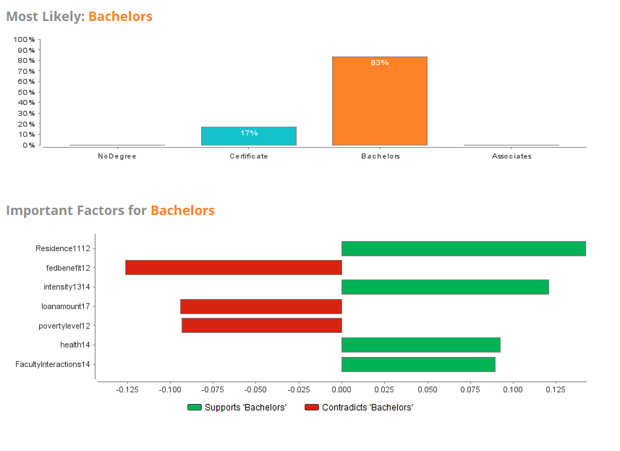
BASSAI
Gradient Boosting (AA only)
HIGHEST
Notes:
Gradient boosting showed a little less sensitivity to weighting adjustments
Heaviest weighted actors changed with inclusion of health and faculty interactions near the top
Also showed importance of income
Binary grouping was a hinderance

Slide 43
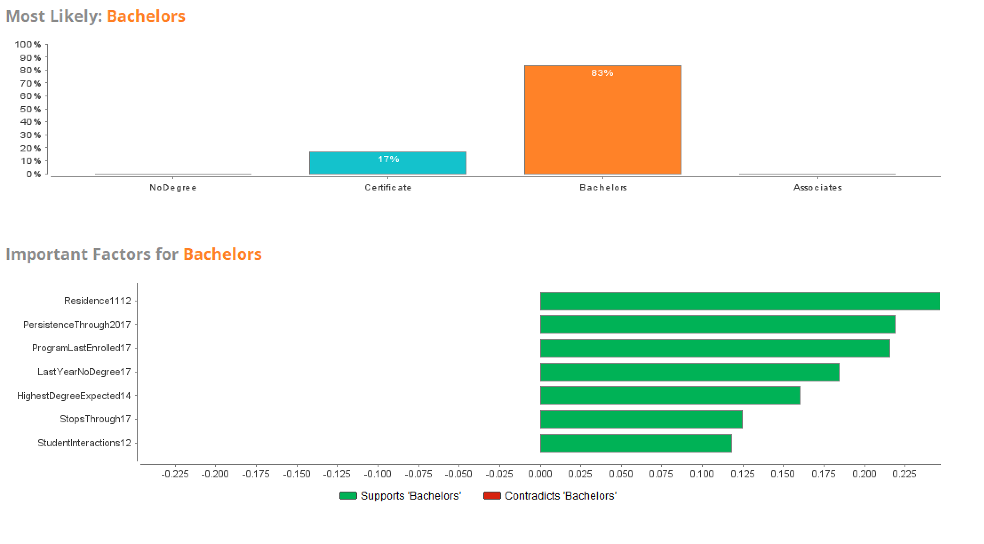
BASSAI
Random Forest (all)
HIGHEST
Notes:
Random forest seemed to be more sensitive to weight adjustments
Emphasis heavily towards intensity and housing
Stratification by parameter characteristics more evident.
Independent trees denoted clear paths to attainment

Slide 44
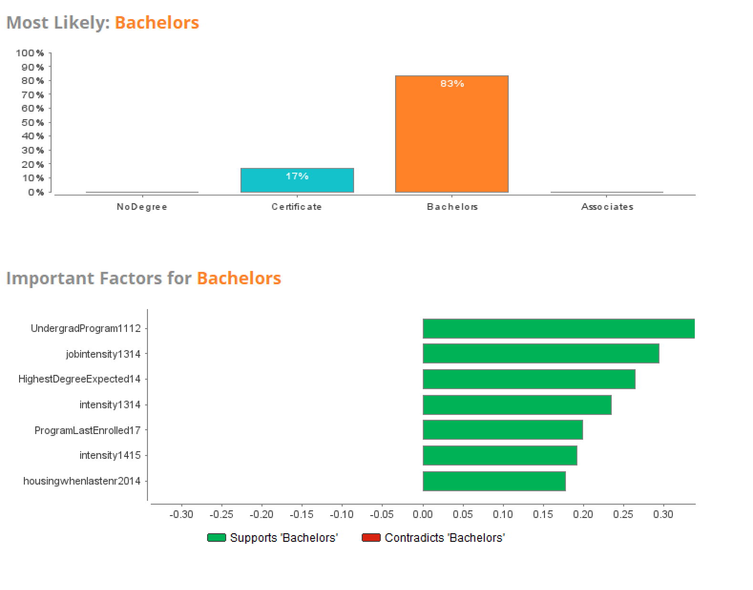
BASSAI
Random Forest (AA Only)
HIGHEST
Notes:
Random forest seemed to be more sensitive to weight adjustments
Emphasis heavily towards intensity and housing
Stratification by parameter characteristics more evident.
Independent trees denoted clear paths to attainment

Slide 45
FINDINGS ASSESSMENT
FINDINGS
Summary and assessment of related works
START

Slide 46
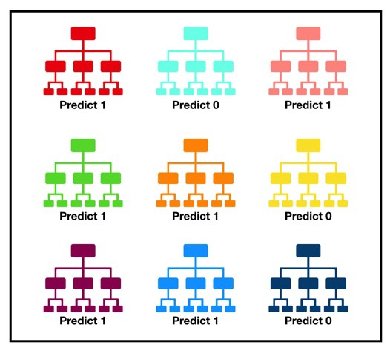
BASSAI
SELECTED MODEL: RANDOM FOREST
Random forest appears to have a good balance between bias and variance. The difference between the expected and actual values is very low
Lack of dependency on other trees. Unlike gradient boost there is no dependency on pathways defined in previous trees
Majority voting provides a means of returning optimal results as a prediction from the parallel and independently processed trees
Identification of weight changes based on study population
Overall performance
Ease of analysis
HIGHEST

Slide 47
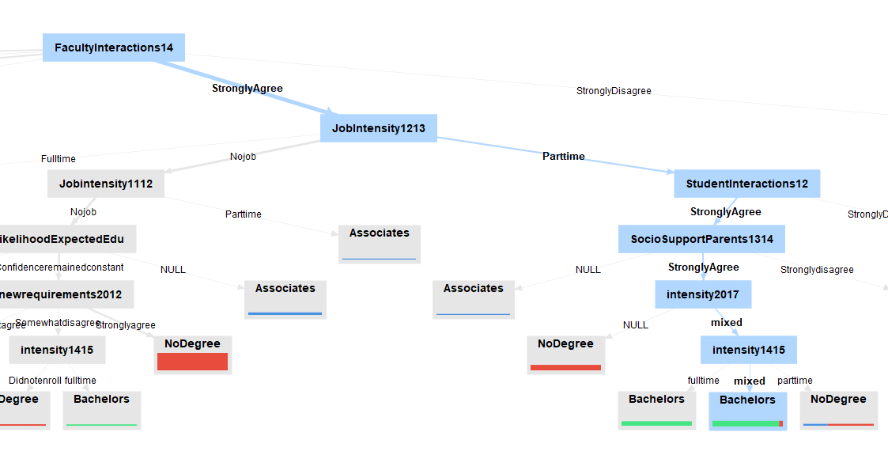
BASSAI
RANDOM FOREST: FACULTY & STUDENT INTERACTIONS & SUPPORT
HIGHEST

Slide 48
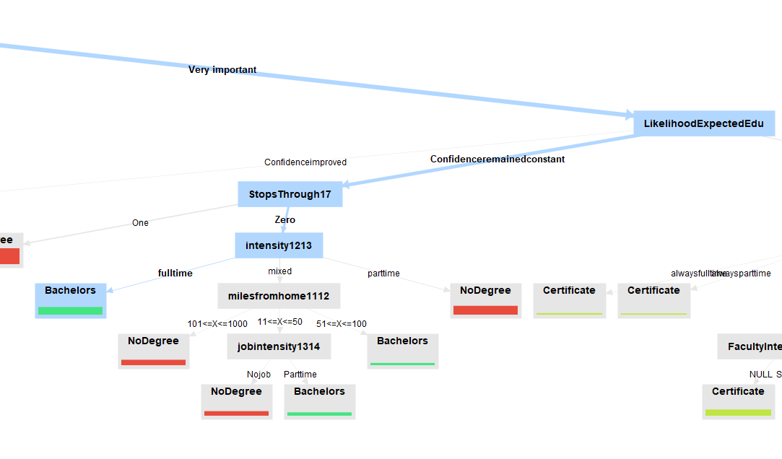
BASSAI
RANDOM FOREST: CONFIDENCE, BREAKS & INTENSITY
HIGHEST

Slide 49
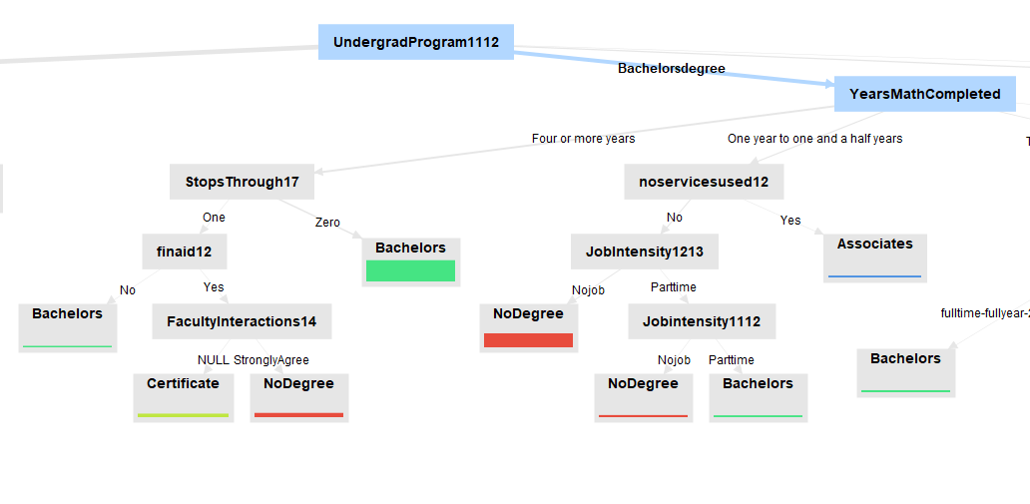
BASSAI
RANDOM FOREST: MATH BACKGROUND & BREAKS
HIGHEST

Slide 50
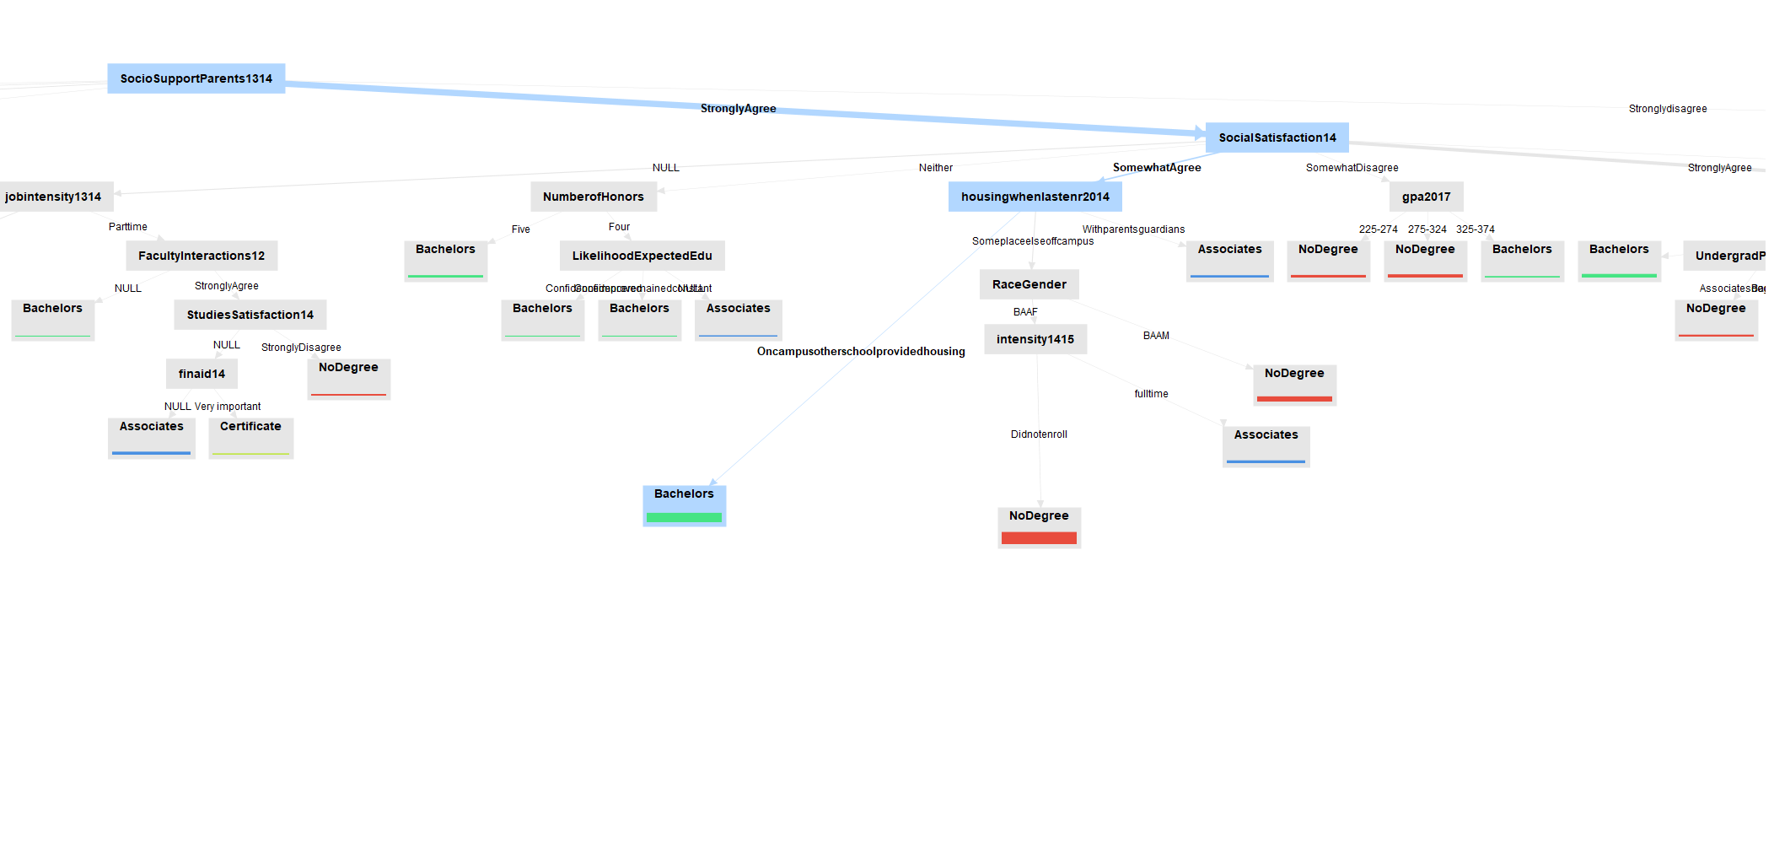
BASSAI
RANDOM FOREST: SUPPORT, CAMPUS CLIMATE AND HOUSING
HIGHEST

Slide 51
SUMMARY NEXT STEPS
SUMMARY
Conclusion and next steps
START

Slide 52
BASSAI
STRENGTHS
CHALLENGES & OPPORTUNITIES
HIGHEST
Random forest appears to have a good balance between bias and variance. The difference between the expected and actual values is very low.
Lack of dependency on other trees. Unlike gradient boost, there is no dependency on pathways defined in previous trees.
Majority voting provides a means of returning optimal results as a prediction from the parallel and independently processed trees.
Overall performance.
Ease of analysis.
The use of AIML in this fashion is uncharted territory.
Collection of more data focused on campus climate.
Analysis and understanding of the impact of online learning.
Analysis with real data versus synthetic data.
More structured integration of critical race theory and intersectionality to ensure race is evaluated from multiple perspectives.
Integration of proven models within existing or new systems for real time use and learning.

Slide 53
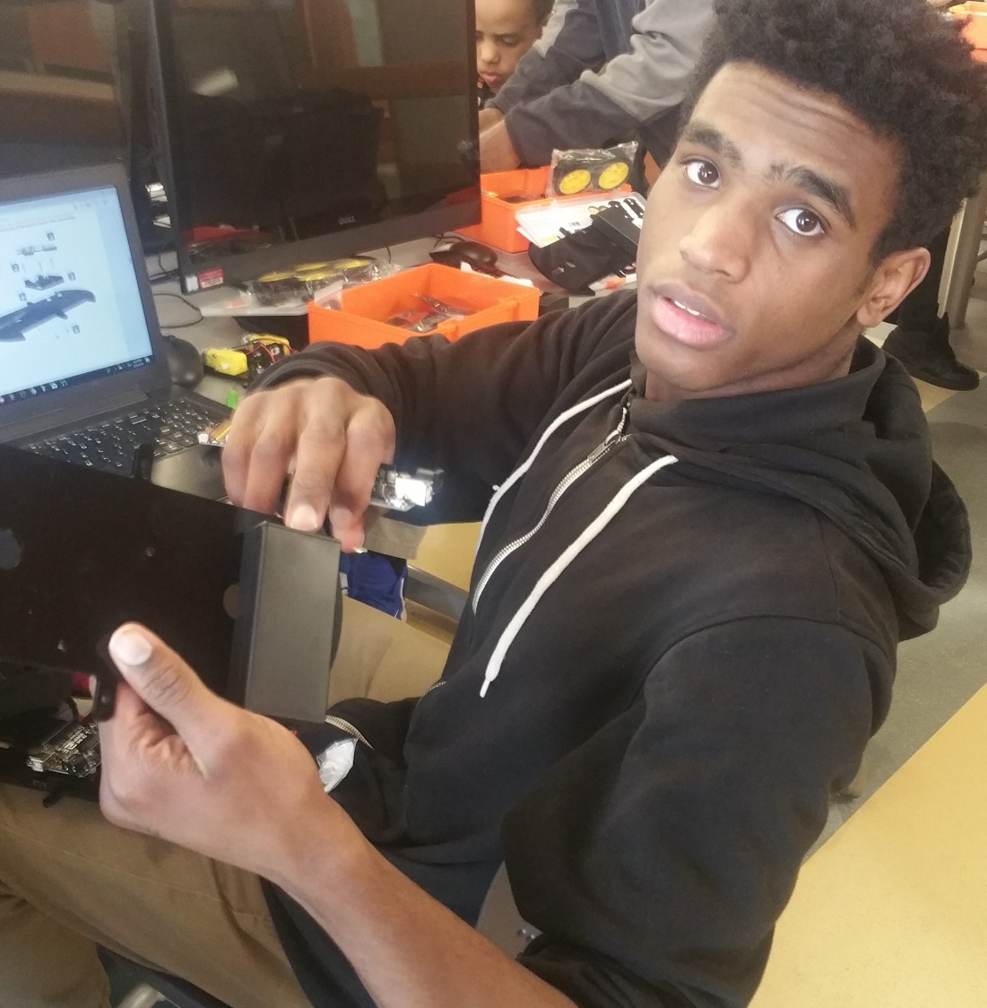
AI ADVANTAGES
Virtual mentoring to support stronger connections.
Bias detection and alerting within the educational environment.
Automated matching for internship opportunities.
Enhanced skills development and adaptive learning platforms that provide more timely responses to needs across a spectrum of subject areas.
Matching algorithms for experimentation that help provide exposure to a broad range of technologies and experiences.
ARTIFICIAL INTELLIGENCE
MACHINE LEARNING

Slide 54
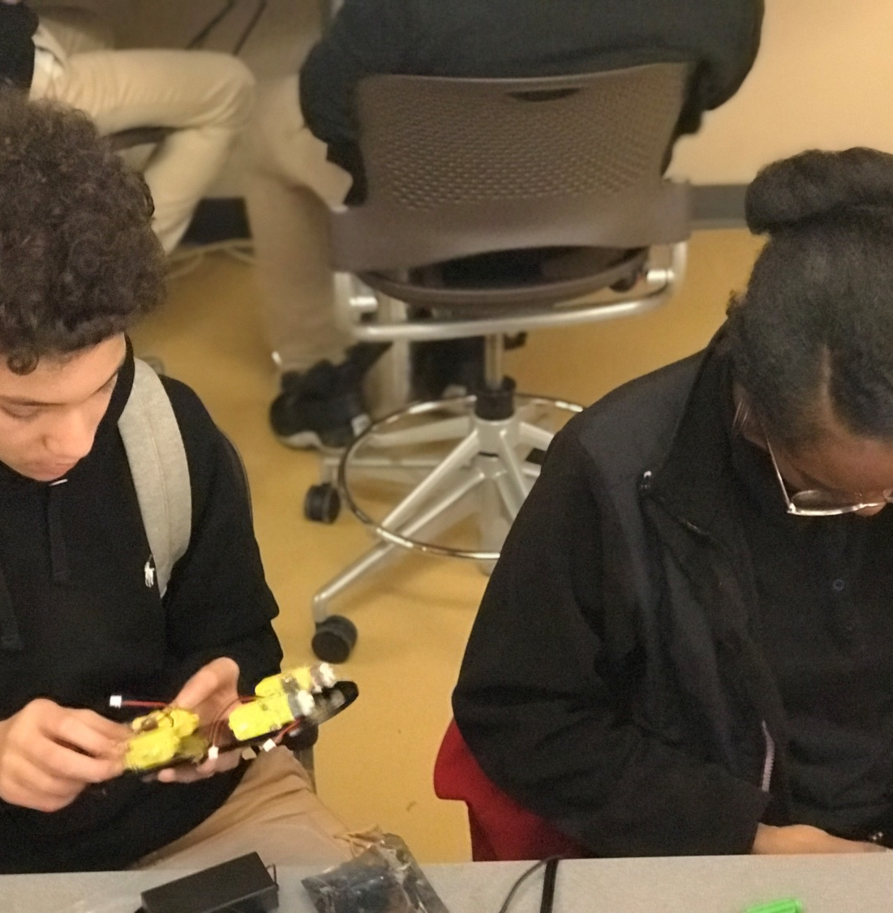
AI CHALLENGES
Risk – bias associated with AI
Too often AI is seen as an extension of systemic oppressions.
  One factor is the lack of focus on bias and the role that it plays in developing models.
This research attempts to leverage AI in a more holistic way that removes bias by focusing on positive outcomes for African Americans.
ARTIFICIAL INTELLIGENCE
MACHINE LEARNING

Slide 55


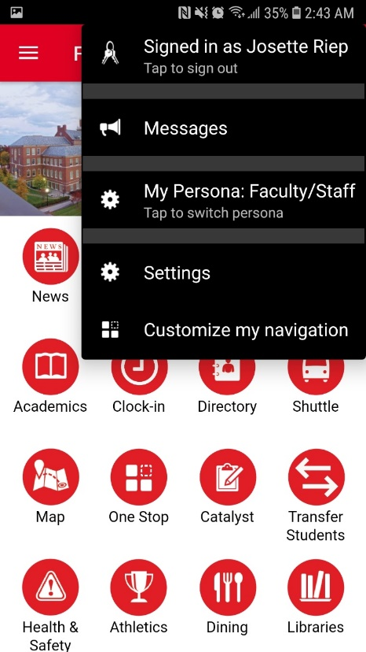
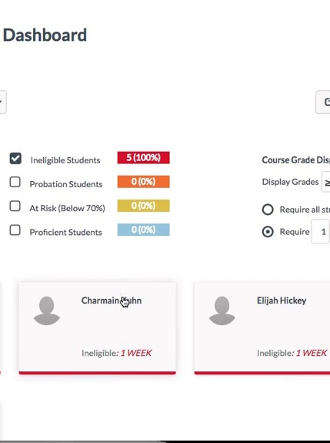

AI Opportunities
The use of BASSAI opens the door to many possibilities where bias-aware dynamic decision-making and personalization can be leveraged to improve the quality of the educational experience and ultimately attainment outcomes.
STUDENT PORTAL
MENTORING
NEXTGEN ADV.
CLIMATE METER
BIAS AWARE
Data driven dynamic services

Slide 56
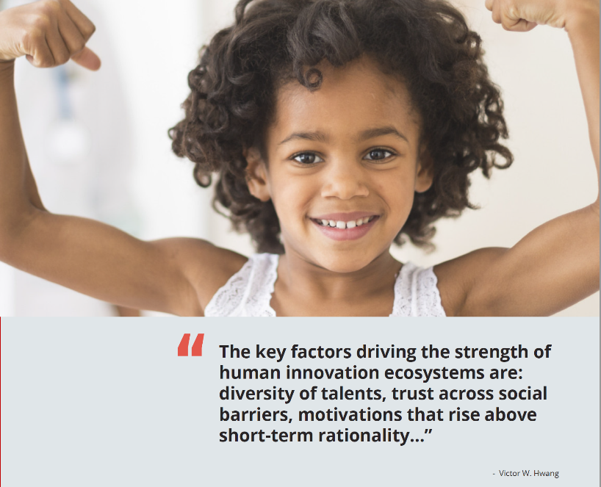
RAINFOREST FOR STEM DIVERSITY
This is a space that warrants solutions that take the best of higher education, the best of the IT workforce, the best of our richly diverse population, and the best in innovation to create models of success. As Victor Wang describes in The Rainforest, true innovation requires an ecosystem. An ecosystem that by nature is full, diverse and driven by innovation. The use of AIML in this study to leverage growing data in new and novel ways provides a glimpse into what is possible.
CONCLUSION
START

Slide 57
Next Steps
Migration from synthetic data model to live training data.
Reassessment of data to ensure size and scope meet intended needs.
Development of modified algorithm leveraging lessons learned from initial analysis.
Assessment of algorithm leveraging AI Fairness 360, FairML, etc.
Pilot implementation of model.
Assessment & analysis (longitudinal study).
Next Steps
START

Slide 58
THANK
YOU
Q&A

