Slide 1



NUI Galway Presentation
February 2020

Slide 2

What we’ll cover today
Health Insurance
NUI Galway Income Protection/Group Life Scheme Update
Financial Planning

Slide 3

About Cornmarket
Over 45 years experience
Public Sector Trade Unions & Affinities
351 employees serving over 250,000 customers with 429,000 policies
Award winning customer service
Broker model – better choice for members
Part of one of the world’s leading assurance organisations
Founded more than a century ago in Winnipeg, Canada, Great-West Lifeco and its subsidiaries, including the Great-West Life Assurance Company, have a record for financial strength, earnings stability and consistently high ratings from the independent ratings agencies.

Slide 4





























Some of our Affinity Partners

Slide 5

Income Protection Plan for
NUI Galway Employees

Slide 6

€1,911,819
Paid by Irish Life in Disability Benefit since the 2014 review
2087
Members currently protected under the Plan
98% of Disability Benefit claims have been paid since the 2014 review
€3.8 million
Paid in Disability Benefit to date
Death Benefit Claims information provided by Irish Life from inception in 1990 to Feb 2020
Membership information provided by Cornmarket Reporting February 2020

Slide 7
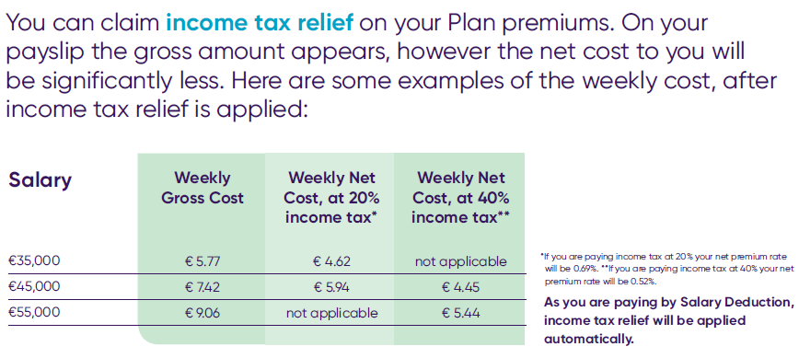
NUI Galway Income Protection Plan
The total premium for this plan is 0.86% of gross salary, this rate will be retained until October 2022

Slide 8
Understand your Sick Pay?
100%
13 WEEKS
FULL
PAY
13 WEEKS
50%
FROM
6 MONTHS
ONWARDS
HALF
PAY
35%
TRR /
SOCIAL
WELFARE
?%
Based on a Public Sector employee, paying Class A PRSI, who is a member of the Superannuation Scheme with 20 years’ service earning €50,000 per annum.

Slide 9


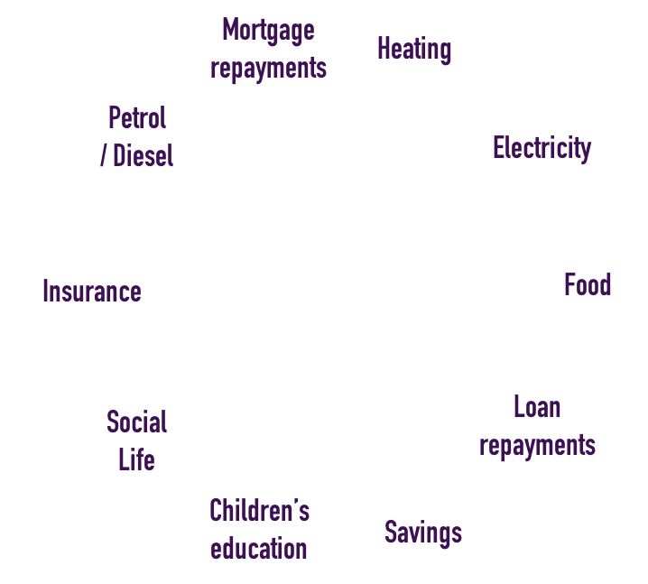


















What could
you do without?
INCOME

Slide 10
What your scheme does
100%
13 WEEKS
FULL
PAY
13 WEEKS
50%
up to
75%
of your salary*
FROM
6 MONTHS
ONWARDS
HALF
PAY
35%
Remember,
it’s for
short term illnesses too
No deferred period for Critical Illness claims
TRR /
SOCIAL
WELFARE
?%
Based on a Public Sector employee, paying Class A PRSI, who is a member of the Superannuation Scheme with 20 years’ service earning €50,000 per annum.
*Less any other income that you may be entitled to e.g. half pay, Ill Health Early Retirement Pension, Temporary Rehabilitation Remuneration, State Illness or Invalidity Benefit.

Slide 11
What your scheme does
Group purchasing power
up to
75%
of your salary*
Dedicated claims team
Paid through your salary
(where available)
*Less any other income that you may be entitled to e.g. half pay, Ill Health Early Retirement Pension, Temporary Rehabilitation Remuneration, State Illness or Invalidity Benefit.

Slide 12
NUI Galway SPS Claims
Jan 2014 – Feb 2020
Breakdown of Conditions of
97 Disability Claims admitted
Since 1st April 2014
SPS Benefit Claims information provided by Irish Life in Feb 2020 for period 01/04/2014 to 13/02/2020 2020
February 2020

Slide 13
Making a Claim
Phone Cornmarket claims team - assigned a dedicated claims expert
Complete claims documentation
Documentation processed by Irish Life, necessary medical assessments requested
Claim assessed by Irish Life
Outcome of claim communicated
If claim paid, ongoing assessment required
If declined, option to appeal where member will be assisted by our claims team

Slide 14
Short Term Claims Process
Member contacts Cornmarket to make a claim
The Claims Team talk the member through the claims process and sick leave
Have you returned to work or have you confirmed a return to work date within the next 10 calendar days
IF YES: Short term claimants are informed of the reduced documentation required and to complete a Short Term Claim form. Forms posted
A member of the Claims team is allocated responsibility for the case progression. That team member identifies the pathway the client will take and processes the paperwork checking they have everything required
Payment of claim
Insurer will pay a payment via Electronic Fund Transfer

Slide 15

Feedback from our Claimants
‘…very knowledgeable and very helpful and friendly each time I contacted them. all my questions/concerns were addressed and answered very promptly and in terms that were easy to understand…’
‘My claim was promptly and efficiently dealt with. All interactions with the department were very courteous.’
‘Excellent customer care.... follow up and regular updates.’
‘They kept me informed throughout the process. They were very efficient and thorough and chased up outstanding documentation when required.’
Source: Cornmarket Claims Survey Sept/Oct 2019

Slide 16

2078
Members currently protected under the Plan
45
is the Average Age of a Member in the Plan
€345,000
Paid out since 2012
NUI Galway Group Life Plan
SPS Claims information provided by Irish Life/Aviva June 2012 to Feb 2020
Member stats information provided by Cornmarket Reporting System Feb 2020

Slide 17
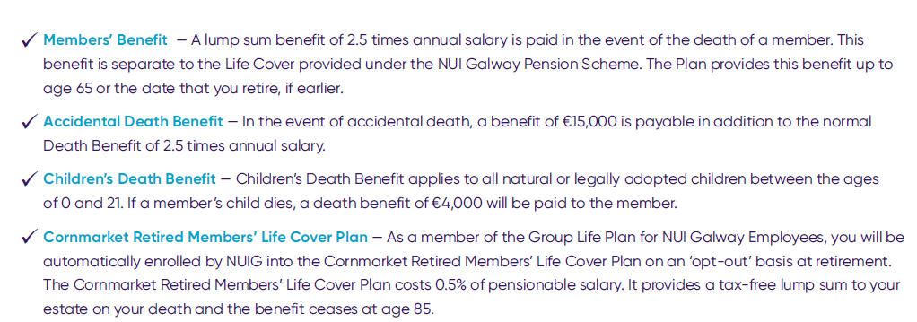
Benefits of the NUI Galway Group Life Plan
  Example of Benefit
Salary Benefit
€35,000 €87,500
€45,000 €112,500
€55,000 €137,500
Key Benefit:
2.5 x Salary

Slide 18
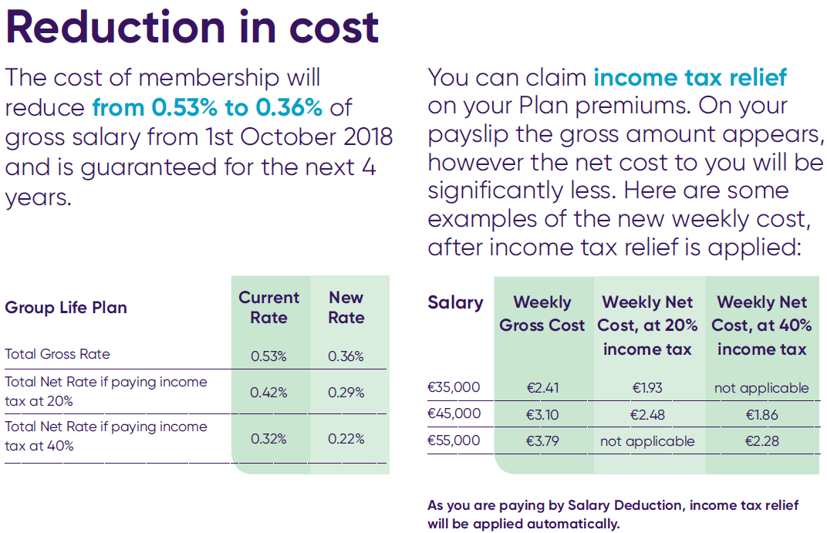
Cost of Group Life Plan
In October 2018, the cost of membership reduced from 0.53% of the gross salary to 0.36%.
This was guaranteed for 4 years

Slide 19
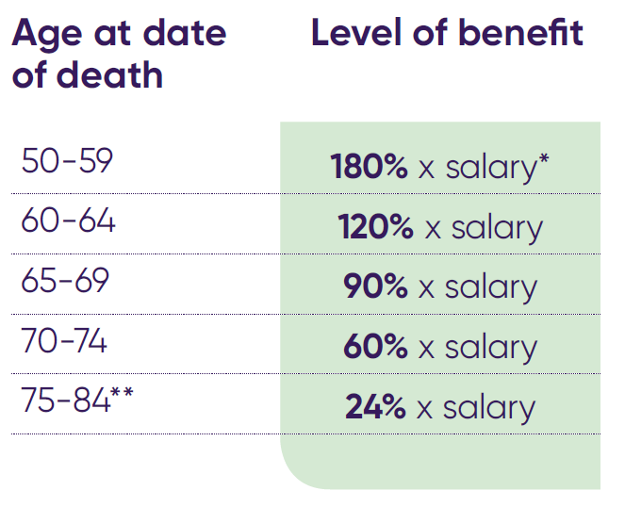
Retired members life cover for NUI Galway members
Members of the NUI Galway Life cover plan are automatically enrolled in the retired members life cover plan at retirement without the need for medical underwriting. Provided on an opt out basis.
Cost
0.5% Full-Time Pensionable Salary*
Pensionable salary takes into account basic salary at retirement + fluctuating pensionable earnings, averaged over 3 yrs prior to retirement

Slide 20


Financially Fit 4 Life!
Brought to you by Cornmarket’s Financial Planning Service

Slide 21

  We know that being financially fit is an essential part of your overall wellness, peace of mind & quality of life.

Slide 22














Financial Planning
CAR
BIG TRIP
HOME
FAMILY
OFF TO COLLEGE
RETIREMENT
CRUISE
A plan makes everything possible

Slide 23









MONEY
NEEDS
GOALS
PLAN
FINANCIALLY FIT LIFE!

Slide 24






82%
of Cornmarket Tax
Return service customers overpay tax*
*Source: Cornmarket PAYE Tax Return client statistics, 2019.
Cornmarket’s Tax Return Service is not a regulated financial product.

Slide 25





-
Insurance cover review
Car
Health
Home
Travel
Over/under insured?
A little time could save money!

Slide 26






Life Insurance review
DEATH IN
SERVICE BENEFIT
SPOUSES’ &
CHILDREN COVER
MORTGAGE
PROTECTION
Review
you
and
your partner’s Cover
GROUP
INCOME PROTECTION
PRIVATE SECTOR
MORTGAGE
PROTECTION
PUBLIC SECTOR

Slide 27

Mortgages
Switching mortgage provider?
Buying your
first home?
Moving?
Investing?
Warning: If you do not keep up your repayments you may lose your home.
Warning: If you do not meet the repayments on your loan, your account will go into arrears. This may affect your credit rating, which may limit your ability to access credit in the future.

Slide 28




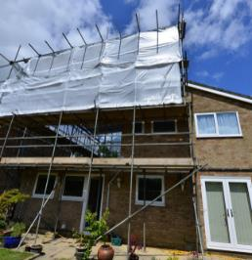




Achieve your
savings goals!
Saving for a
Rainy Day?
Got kids?
4 years in
college costs*:
€20,000 at home
€36,000 renting
*Source: Zurich Life Cost of Education Survey 2018. Figures have been rounded to the nearest 1,000

Slide 29
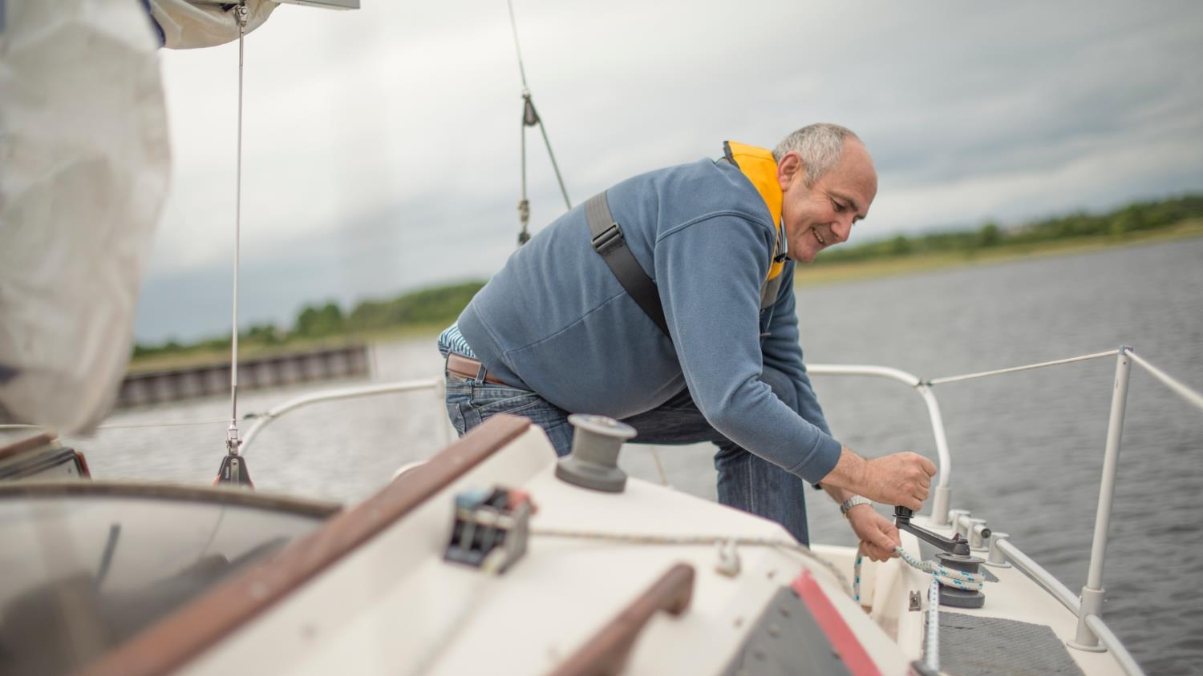
Expert Advice Essential
Before
Retirement
At
Retirement
In
Retirement

Slide 30



Retirement age has increased globally
People who are Working Vs Retired
France 60 ▶ 62
1950
Ireland 66 ▶ 68
2012
2050
Source: The Economist, 07.04.11, figures have been rounded.

Slide 31



Will you have enough money for
your life in retirement?
Better quality
of life
Additional
health costs
Financial
freedom

Slide 32


Plan for the Future
Meet with an Expert
Discuss your concerns
and goals
Review your finances
Create your tailored plan
Notes:
New slide

Slide 33




-
Other Services
Retired Members Life Cover
Inheritance
Planning
Savings
Car
Health
Home
Travel

Slide 34
Thank you!
Cornmarket Group Financial Services Ltd. is regulated by the Central Bank of Ireland. A member of the Irish Life Group Ltd. which is part of the Great-West Lifeco Group of companies. Irish Life Assurance plc is regulated by the Central Bank of Ireland.

