Slide 1
H2020
Fact Sheet
H2020 at a Glance

Slide 2
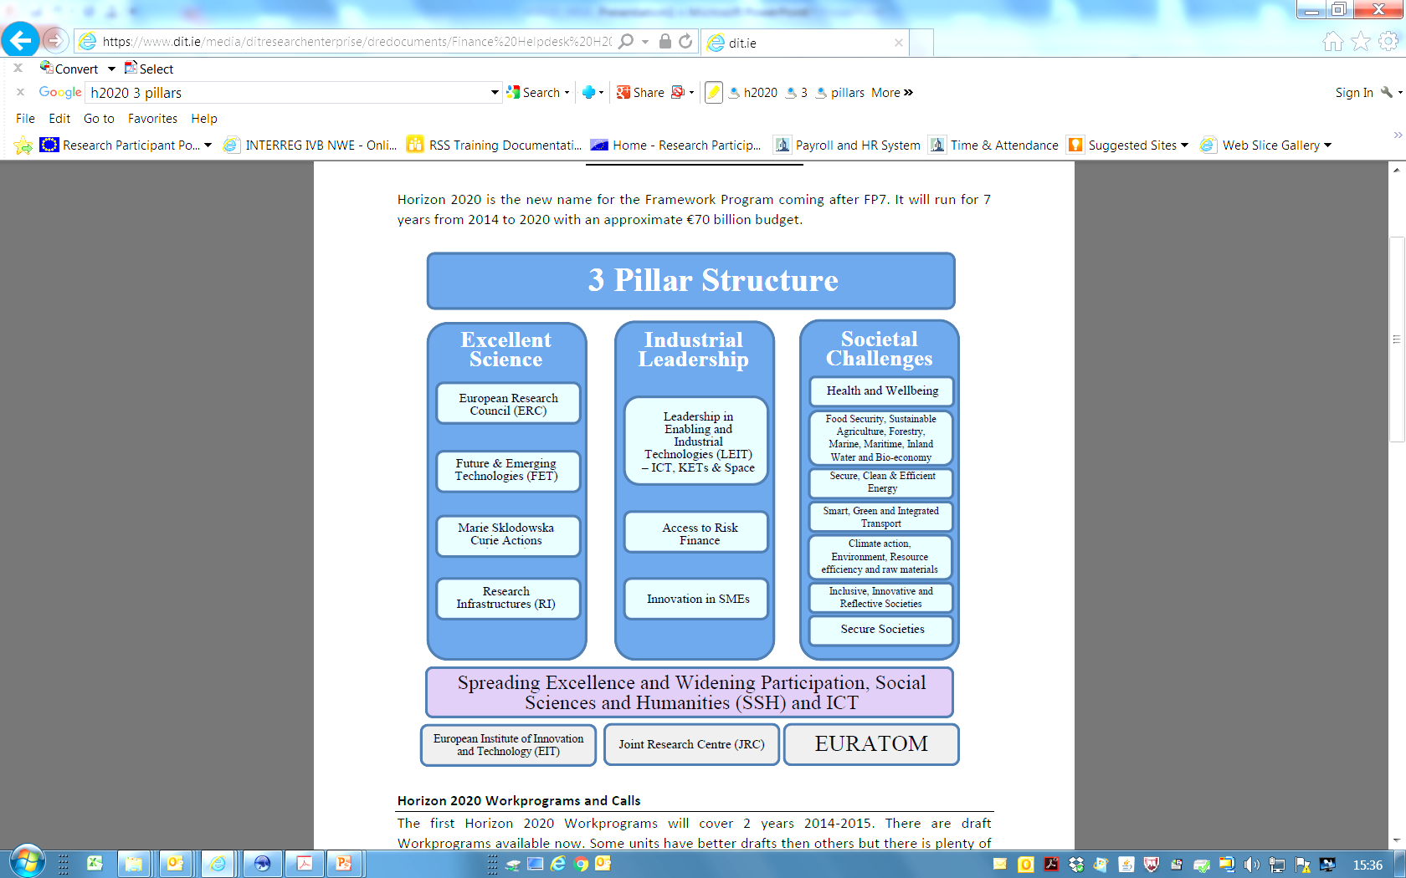

Slide 3
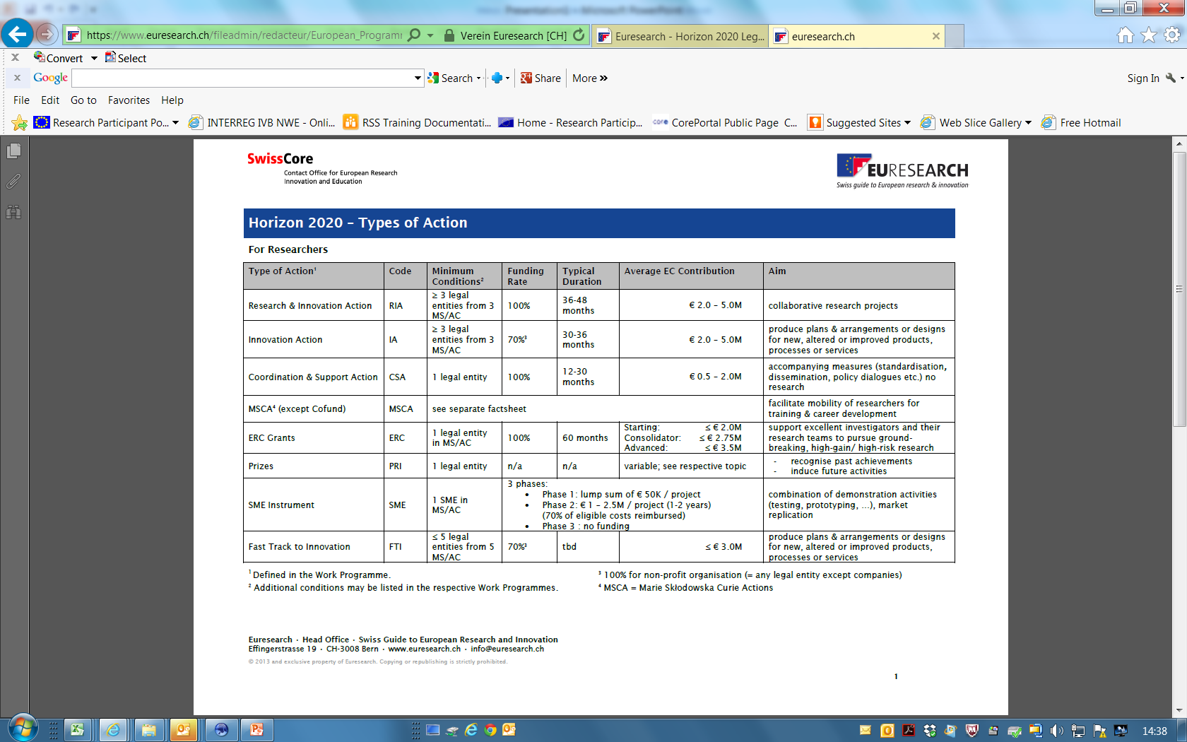
*
* Member States (MS) /Associated Countries(AC)

Slide 4
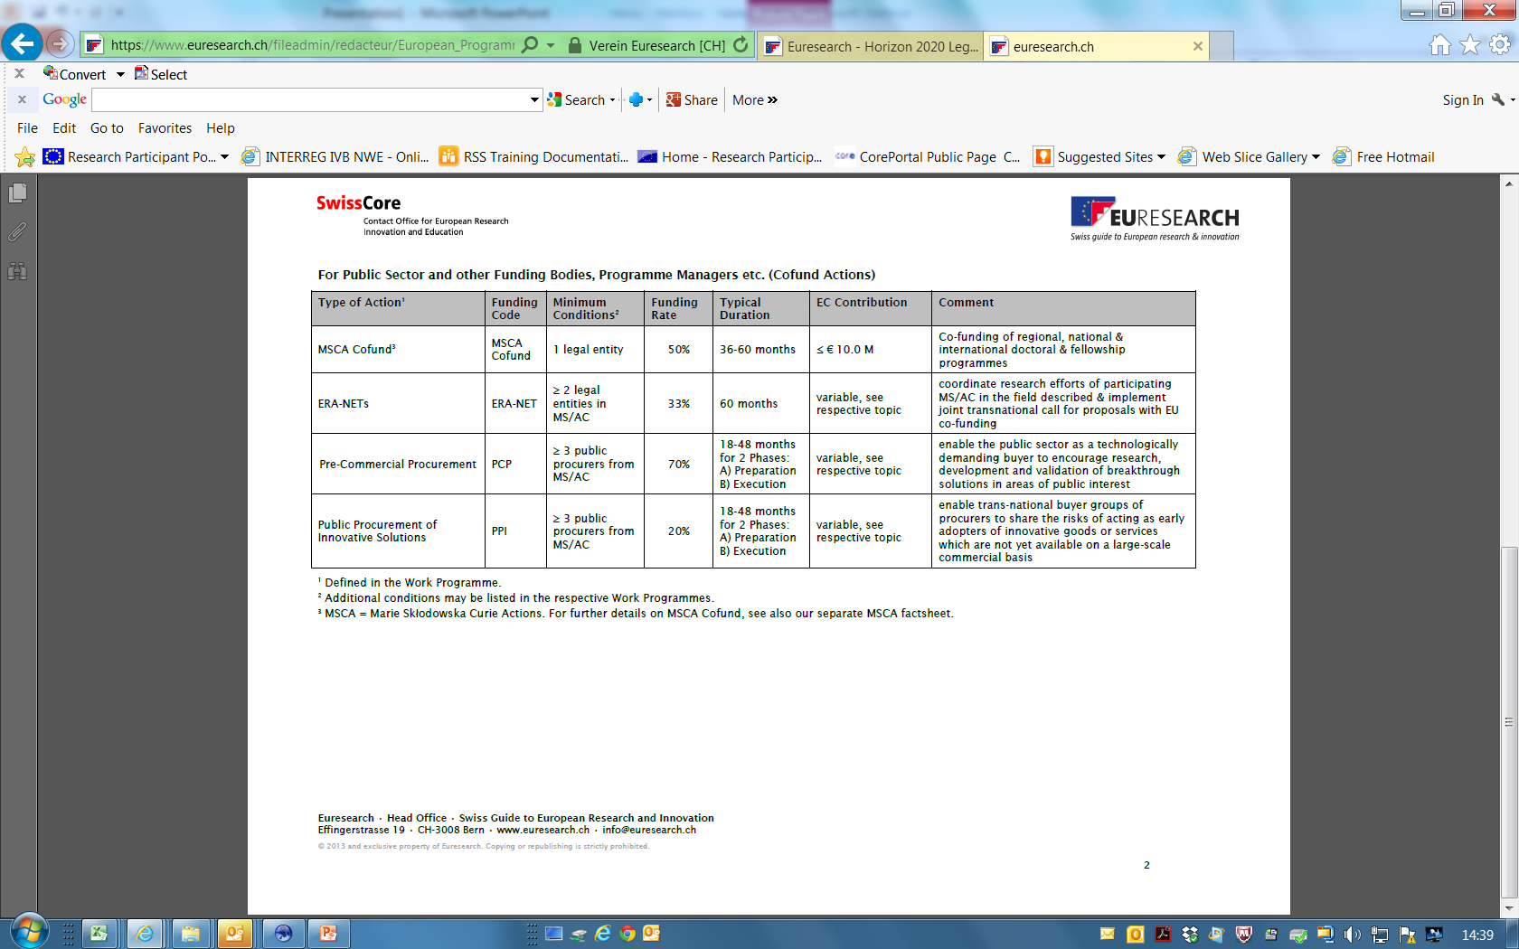

Slide 5
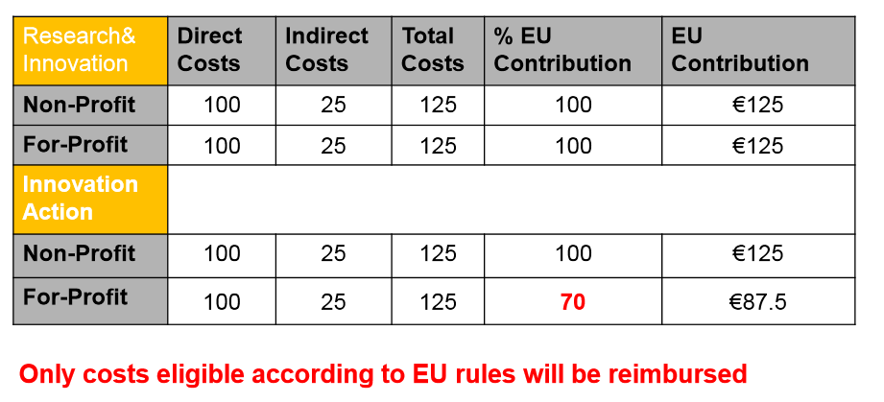
H2020 Financial Rules- Example of collaborative projects
e.g. Applicable to Universities
Applicable to SME’s
e.g. Applicable to Universities
Applicable to SME’s

Slide 6
Time of Application to grant: speeding up the process
A maximum TTG of 8 months
- 5 months for informing all applicants on scientific evaluation
- 3 months for signature of Grant Agreement (GA)
- ERC may take longer - interviews

Slide 7
Communication between the Commission and the beneficiaries
•Through the Participant Portal
•Electronic-only submission of reports
Electronic signature :
•Of the Grant Agreement
•Of the Amendments
•Financial Statements and Technical reports

Slide 8
Horizon 2020 model Grant Agreement:
Annexes to the grant:
Annex 1: Description of the action
Annex 2: Estimated budget
Annex 3: Accession Forms, 3a & 3b
Annex 4: Financial statements
Annex 5: Certificate on the financial statements
Annex 6: Certificate on the methodology
Link to Annotated Model Grant Agreement: http://ec.europa.eu/research/participants/data/ref/h2020/grants_manual/amga/h2020-amga_en.pdf

Slide 10
Costs Covered in H2020 Projects
•Personnel costs (incl. employer’s costs)
•Travel, equipment (Note: depreciation rules if applicable),
goods, works and services, Airport Taxes and City taxes allowed
•Subcontracting
•Overhead (Flat rate 25%)

Slide 11
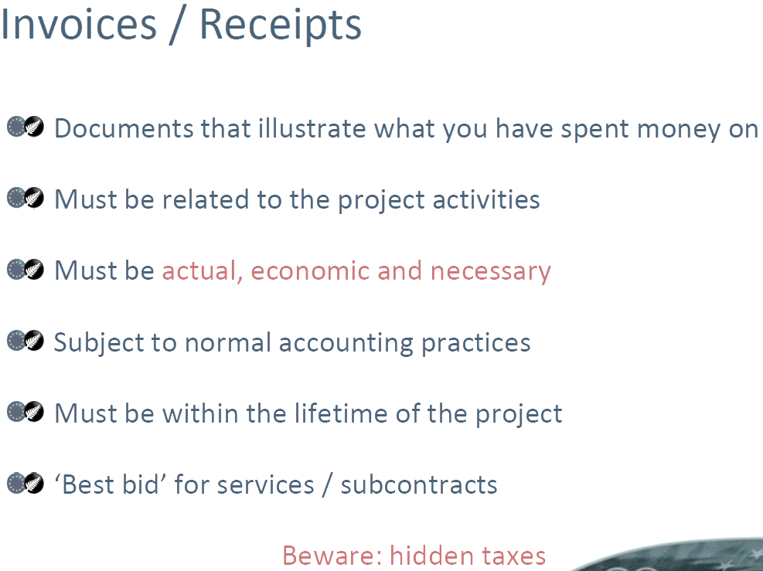

Slide 12
VAT
VAT must be included on all Costings where applicable
--------------------------------------------------
Personnel Costs
Annual productive hours (inclusive of Employer Costs)
1720 hours p.a / 215 Days p.a
(N.B! See following slides for sample timesheet record and calculation of annual personnel costs)

Slide 13
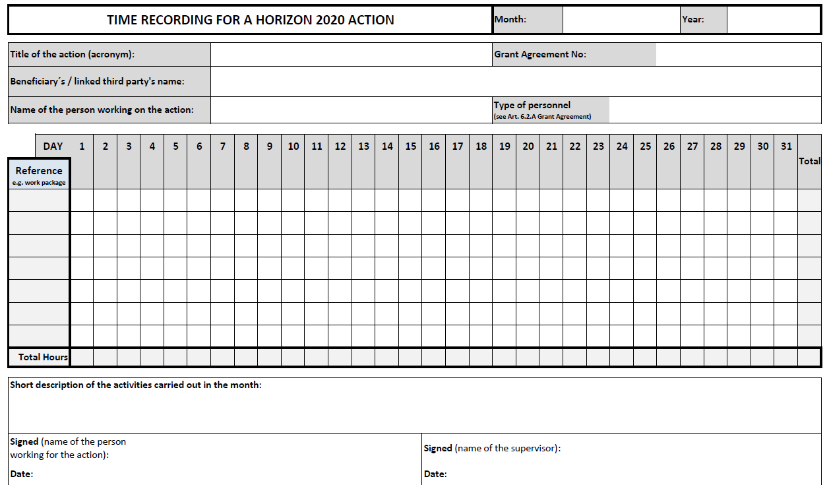

Timesheet: template available in the AGA (version 19/12/2014)

Slide 14

Personnel costs: hourly rate
A: General case
!
The hourly rate is to be calculated per financial year
If the financial year is not closed at the time of reporting, the beneficiary must use the hourly rate of the last closed financial year available.
01/10/2014
31/03/2016
Reporting period (example)
2014 | 2015 | 2016
Hourly rate of 2014
Hourly rate of 2015
Hourly rate of 2015 also for these months
Advantages

Slide 15
Exercise: General calculation of personnel costs
Step 1.b
Calculate the hourly rate: annual productive hours
Out of the three options offered by the H2020 grant agreement:
Fixed hours
Individual annual productive hours
Standard annual productive hours
The beneficiary applies option 1 for all its staff
Annual productive hours of Ms R. = 1720
?
What if Ms R. would be a part time employee?

Slide 16
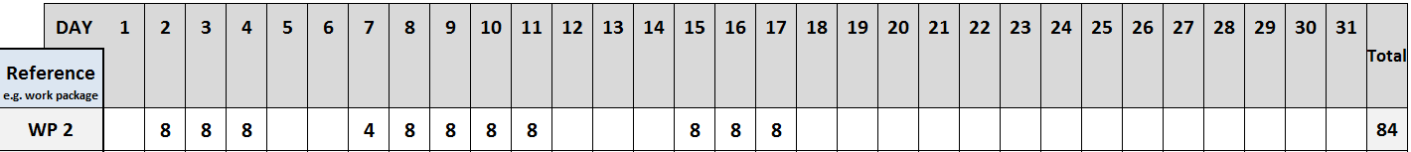

Exercise: General calculation of personnel costs
Step 2
Identify the hours worked for the action
Ms R. worked some hours in December 2015 (registered in a timesheet):
And in 2016 she signed a declaration of exclusive work in the action covering the period:
Hours worked for the action in 2016 = (1720 / 12 months) x 1,5 months = 215

Slide 17



Exercise: General calculation of personnel costs
Step 3
Multiply the hours worked for the action by the hourly rate
!
As 2016 is on-going, the 2015 hourly rate will apply also for the 2016 months of the reporting period
215 x 22.67 = 4 874.05 EUR

Slide 18
Non-eligible costs :
Costs pre formal start date as per Contract (except equipment as agreed with PO)
Costs not related to the project
Notional costs are not eligible
Any cost which does not meet the conditions of an eligible cost
Interest owed
Provisions for possible future losses or charges exchange losses
Costs declared, incurred or reimbursed in respect of another Community project
Cost of return on capital debt and debt service charges
Excessive or reckless expenditure
Any cost which does not meet the definition of eligible costs
Bank charges to receive EC grant funds
Indirect taxes and duties (central government taxes), unless allowed in Call.

Slide 19
Receipts to the project
Three kinds of receipts:
1. For income generated by the project:
  Any income generated by the project itself is considered to be a receipt. eg: admission fee to a conference carried out by the consortium; sale of the conference proceedings; sale of equipment bought for the project (limited to the initial cost of purchase)
Financial contributions given by third parties specifically to be used for the action
  (i.e. money given as a donation by a third party (a donor) to a beneficiary/linked third party specifically for the action covered by the GA (if specific to action )
3. Contributions in kind from third parties (if specific to action )
  For financial transfers and contributions in kind:
  - Endowments/donations are receipts, provided specifically to be used in the project.
Income generated by exploiting the results of the project (e.g. the IPR) is not considered a receipt since successfully exploiting the results is one of the main objectives of the action

Slide 20
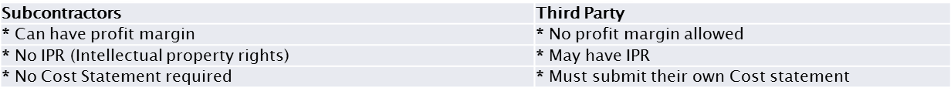
SUBCONTRATORS and THIRD PARTIES Overview
Subcontracting of action tasks is allowed, if it is:
▪necessary for the action
▪justified & described in DoW (Description of work)
▪quantified in the estimated budget
▪may only cover part of the action
▪best value for money
Funding for non-project partners “affiliated Third Parties“
can only report their own actual costs
• Name/assignment of the “Third Party“ must be agreed
in the GA
• The “Third Party“ must be an associated enterprise
(parent company/subsidiary company/ affiliated company) of the participant or
• A legal link must exist with the project partner
Overview/Differences: Subcontracor vs Third Party:

Slide 21
Record keeping Required– H2020
Proposal
Technical annex
Records of meetings
Periodic activity/progress reports
Financial reports and all associated back up to costs ensuring procurement and financial rules followed and adhered to
Management reports
Technical reports
Dissemination and implementation plans
Time sheets – for everybody involved (Academics, Researchers, Students)

Slide 22
Certificate on the Financial Statements - CFS & Audit
Only for direct costs funding ≥ 325.000 EUR
• Are to be submitted only once at the end of the
Project

Slide 23
 | H2020 – SUMMARY: Main Financial Changes from FP7
 | Shorter Time to Grant: 8 months
 | 100% funded unless otherwise stated on Call
 | One single flat rate of 25% for Indirect Costs (Overhead)
 | If Direct Budget €325K or greater, one CFS (audit certification) required at end of grant.
 | Personnel: Standard Productive Hours - Default productive hours 1720p.a
 | VAT must be included in all costs
 | Move to Electronic submissions on EU Portal
 | Airport and City Taxes allowed under H2020. Central government taxes - not allowed. H2020 reporting periods and prefinancing moving from 12 months periods to 18 months periods (Note - can be exceptional cases where reporting will occur in shorter time period) Change in 'language' - Good and Bad Synonyms: e.g. Marketing (bad) ; Dissemination (good)

Slide 24
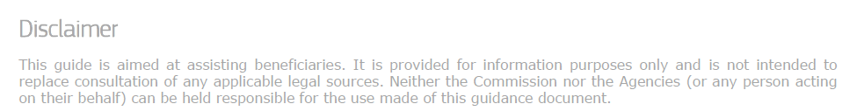
LINKS:
Research Accounts:
http://www.nuigalway.ie/research-accounting/
H2020
http://ec.europa.eu/programmes/horizon2020/
AMGA
http://ec.europa.eu/research/participants/data/ref/h2020/grants_manual/amga/h2020-amga_en.pdf

