Slide 1
Complexity Theory and Public Services
An overview of how complexity theory can guide public management practice
UNESCO Child & Family Research Centre Lunchtime Webinar 26 April 2023
Prof. ML Rhodes

Slide 2
Overview agenda
Why adopt a complexity perspective?
Framework for complex systems analysis in public management
Insights for managers, leaders and policy-makers in complex public services

Slide 3
Coming around to complexity theory (1):
Beginning in 1980s: “New Public Management” rolls out:
Expanded role of private and non-profit sectors in service delivery; Public sector as coordinator / network manager;
New forms of democratic participation in public decision-making;
The academic discipline of public administration is “drifting and largely ignored” (Weber 2005)
Notes:
References:
Pollitt & Bouckaert 2004
Weber 2005
Bottom-up ‘changes’ from local government; organizational change -> EE’s PhD student

Slide 4
Coming around to complexity theory (2):
In the meantime – the world keeps on going:
Technological change speeds up and creates opportunities & threats
“Wicked Problems” seem unsolvable
Unanticipated outcomes keep arising
Theories of human behaviour emerge that appear to map onto biological / physical models of complex systems
Notes:
Examples of technological change: internet 2.0 / 3.0; big data collection / processing; robotics; generative AI
Examples of wicked problems: obesity; family breakdown; teenage pregnancy; homelessness
Examples of unanticipated outcomes: family size policy (Sweden vs. Romania); the dynamics of pest control resulting in more pests (budworm, balsam fir trees (most competitive tree) and ‘natural predators’); inserting / removing traffic lights; wait time indicators in Ireland
Emergence of complexity theories in human behaviour / public management: “Early work drawing on complexity theory (e.g. Prigogine, 1978; Prigogine & Stengers, 1984; Waldrop, 1992; Kaufman, 1993; Stacey, 1992; Holland, 1995; Byrne, 1998; Cilliers, 1998) offered new ontological insights about the nature of the (physical and social) world and the way it behaves. Briefly, there are recursive, ongoing nonlinear interactions between all the elements (the actors, the institutions, the contexts and so on) that make up the public administration whole and these elements continuously adapt to each other in nonlinear ways. Nonlinear interactions among actors and with institutions and contexts create contingency and uncertainty about what the future will become meaning that the whole lacks predictability. Over time new patterns and assemblages of actors occur, create features, characteristics and institutions formerly unknown through the endogenous, reflexive, self-organisation of actors and their nonlinear interactions (Davies, 2003; Eppel, 2012) “ (Eppel et al in 2018)

Slide 5
Coming around to complexity theory (3):
What does complex systems theory provide?
Incorporation of multiple actors with different characteristics / objectives;
The potential for actors to adapt to changes in the environment and to each other;
Recognised patterns in systems behaviour (e.g., emergence, path-dependency, etc.);
New modeling and analytic frameworks.
Notes:
Agent-based models!

Slide 6
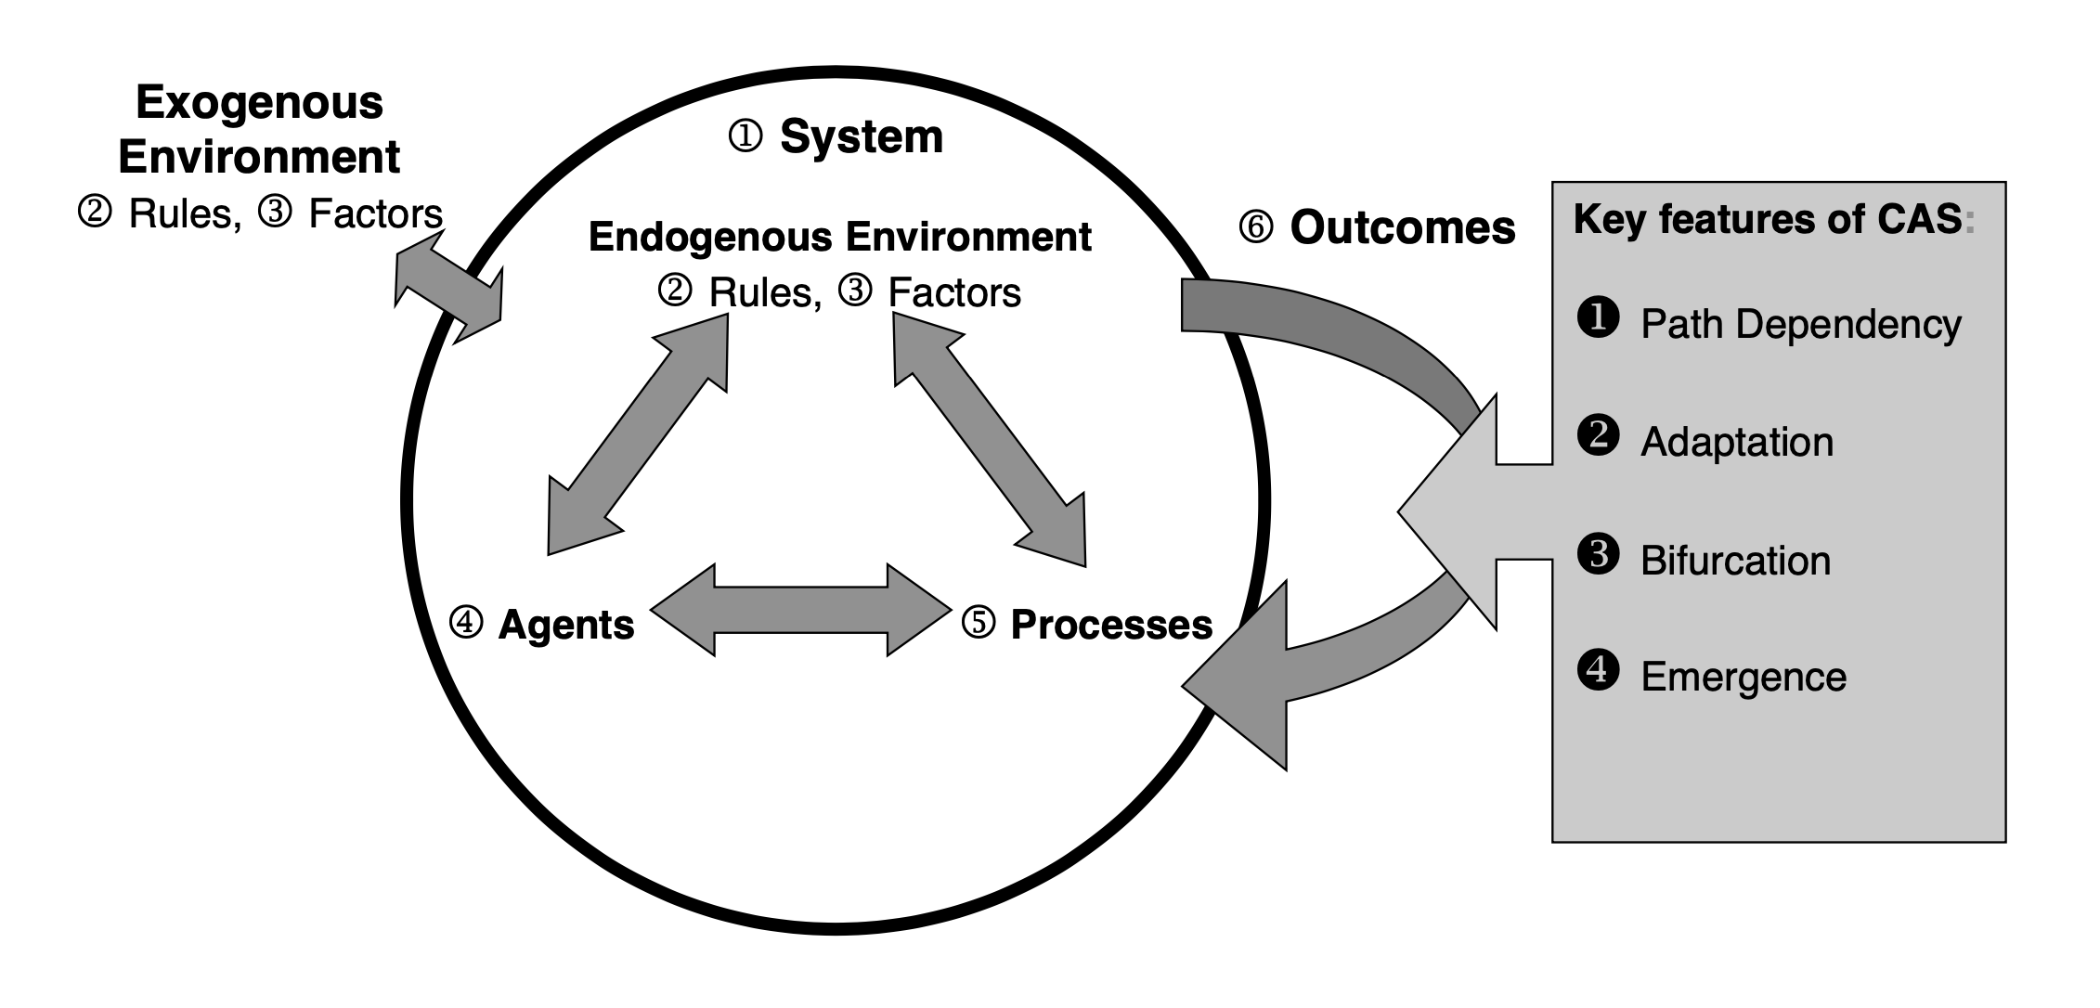
Frameworks for complex systems analysis in public mgmt (1):
HEA funded research in ROI/HI cases in urban development and ICT in healthcare (2004-2007):
CAS: the 6+4 Analytical Framework (Rhodes et al 2011)
Notes:
References:
Rhodes, ML, Joanne Murphy, Jenny Muir & John Murray (2011) Public Management & Complexity Theory: Richer Decision Making in Irish Public Services, UK, Routledge

Slide 7
Insights for managers:
Chap. 9 (Rhodes et al 2011)
Deciding on the boundary of the system* is non-trivial and has implications - not only for the resulting systems definition - but also for legitimacy with stakeholders;
Path-dependency will shape the system’s characteristics and trajectory and initial conditions need to be taken into consideration when trying to create a ‘shared vision’ of appropriate interventions;
Private sector involvement may precipitate a system bifurcation; opening up new possibilities and/or creating major complications;
The presence of the CAS dynamics requires that managers engage in real-time analysis and remain flexible in order to adapt effectively to achieve outcomes.
*boundaries may be functional, physical or professional
Notes:
Examples for each bullet point:
- Boundaries/spanners: tribalism in health: nurses; doctors; management; ICT – whose job was most important / valid (‘sanctifying & demonizing’ ); project manager unable to adjust and abruptly quitting
Role of history/path-dependency: urban regeneration projects in NI – a street in which previous regeneration had resulted in fewer households from one community was remembered for decades and led to lack of trust and necessitated significant efforts to reassure members of that community
Private sector impact: technology and the introduction of modem links between GPs/Mater hospital and rapid transition to internet leading to massive expansion of the HealthLink network; Introduction of private developer in Fatima mansions incr densitiy and decreased social housing; South Korea COVID App examples (finding masks – identifying outbreaks)
CAS dynamics requiring adaptation: the emergence or not of a shared vision in urban regeneration

Slide 8
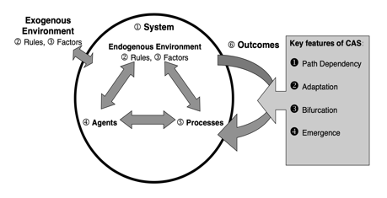
Insights for managing ‘outcomes’
Chap. 8 (French et al 2021)
Measuring and managing outcomes (‘performance’) became a feature of public management as part of NPM reforms of 1980s/1990s;
While it is possible to measure outcomes in complex systems, it is difficult to ‘control’ these and equally difficult to assess / allocate ‘accountability’;
Outcomes for individuals will vary based on their needs; capabilities and beliefs – making performance standardization challenging;
Desired outcomes may vary over time as individuals, institutions and the environment change.
Notes:
Story from New Zealand – Reform: ‘Better Public Services’ – picked a couple of areas and picked some key measures that they wanted to see and told everyone to work together (vaccine rates in children); there was some ‘gaming’ in particular areas, but this largely worked!
References:
French, M., Lowe, T., Wilson, R., Rhodes, ML & Hawkins, M. (2021) Managing the complexity of outcomes: a new approach to performance measurement and management. Chapter 8 in Handbook on Performance Management in the Public Sector, UK: Edward Elgar

Slide 9
Insights for policy-makers / leaders:
Be aware of and/or adopt as appropriate:
Boundary critique / boundary spanners
Knowns; known-unknowns; unknown-unknowns; confirmation bias
Nudging, new actor introduction
Real-time monitoring of outcomes and adaptive behaviour
Collective decision-making / shared accountability
Attractors and performance ‘peaks’
Complexity leadership practices
Murphy et al (2017); Eppel et al (2018, 2021)
Notes:
Examples:
Boundary spanners:
Unknowns: D Rumsfeld’s phrase in relation to policy development – relates to the ‘Johari’ window for understanding self & relationship to others
New actor introduction: PSA (project specific actors); public-private partnership
Real-time monitoring:
Collective decision-making / accountability:
Attractors/peaks:
Complexity leadership: “In highlighting the tensions between administrative and adaptive practices and conceptualizing them as dualisms, rather than dualities (Farjoun 2010), this study has implications for leadership theory, development and practice. Our initial conceptual model (Figure 1) positioned these tensions as ‘enabling’ dualisms e.g. Buffering tension, acting to reduce conflict v.s injecting tension and conflict. In terms of leadership practice, our study suggests a core function of leadership is to embrace leadership tensions and help shift actors beyond “either/or” toward paradoxical thinking that entails a both/and mind-set that is holistic and dynamic (Lewis and Smith, 2012). Murphy et al 2017:703“
References
Eppel, E.A., Rhodes, M.L., Gerrits, L. (2021) Complexity in public management: perspectives, institutions and practices. Chapter 11 in Handbook of Public Administration (4e), NY: Routledge
Eppel, E.A., Rhodes, M.L. (2018), “Complexity theory and public management: a ‘becoming’ field”, Public Management Review, vol 20(7), pp. 949-959
Murphy, Joanne, Rhodes, ML, Meek, Jack, Denyer, David, (2017) Managing the Entanglement: Complexity Leadership in Public Sector Systems, Public Administration Review, vol 77(5), pp. 692-704

